Slide 1
Department of Zoology and Environmental Biology
Faculty of Science
Lagos State University
Databases of Insect genomic resources: a review
Abdulazeez Giwa¹*, Oluwasegun Gbenle² and Abiodun Denloye¹
¹Department of Zoology and Environmental Biology, Lagos State University, Ojo, Lagos.
²Department of Biomedical Engineering, University of Lagos, Akoka, Lagos.
*Corresponding author: Email: abdulazeez.giwa@lasu.edu.ng
11th October, 2017
FoS conference 2017

Slide 2
INTRODUCTION
Insects constitute a remarkably diverse and largest animal group in the world, as 75% of all species are insects (Grimmelikhuijzen et al., 2007).
They are pollinating agents, pests, vectors as well as important ecological, evolutionary, developmental and medical models (Losey & Vaughan, 2006; Pimentel et al., 2000)
The genome is the set of all genetic information of an organism encoded in the deoxyribonucleic acid (DNA) of the nucleus and organelles.

Slide 3
INTRODUCTION
The i5k initiative aimed to sequence the genomes of 5000 species of insects and other arthropods by 2016 generating vast amounts of data.
The genomes of insects sequenced to date have already provided important insights into genome architecture & evolution, immune response pathways (Evans et al., 2006), eusociality (Simola et al., 2013) and speciation (Lawniczak et al., 2010; Neafsey et al., 2010)
This deluge of genomic information has led to an absolute requirement for computerized database to store, organize and index the data along with development of specialized tools to view and analyze the data.

Slide 4
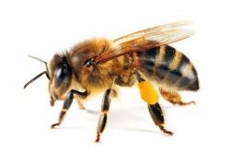
AIM
This review attempts to provide comprehensive information on available insect genomic resources contained in databases to researchers for better use of such information therein in enhancing entomology research.

Slide 5
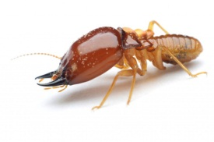
METHODS
The database issues of the Journal, Nucleic Acids Research and PubMed database was searched for publications of genomic databases for insect species

Slide 6
RESULTS
Database
General
Organism Specific
GenBank (ncbi.nlm.nih.gov/genbank)
ENA (ebi.ac.uk/ena)
DDBJ (ddbj.nig.ac.jp)
UCSC Genome Browser
VectorBase, InsectBase, SuperFly, MonarchBase, FlyBase, iBeetleBase, MitoDrome, HGD, InSatDb etc

Slide 7
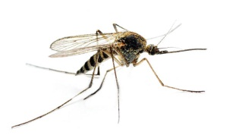
https://vectorbase.org
Data types
Tools: Biomart, Galaxy, BLAST, PopBio, Web Apollo, Genome Browser, Expression Browser & Map etc
Organisms: 35 (+2 ticks, +Biomphalaria glabrata)

Slide 8
http://superfly.crg.eu
Expression data of segmentation genes (9) during early development (cleavage and Blastoderm)
For fly development geneticists, evolutionary developmental biologists
Cicin-Sain et al., 2015

Slide 9
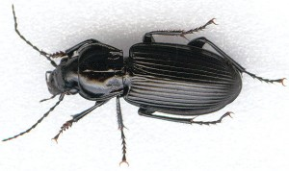
FlyBase
http://flybase.org
Data; genes and mutations of Drosophila
Primary database for Drosophila genomics and transcriptomics
Directory of names, addresses of people in the Drosophila community

Slide 10
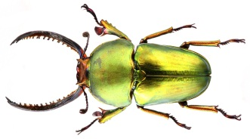
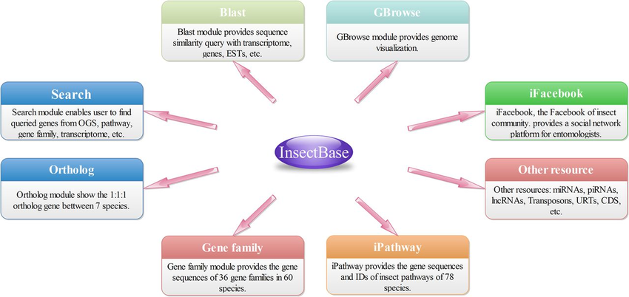
InsectBase
http://insect-genome.com
138 insect genomes, transcriptomes etc.
Over 12 million sequences

Slide 11
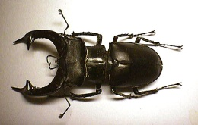
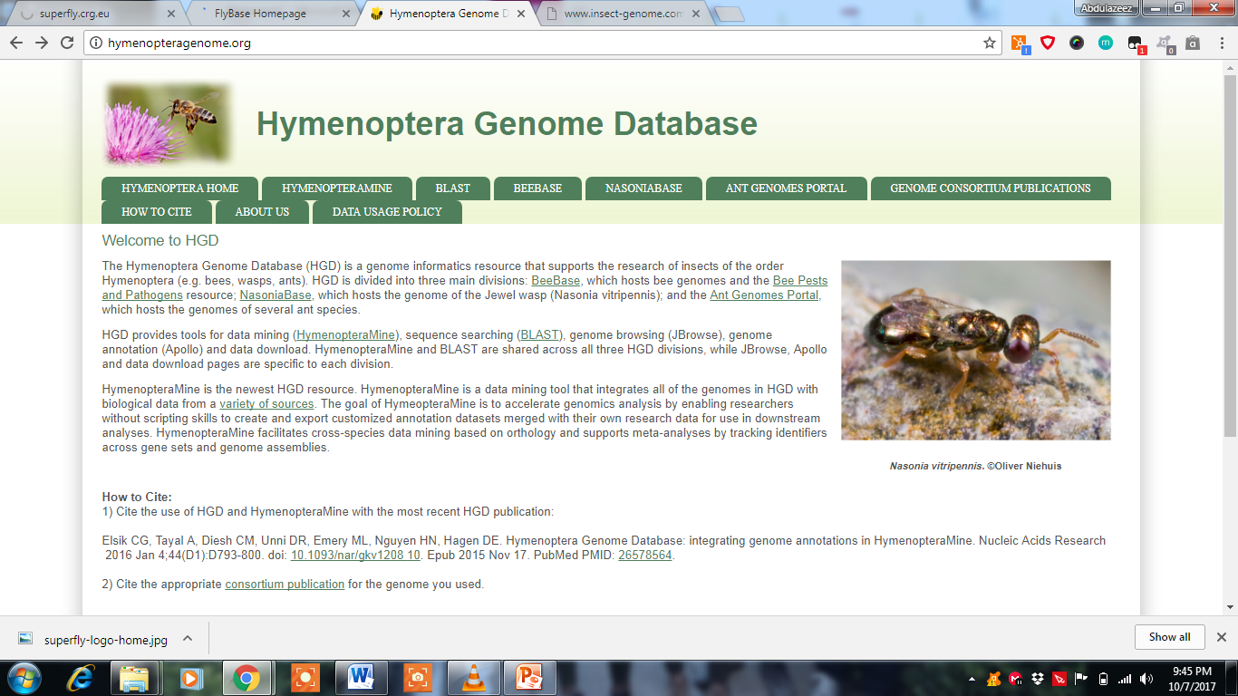
Hymenoptera Genome Database
http://hymenopteragenome.org
Order wise database that brings BeeBase, NasoniaBase, and the Ant genomes under a single umbrella.

Slide 12
MonarchBase http://monarchbase.umassmed.edu
REDFly (http://redfly.ccr.buffalo.edu) – Resource for Drosophila RE and TFBsites
iBeetleBase
http://ibeetle-base.uni-goettingen.de
Annotations of RNAi phenotypes gathered in a large screen in T. castaneum.

Slide 13
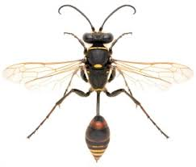
http://vanderbilt.edu/IIID
Contains immune repertoires of 5 insect models (D. melanogaster, A. gambiae, A. mellifera, Acrythosiphon pisum & Nasonia)
http://www.cdfd.org.in/insatdb
Stores data for D. melanogaster, A. mellifera, A. gambiae, T. castaneum and B. mori
http://aphidbase.com
KONAGABase, MitoDrome, SilkSatDb, FlyRNAi, SpodoBase
http://imgd.org

Slide 14
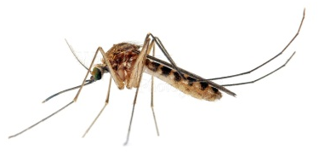
DISCUSSION
WGS of insects is an invaluable resource
No specific database for proteins (insect)
Synchronize or merge data in some databases
Need to review the UX of databases
Insects belonging to the Orders Diptera, Coleoptera, Hymenoptera and Lepidoptera make up the bulk of organism-specific databases.
We expect this to change in the future when more genomes of insects of diverse orders will be available.

Slide 15
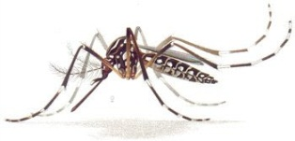
CONCLUSION
More genomes will be sequenced
More databases will be created
Better methods for pest and vector disease management

Slide 16
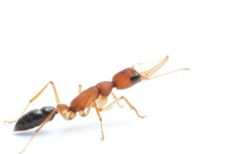
References
Benson, D.A., Cavanaugh, M., Clark, K., Karsch-Mizrachi, I., Lipman, D.J., Ostell, J. and Sayers, E.W. (2017). GenBank. Nucleic Acids Research, 45: D37–D42.
Cicin-Sain, D., Pulido, A.H., Crombach, A., Wolton, K.R., Jimenez-Guri, E., Taly, J., Roma, G. and Jaeger, J. (2015). SuperFly: a comparative database for quantified spatio-temporal gene expression patterns in early dipteran embryos. Nucleic Acids Research, 43: D751-D755
Giraldo-Calderon, G., Emrich, S.J., MacCallum, R.M., Maslen, G., Dialynas, D., Topalis, P., Ho, N., Gesing, S., the VectorBase Consortium, Madey, G., Collins, F.H. and Lawson, D. (2015). VectorBase: an updated bioinformatics resource for invertebrate vectors and other organisms related with human diseases. Nucleic Acids Research, 43: D707-D713
Grimmelikhuijzen, C. J., Cazzamali, G., Williamson, C. M. and Hauser, F. (2007). The promise of insect genomics. Pest Management Science, 2007, 63: 413–416.
Losey, J.E. and Vaughan, M. (2006). The economic value of ecological services provided by insects. Bioscience, 56: 311–323.
Pimentel, D., Lach, L., Zuniga, R. and Morrison, D. (2000). Environmental and economic costs of nonindigenous species in the United States. Bioscience, 50: 53–65.
Robinson, G.E., Hackett, K.J., Purcell-Miramontes, M., Brown, S.J., Evans, J.D., Goldsmith, M.R., Lawson, D., Okamuro, J., Robertson, H.M. and Schneider, D.J. (2011). Creating a buzz about insect genomes. Science, 331: 1386-1386
Evans, J.D., Aronstein, K., Chen, Y.P., Hetru, C., Imler, J.L., Jiang, H., Kanost, M., Thompson, G.J., Zou, Z. and Hultmark, D. (2006). Immune pathways and defence mechanisms in honey bees Apis mellifera. Insect Molecular Biology, 15, 645–656.
Lawniczak, M.K.N., Emrich, S.J., Holloway, A.K., Regier, A.P., Olson, M., White, B., Redmond, S., Fulton, L., Appelbaum, E., Godfrey, J., Farmer, C. et al. (2010). Widespread divergence between incipient Anopheles gambiae species revealed by whole genome sequences. Science, 330: 512–514.
Neafsey, D.E., Lawniczak, M.K.N., Park, D.J., Redmond, S.N., Coulibaly, M.B., Traore, S.F., Sagnon, N., Costantini, C., Johnson, C. et al. (2010). SNP genotyping defines complex gene-flow boundaries among African malaria vector mosquitoes. Science, 330: 514–517.
Simola, D.F., Wissler, L., Donahue, G., Waterhouse, R.M., Helmkampf, M., Roux, J., Nygaard, S., Glastad, K.M., Hagen, D.E., Viljakainen, L. et al. (2013). Social insect genomes exhibit dramatic evolution in gene composition and regulation while preserving regulatory features linked to sociality. Genome Research, 23, 1235–1247.

