Slide 1

Inhibitory effect of aqueous leaf extract of Annona Muricata on testosterone-induced benign prostatic Hyperplasia in male Wistar rats.
PRESENTED AT: 5TH FACULTY OF SCIENCE CONFERENCE
FACULTY OF SCIENCE
LAGOS STATE UNIVERSITY,
OJO, LAGOS
BY:
TOLULOPE, AJAYI
ON:
OCTOBER, 2017

Slide 2
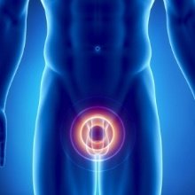
INTRODUCTION 1/3
Benign Prostatic Hyperplasia (BPH) is an increasing hormonal age-related disease of men shown by variances in the prostate (Wei et al., 2005).
This disease is receiving attention due to the increase in its activity and support to a number of deaths which is a huge public health concern. (Wei et al., 2005].
The commonest therapeutic drug prescribed for the treatment of BPH is Finasteride, which is a Type ІІ 5-α reductase inhibitor, exhibits severe side effect due to its similar structure to steroidal hormones. (McConnell et al., 1998., Foley & Kirby, 2003)
All aspects of the A. muricata tree, same as other Annona species, including A. squamosa and A. reticulata are used as ancient medicines against a number of human sicknesses and diseases, especially cancer.

Slide 3
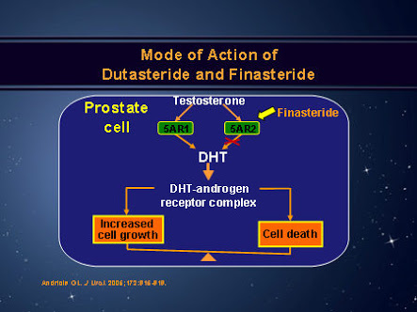
2/3
Figure 1: Mechanism of action of Finasteride. (Roehrborn, 2007)

Slide 4
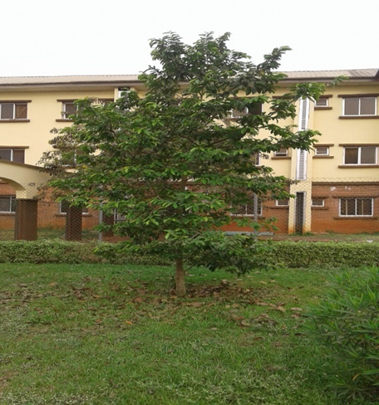
3/3
Figure 2: Annona Muricata plant taken in Babcock University (30/1/2017)

Slide 5
JUSTIFICATION
Despite the in vitro cytotoxic effects of Annona muricata on prostate gland, little research has been done on the in vivo studies of this plant.
Also, the commonly used drug is known to have adverse side effects. Hence the need to search for an alternative treatment which is better and with lesser adverse side effects.

Slide 6
AIM
This study aimed at investigating the inhibitory effects of Annona muricata aqueous extract (AMAE) on testosterone-induced BPH in Wistar male rats.

Slide 7
MATERIALS & METHODS 1/4
Drugs and chemicals
TP was purchased from Laborate pharmaceuticals India Ltd. (Panipat, India).
Finasteride, a type II 5-reductase inhibitor, was obtained from Teva pharmaceuticals Industries Ltd (UK).
5α-reductase 2, P21 and β-actin oligonucleotide primers were purchased from Invitrogen (Camarillo, CA, USA) and SYBR Premix Ex Taq was purchased from Life Technologies (Grand Island, NY, USA).
Total RNA isolation kit (Easy-Blue Reagent) was obtained from iNtRON Biotechnology, Inc., (Gyeonggi-do, Korea), High-capacity cDNA synthesis kit (Bioline, SensiFAST).

Slide 8
MATERIALS & METHODS 2/4
Extraction
Annona muricata leaves were obtained freshly from the horticultural garden of Babcock University and were identified at Botany Department, University of Ibadan, with voucher number, UIH-22561.
Extraction was carried out according to the method described by Awoyinka & Dada, 2011.
Animals
The rats (130g ± 20) were randomly divided into four groups (n=5).
BPH was induced by subcutaneous injection of TP (20mg/kg) at the inguinal region for 18 days following the methods of Kim et al., 2015 with slight modifications.

Slide 9
MATERIALS & METHODS 3/4
The experimental groups include:
Control (CON) group given vehicle corn oil (c.o) (200µl);
(2) BPH group that received TP with c.o.
(3) Finasteride (FINA) group that treated 5mg/kg, administered orally for 18 days as a positive anti-BPH drug;
(4) Annona muricata aqueous extract (AMAE) group that treated 300mg/kg, administered orally for 18 days. The dosage of AMAE (300mg/kg) referred to previous study (Asare et al., 2014).
All materials were administered to animals once daily for 18 days and body weight was measured weekly.

Slide 10
MATERIALS & METHODS 4/4
Ethics
Animals were euthanized by cervical dislocation and samples were collected for analysis. The investigation conforms to the Guide for the Care and Use of Laboratory Animals (NIH Publication, revised 1996).
Statistics
The data are presented as mean ± standard deviation (SD). Statistical significance was calculated using one-way analysis of variance (ANOVA) with SPSS 23.0.
All graphs were done using graph pad prism 6.0. Significant mean differences were considered significant at p< 0.05, p<0.01 & p<0.001.

Slide 11
RESULTS 1/9
Effect of AMAE on Prostate weight and Prostatic Index
Figure 3: Data as mean ± S.E.M; n=5, ª p<0.05, ^{c} p<0.01 or ^{e} p<0.001 when compared with CON, ^{b} p<0.05, ^{d} p<0.01 or ^{f} p<0.001 different from BPH

Slide 12
RESULTS 2/9
Effect of AMAE on Prostate Testicular Index
Figure 4: Data as mean ± S.E.M; n=5.

Slide 13
RESULTS 3/9
Effect of AMAE on Liver Biomarkers
Figure 5: Data as mean ± S.E.M; n=5, ª p<0.05, ^{c} p<0.01 or ^{e} p<0.001 when compared with CON, ^{b} p<0.05, ^{d} p<0.01 or ^{f} p<0.001 different from BPH

Slide 14
RESULTS 4/9
Effect of AMAE on Liver Biomarkers
Figure 6: Data as mean ± S.E.M; n=5, ª p<0.05, ^{c} p<0.01 or ^{e} p<0.001 when compared with CON, ^{b} p<0.05, ^{d} p<0.01 or ^{f} p<0.001 different from BPH.

Slide 15
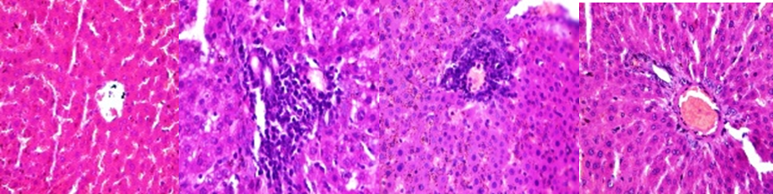

RESULTS 5/9
Effect of AMAE on Liver tissue
B
C
D
A
Figure 7: Photomicrographs of LIVER tissue show (a) CON: No significant lesion (b) BPH: Focal area of granulation tissue and mild microvascular steatosis (c) FINA: Mild periportal inflammation (d) AMAE: Normal portal triads. NR: Normal

Slide 16
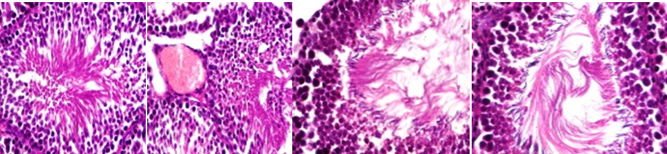
RESULTS 6/9
Effect of AMAE on Testes tissue
A
B
C
D
Figure 8: Photomicrographs of TESTES tissue show (a) CON: NR (b) BPH: Mild congestion of blood vessels (c) FINA: NR (d) AMAE: Focal area of maturation arrest

Slide 17
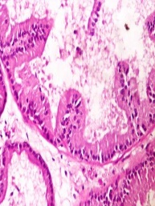
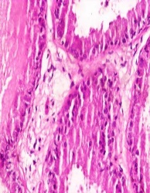
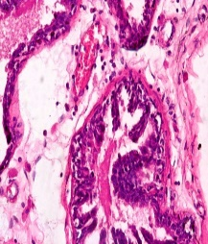
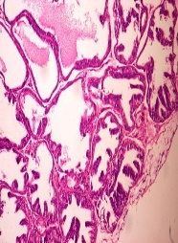
RESULTS 7/9
Effect of AMAE on Prostate tissue
Figure 9: Photomicrographs of prostatic tissue show (a) CON: Normal secretion of EC (b) BPH: Proliferation of gradular EC (c) FINA: Many secretions (d) AMAE: Normal tall columnar secretory cells. EC: Epithelia cells.
.

Slide 18
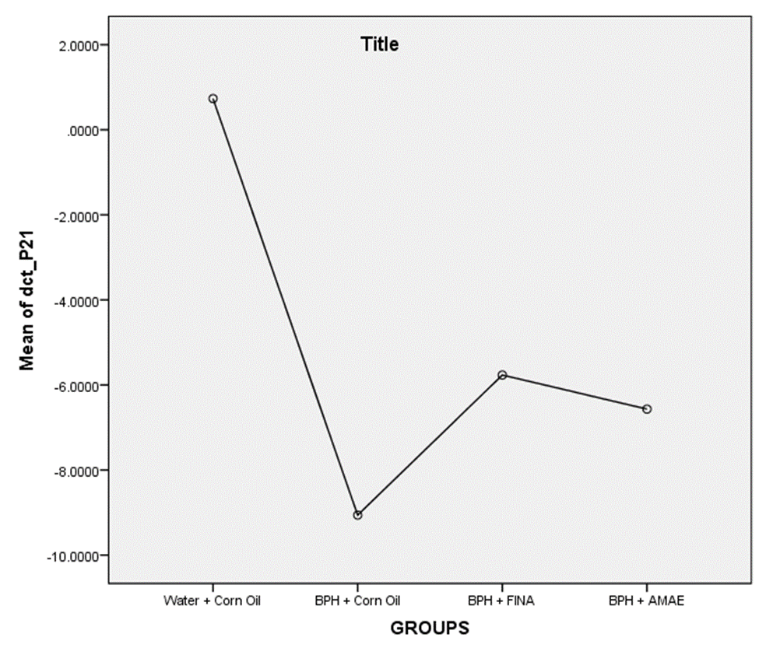
RESULTS 8/9
Effect of AMAE on 5 α-reductase and P21 mRNA expression
Figure 10: Data as mean ± S.E.M; n=5, ª p<0.05, ^{c} p<0.01 or ^{e} p<0.001 when compared with CON, ^{b} p<0.05, ^{d} p<0.01 or ^{f} p<0.001 different from BPH

Slide 19
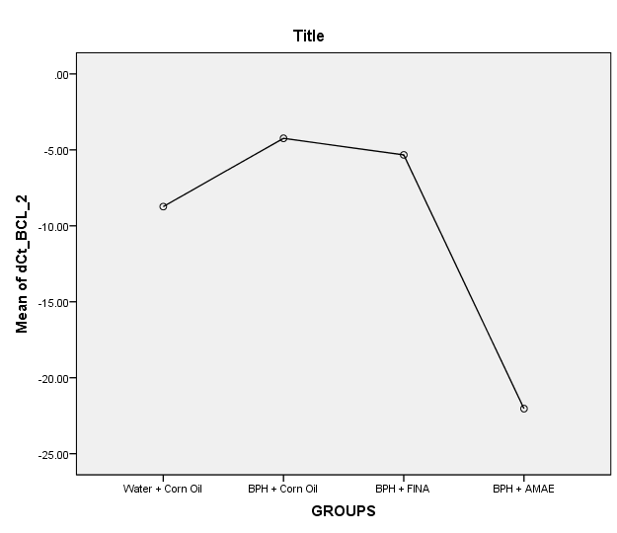
RESULTS 9/9
Effect of AMAE on Bcl-2 mRNA expression
Figure 11: Data as mean ± S.E.M; n=5, ª p<0.05, ^{c} p<0.01 or ^{e} p<0.001 when compared with CON, ^{b} p<0.05, ^{d} p<0.01 or ^{f} p<0.001 different from BPH

Slide 20
DISSCUSSION 1/2
Increase in prostate weight and prostatic index are important bio- indicators of BPH development as shown by Adeteye et al., 2011
Although, there was no significant difference, the prostatic index (0.41 ± 0.17) for the AMAE group was lower than that of the BPH only group (0.51 ± 0.1). This indicates that the aqueous extract was able to reduce the prostatic index of the BPH + AMAE group. These findings agree with that of Ghlissi et al., 2012.
Also, AMAE had lower values of ALT, AST and ALP levels compared to BPH group ALT, AST and ALP at P<0.05, P<0.01 and P<0.001 respectively. This indicates that AMAE was able to reduce liver enzymes activity in sera. These findings are supported by Offor et al., 2014.
The relative quantitation (RQ) of 5- α reductase (0.45387 ± 0.4225) for AMAE group was significantly lower than the BPH only group (1.2437 ± 0.2041) at P<0.05, P<0.01 and P<0.001 respectively. AMAE group (-6.5667 ± 1.8502) had higher P21 expression compared to the BPH only group (-9.06 ± 11.4798). This means that the extract promoted the activity of the P21 protein, which leads to apoptosis.

Slide 21
DISSCUSSION 2/2
These results are in accord with that done by Astirin et al., 2013.
Also, the mean dCt value for Bcl-2 (-22.0333 ± 16.3968) of AMAE group was significantly lower than the BPH only group (-4.2400 ± 1.3088) at P<0.05.
This means that the aqueous extract significantly inhibited the expression the Bcl-2 protein, thereby promoting apoptosis. This result is in agreement with those recorded by Moghadamtousi et al., 2014.

Slide 22
CONCLUSION
Our data demonstrates the apoptotic, anti-cancer and hepatoprotective properties of Annona muricata leaf extract.

Slide 23
REFERENCES
(1) Wei, J. T., Calhoun, E. & Jacobsen, S. J. (2005). Urologic diseases in America project: Benign prostatic hyperplasia. Journal of Urology, 173: 1256-1261.
(2) McConnell, J. D., Bruskewitz, R., Walsh, P., Andriole, G. & Lieber, M. (1998). The effect of finasteride on the risk of acute urinary retention and the need for surgical treatment among men with benign prostatic hyperplasia. National English Journal of Medicine. 338: 557-563.
(3) Foley, C.L. & Kirby, R. S. (2003). 5 Alpha-reductase inhibitors: What's new? Current Opinions in Urology, 13: 31-37.
(4) Awoyinka, O.A. & Dada, O.O. (2011). Partial Purification and Characterization of lectin from the seed of Cissus populnea. European Journal Of Medicinal Plants, 1(4):130-139
(5) Kim, S., Seok, H., Park, H., Jeon, H., Kang, S., Lee, B………….Chung, J. (2015). Inhibitory effect of curcumin on testosterone induced benign prostatic hyperplasia rat model. BioMed Central,15, 380.
(6) Asare, A. G., Afriyie, D., Robert, A., Abutiate, N. H., Doku, D., Mahmood, S. A. & Rahman, H. (2014). Anti-proliferative Activity of Aqueous Leaf Extract of Annona muricata L. on the Prostate, BPH-1 Cells, and Some Target Genes. Integrative Cancer Therapies, 1–10.
(7) Adeteye, O. V., Yama, O. E., Gbotolorun, S. C. (2011). Third degree burns in female Wister rats: the corollary on estrous cycle and ovarian histo-architectural organization. International Journal of Medical Science, 3: 256–61.

Slide 24
REFERENCES
(8) Ghlissi, Z., Hamden, K., Saoudi, M., Sahnoun, Z., Zeghal, K. M., Feki, A. E. & Hakim, A. (2012), Effect of Nigella sativa seeds on reproductive system of male diabetic rats. African Journal of Pharmacology, 6 (20): 1444–1450.
(9) Offor, C. E. & Aja, P. M. (2014). Effects of ethanol leaf-extract of Vernonia amygdalina and Azadirachta indica on liver enzymes in albino rats. Middle-East Journal of Scientific Research, 21(6): 920.
(10) Astirin, O. P., Artanti, A. N., Fitria, M. S., Perwitasari, E. A. & Prayitno, A. (2013). Annona muricata Linn leaf induce apoptosis in cancer cause virus. Journal of Cancer. 4: 1244-1250.
(11) Moghadamtousi, S. Z., Karimian, H., Rouhollahi, E., Paydar, M., Fadaeinasab, M. & Kadir, H. A. (2014). Annona muricata leaves induce g1 cell cycle arrest and apoptosis through mitochondria-mediated pathway in human HCT-116 and HT-29 colon cancer cells. Journal of Ethnopharmacology. 156: 277–289.

Slide 25
THANK YOU FOR LISTENING

