Slide 1
HEAVY METALS CONTAMINATION AND HUMAN HEALTH RISK IN COMMERCIAL
FISH , IN LAGOS NIGERIA
.
BY
NNODUM, CHIMA FAUSTAª; YUSUF, KAFEELAY ABOSEDE ^{b} AND ADENIJI,
COMFORT ADETUTU ^{c}
a,b. Department of Chemistry.
c. School of Agriculture.
Lagos State University , Lagos, Nigeria.

Slide 2
INTRODUCTION
Increase in fish and shrimps consumptions.
Increased awareness of their nutritional and therapeutic values.
Increased industrialization world wide.
One of the country’s imports .
⁾
.

Slide 3
AIM
This study is aimed at assessing the heavy metal concentrations and
health risk of commercial fish and shrimps ( titus , croaker, scumbia,
shrimps ) obtained from four markets in three local Governments in
Lagos, Nigeria. These markets serve over two million people .

Slide 4
OBJECTIVES;
To study the presence of metal bio-accumulation
in fish and shrimp samples.
To ascertain their toxic levels .
To obtain data for future use in these areas.

Slide 5
Heavy metals.
What are heavy metals?.
They have specific gravities are at least five times that of water.
Specific gravity of water is 1 at 4 ⁰c (39⁰F) .Simply stated, Specific gravity is a measure of density of a given amount of solid substance when it is compared to
an equal volume of water.
Lead 11.34; Cadmium 8.69; Iron 7.9; Arsenic 5.7 ; Copper 8.96
Where are they found?.
Earth crust.
Industrial and consumer wastes,
Acidic rain breaking down soils and releasing them into streams, lakes ,
Rivers and ground water¹⁴.

Slide 6
In this study , we will concentrate on:
Cadmium ( ^{112.4}Cd₄₈ ) is a non essential toxic metal and by product of mining of lead and zinc.
It occurs naturally in sedimentary rocks .
Used in nickel Cadmium battery manufacture, PVCs, plastics, paints ¹⁵
and others.
It enters into water supplies from corrosion of zinc- coated (galvanised )
pipes and fittings.
Target organs are the liver, placenta ,kidneys, lungs, brains and bones¹⁶.

Slide 7
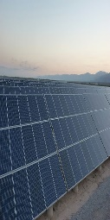
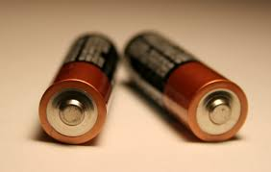
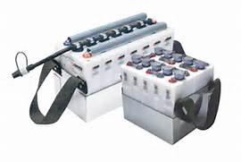
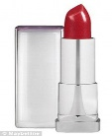
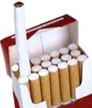
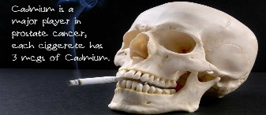
USES OF CADMIUN

Slide 8
Copper ( ^{63.5}Cu₂₉ ) is essential for life in trace amount.
present in metal pipes .
At high levels , it causes vomiting, diarrhoea and
loss of strength.
Severe exposure to copper causes liver cirrhosis.

Slide 9
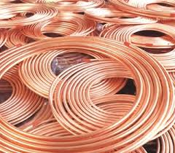
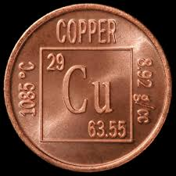
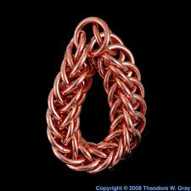
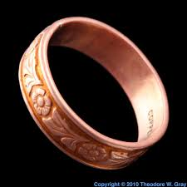
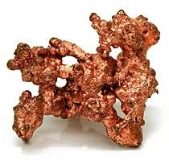
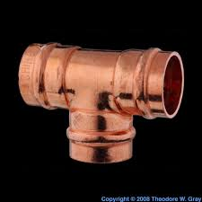
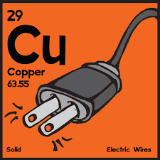
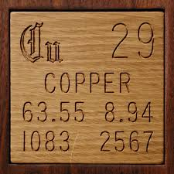
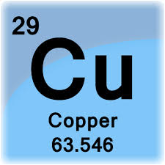
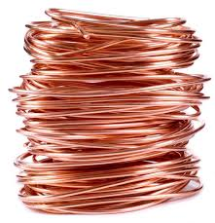
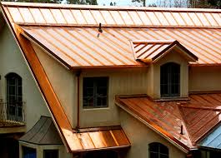
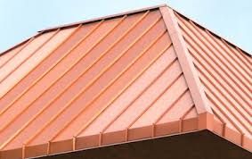
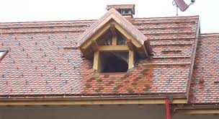
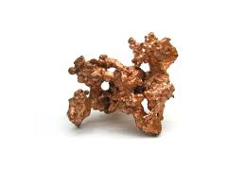
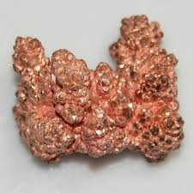
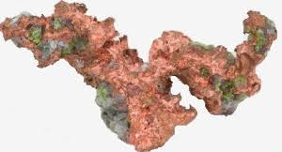
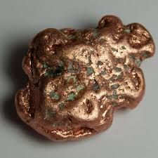
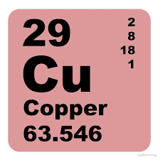
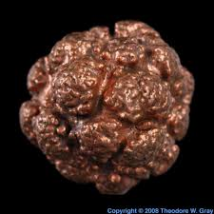
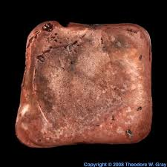
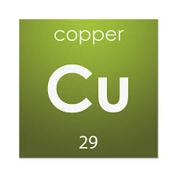
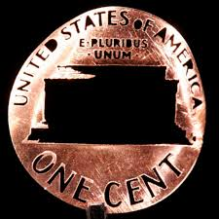
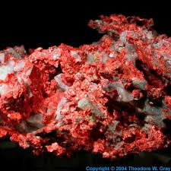
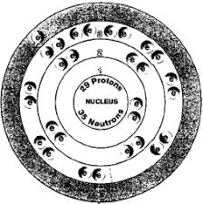
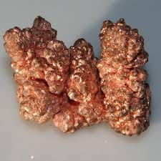
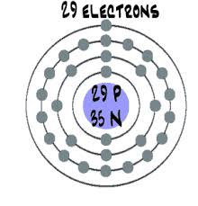
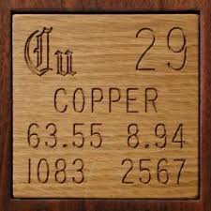
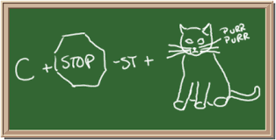
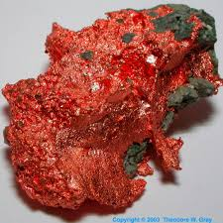
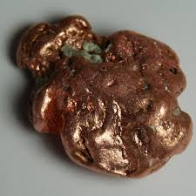
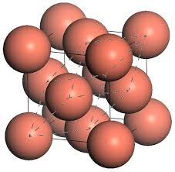
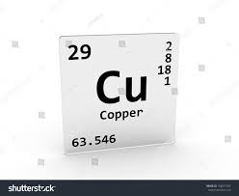
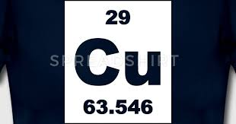
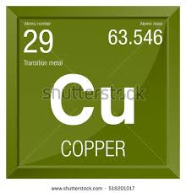
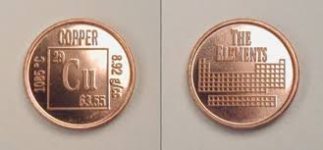
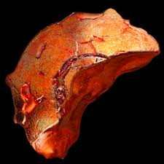
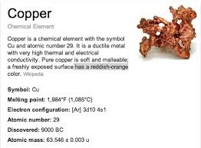
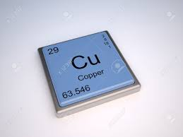
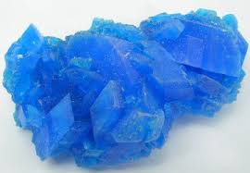
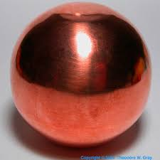
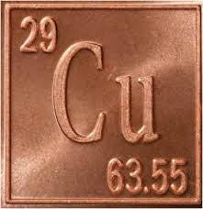
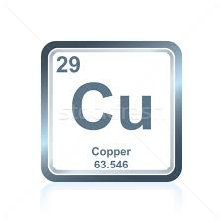
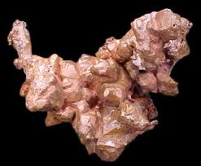
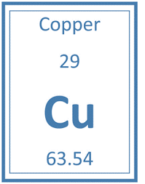
Uses of copper
A
1 day ago
Copper leaf, a sample of the element Copper in the Periodic Table
Photographic Periodic Table1000 × 1000Search by image
Copper Copper leaf
Related images:
View more
Images may be subject to copyright.Get helpSend feedback
Pictures, stories, and facts about the element Copper in the ...
Photographic Periodic Table356 × 356Search by image
Pictures, stories, and facts about the element Copper in the Periodic Table
Images may be subject to copyright.Get helpSend feedback

Slide 10
Lead ( ^{207.2}Pb₈₂ ) occurs naturally in the Earth crust.
anthropogenic activities
used in metal pipes¹⁷, .
2.5 million tons are produced annually through out the world.
Lead accounts for most of paediatrics heavy metal poisoning (Robert et al 1999).
Target organs are the bones, brain , blood, kidney and thyroid gland.

Slide 11
Uses of Lead.
AMMUNITION
PIGMENT
LEAD ORE
LEAD ROOFING SHEETS

Slide 12
ROOTS OF ENTRY

Slide 13
ROOTS OF ENTRY

Slide 14
Some of the EFFECTS OF heavy METALS POLLUTION.²⁵

Slide 15
MATERIALS AND METHODS
2.1 Materials
All chemicals were of analytical grade.
2.2 Study Area.
The markets used for this study are,
1 . Agboju market in Amuwo odofin LGA. 2. Kuje market in Amuwo Odofin LGA.
3. Alabasuru market in Ajeromi LGA. 4. Odunero market in Ojo LGA , all in Lagos, Nigeria.
2.3 Four species of fish and shrimps were obtained from these markets.
Fish and shrimp species assessed are :
1. Titus {Thunus Albacare}. 2.Scumbia (Anlopus Cadenati)
3. Croaker (Illisha Africana ) 4.Shrimps.(Nimatocarsinus Africana)

Slide 16
2.3 Sample preparations and analysis
5g of the tissues and gills were dried in an oven
at 110$°$C for 8h.
2g of each dried tissue and gill was put in a beaker and 5ml of Nitric acid {HN 03} was added, all digested on a hot plate at 100$°$c for 3hrs.
The analysis was carried out using the atomic absorption method
And instrumentation by Lark, B and Mahajan, R.I. ⁶ (2002).

Slide 17
2.4 WATER AMPLE PREPARATION AND ANALYSIS
Filteration of 100 ml of distilled water with 0.45µn filter paper in a acid cleaned bottles.
acidification of 100ml with 5ml HNO3 and stored at room temperature
for h.
Drying for almost complete evaporation was done and made up to 100ml.
2.3 Analysis of Pb , Cd and Cu were carried out using atomic absorption spectrophotometer
200 perkin ,Cd was not detected. There wavelengths were 283.3nm for pb, 228.8nm
for Cd and 324.7nm for Cu .
All analysis were replicated 3 times to asses the reproducibility of measurement.
However, accuracy of analysis was verified by analyzing Blanks and Calibration
Standard Solutions with results being expressed in mg/kg.
Beer’s Law

Slide 18
3.1 CONCENTRATION LEVELS IN THE TISSUES AND GILLS.
The concentration levels in the tissues and gills of the fish samples are
in the table below.
Cd was not detected in the both the tissues and the gills
Cu and pb were in the range of 0.05 – 1.00mg/kg and 0.05 – 0.30 mg/kg
respectively.

Slide 19
Results of analysis mg/kg. (standard deviation (+or -0.02)
SAMPLE | Cd | Cu | MG/KG pd
TITUS TISSUE GILLS | ND ND | ND 1.00 | ND 0.50
CROAKA TISSUE GILLS | ND ND | 1.00 0.50 | 0.30 1.00
SHRIMPS TISSUE | ND ND | 1.00 0.50 | ND ND
SCUMBIA TISSUE GILL | ND ND | ND 0.05 | 0.25 ND
EU | 0.05 | 2.25 | 0.30

Slide 20
CONCLUSION and recommendation.
Metal concentrations in the tissue and shrimp samples showed some variations as observed among all species .The differences in feeding pattern and bio accumulation factors may be responsible for that. However, their concentrations were in the ranges of 0.05- 0.30mg/kg for Pb, 0.05-1.00mg/kg for Cu and Cd was not detected. They were below the permissible limits by EU regulation(1881/2006) which is 0.30mg/kg for Pb, 0.05mg/kg for Cd and 2.25mg/g for Cu ⁸.
However there should still be continous monitoring for the safety of the environment.

Slide 21
RECOMMENDATIOS FOR REDUCTION OF METALS INFLOW INTO THE AQUATIC ENVIRONMENT WATER.
1. Reduction in the use of metal implements for water transports.
2. waste the initial volume of water when refilling fish ponds.
3. Removal of metals from industrial effluents using activated carbon
and other chemical processes.

Slide 22
REFERENCES
1 .Yujun, y.I; Cailong Tang; Tieci y.I; Zhifeng, y; Zhang, s. (2017)
Health risk assessment of heavy metal in fish and accumulation patterns in food web in the upper Yangtze River.
2.Lokhande R.S and Kelkan, N; (1999). Studies on heavy metals in water of vasa creek, Maharashtra, Indian. J. Environ protect. 19. 664-668
3.Lee. J.D. (2007), concise inorganic chemistry. Fifth edition Chapman Hall UK, p 147
4.C.A commission Joint :FAO/ WHO Food Standards Programme.
FAO/ WHO, Rome (2011), p 122.
5. Copat. C; Bella F; castaining M; Jalliw, R; Sciacca, S; Ferrante, M. (2012). Heavy metals concentrations in fish pond from sicily (Mediterranean sea) and evaluation of possible health risks to consumers. Bull Eviron Contain Toxical, 88 78-83.
6.Lark ,B.S and Mahajan, R.I .( 2002 ), Determination of metals of toxicological significance in sewage irrigated vegetables by using atomic absorption spectrometry and anodic stripping voltammetry. Indian J. Environ Health , 44, 164-167.
7. Steve J.H, Andy, S, (2017). Atomic absorption methods and instrumentation in encyclopedia of spectroscopy and spectrometry (third edition) (pp 44-51)
8. EU regulation 1881/2006
9. Reels ,H.A; lauwerys , R.R; Buchet, J.P; Bernard, A; chettle, D.R; Harvey, T.C; Al-Haddad, I.K; (1981)In vivo measurement of liver and kidney cadmium in workers exposed to thin metal. Its significance with respect to cadmium in blood and urine. Environ Res, 26, 217-240.
10. Less, K.G; Kweon, H; Yeo, J.H; Woo, S, ;Han, S ; Kim, J.A; (2011)CCharacterization of styrosin rich antherasea pernyl silk fibroid hydrolystate. Intl J . BOI. Macromol; 48.223-226
11. Maceda-veiga, A; Monroy , M; Navarro, E; Viscor, Gh; sosloa, A. (2013)
Metal concentrations and pathological responses of wild fish exposed to sewage discharge in Mediterranean river. Sci Total Eviron. 449 (2013), 9-19
12. Ahmed, M.K; Boki, M.A; Isalam, M.S; Kundn, C.K; Habiibullah-AL-mamlim, M; Sarka, S.K, Hossain, M.M; (2015), Human health risk assessment of heavy metals in tropical fish and shellfish collected from the river Biriganga, Bangladesh.’’Environ. su. pollut. res, 22. 15880-15890
13. Rahman. M; Molla, A; Arafat , S ;(2010); Status of populatin around Dhaka export processing zone and its impact on bangshi River, Water, Bangladesh.
Jornal of national science-SUST Technol 4 91-110

Slide 23
REFERENCES
14. FSANZ Food Standards Australia New Zealand J, (2008), Australia New Zeal Food Standards Code (incorporating amendments up to
and including Amendment 97). Anstat pty Ltd Melbourne
15. Wilso O,N, (1988) cadmium market trend and influences, London, Cadmuim 87 proceedings of the 6th international cadmium conferences p 9-16
16. Gesamp, IMO/FAO/UNESCO/WMO/WHO/IAEA /UN/UNEP joint group of expert on the scientific aspects of marine pollution Report of the seventeenth session. Geneva, Switzerland; World Health Organization 1987-( Reports and studies) NO.31)
17. Jacob D.E; clickners, R.P; Zhen, J, Y ;(2002). The prevelance of lead-base paint hazards in U.S housing.
18. Lanphear B.P; matt ,T.D; Roger, J;( 1998) The contributions of lead contaminated house dust and residential soil to children’s blood lead level. Environ Res 79;51-68 [pub med;9756680]
19. Tchounwou, P.B; yediou, G.C; patlolla, A.K and Sutton, D;J,;(2012) Heavy metal toxicity and the environment.National institute of health . USA. 101:133-164.doi.10.1007/978-3-7643-8340-4-6
20. USEPA, (2011). USEPA Regional screening level (RSL) summary Table. November 2011.
21. Yohannes, Y.B; Ikenaka, y; Nakayama S.M ;Saengtienchai, A, watanab E, K; Ishizuka, M.
Organochlorine pesticides and heavy metals in fish from stable isotope analysis. Chemosphere, 91.857-863.
22. Aradhi, K; Krishna, M; Satyana rayanan, (2009)
Assessment of heavy metal pollution in water using multivariate statistical techniques in an industrial area. Jornal of hazardous material 167, (1-3) page 366-373
23. Forstna, U; Wittmann G.T,W; (2012). Metal pollution in the aquatic environment second edition. Berlin Heidelberg ,New York . pp5-22
24. Weis,J.S.(2015) Marine pollution, What everyone needs to know .Oxford University press, New York .1-20
25. Godt, J, Schedig, F; Gross –Siestrup,C ; ( 2006) Toxicity of cadmium and resulting hazards for human health.
Jornal of occupational medicine and toxicity 1:22
https://doi .org/10.1186/1745-6673-1-22r

Slide 24
REFERENCES
26. Wang.x,;Sato, T and Boashan ,X; (2005) . Healkth risk of heavy metals to the general public of Tianjin,
china through comsumption of vegetables and fish. Science of Total Environment 350:28-37.
27. Shah, S.L and Altindag, A. (2003) Effects of heavy metal accumulation on the 96-h L.C50 Values in Tench Tinca .Turk J, vet. Anim sd. 29 139-144
28. Raikiwan, M.K; Kuman, P; Singh, M and Singh. A. (2008). Toxic effects of heavy metals in investment health Veterinary World, I(i), 28-30
29. Fidan, A.F; Cigerci, H; Konuk, M; Kucukkurt, I,; Aslan and Dundan, y, (2008). Determination of some heavy metal level and oxidative status in carassius carassius L 1758 from Eber lake
Environ Monit Asses 147; 35-41
30. Amiraaah, M. N and Afiza, A.s ; (2013)
Human Health Risk Assessment of Metal Contamination through Consumption of Fish
Jornal of Environment Pollution and Human Health(1) 1-5.

Slide 25
THANK YOU

