Slide 1
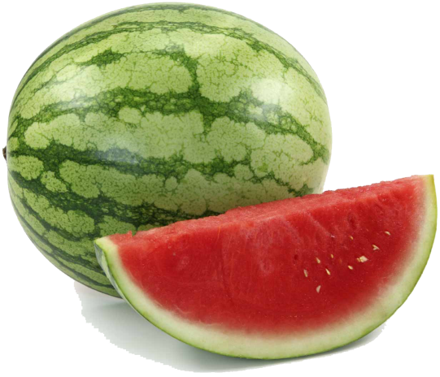
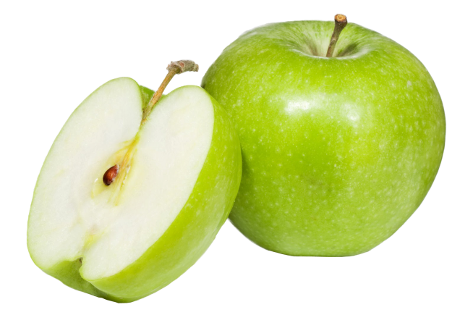
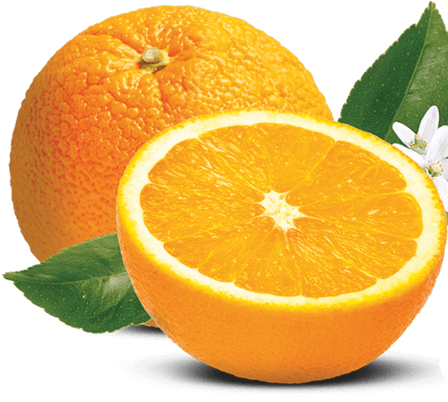
Assessment of Pesticide Residue Levels in common Fruits consumed in Lagos State, Nigeria
Koleayo O. Omoyajowo
Department of Science Policy & Innovation studies,
National Centre for Technology Management
@ LASU-FoSC 2017
October 10- 14, LASU, Lagos, Nigeria

Slide 2
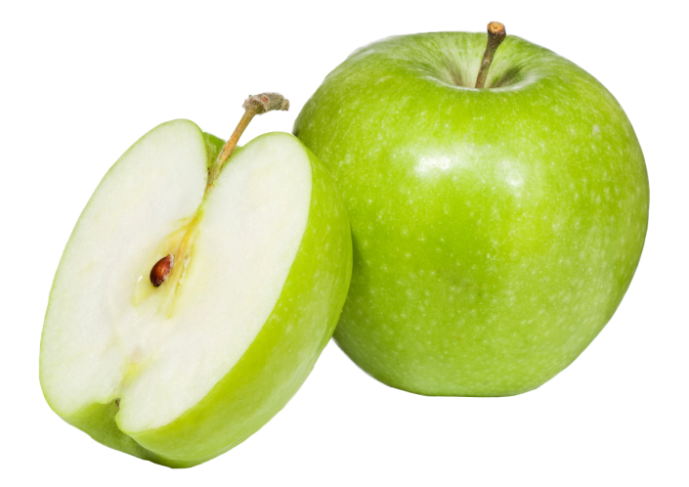
Outline:
Background information:
Aim & objectives
Pesticides: benefits & harms
Fresh fruits
Materials & Methods
Results
Discussion
Conclusion

Slide 3
Background information
Food safety is vital for the survival of all organisms involved in food chain
Severe poisoning with pesticides is a global public health problem that accounts for as many as 300 000 deaths worldwide every year (Goel and Aggarwal, 2007)
not all farmers are duly enlightened on the sustainable and judicious practices of pesticides application during production and post-harvest
There is paucity of information on the pesticide residue in the fruits consumed in Lagos, being the commercial city of Nigeria.
Thus, this study attempts to provide monitoring information on the levels of pesticides’ residues in fruits commonly consumed in Lagos State, Nigeria

Slide 4
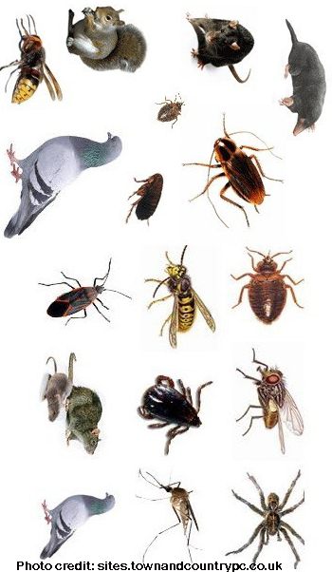
Pesticides: basic understanding
Pesticide is any biological or chemical agent that helps to eradicate unwanted organism (simply pest).
In agriculture, they are used to protect crops against insects, fungi, weeds and other pests
Major classes of pesticides:
Insecticide: kills insects
Herbicide: hinders growth of weeds
Fungicide: eradicates fungal growth
The benefits of pesticides include:
increased food production,
increased profits for farmers
prevents the spread of diseases.
They are mostly applied during planting and storage periods.

Slide 5
Pesticides used during planting & storage

Slide 6
Pesticide residues
Pesticide residue refers to the pesticides that may remain on or in foods after they are applied to food crops that are considered to be of toxicological significance. .
Thus, It may includes any specified derivatives, such as degradation and conversion products, metabolites, reaction products, and impurities

Slide 7
Pesticide exposure: Any harm?
Reduced soil biodiversity (Johnston, 1986).
Causes a wide range of human health hazards such as acute neurologic toxicity, chronic neurodevelopmental impairment,
cancer, reproductive dysfunction, and
possibly dysfunction of the immune and endocrine systems (Andersson et al, 2014).

Slide 8
Fruits
fruits are one of the supplementary sources of carbohydrates, lipids, vitamins, minerals, antioxidants and other important nutrients.
A high intake of fruit has been encouraged not only to prevent consequences due to vitamin deficiency but also to reduce the incidence of major diseases such as cancer (Wattenberg, 1992),

Slide 9
MATERIALS AND METHODS
Sample collection
Three (3) fresh fruit varieties namely apple watermelon and sweet orange were collected from massively patronised sale points of fruits in 3 Local government areas (LGAs) in Lagos state, Nigeria (see figure 1)
A total of 81 fruits were sampled in 9 sampling points in the 3 LGAs which imply that 3 apples, 3 water-melons and 3 sweet oranges were sampled per location.

Slide 10
Figure 1: Map of Lagos State, Nigeria showing sampling sites.

Slide 11
Sample preparation
About (10 g) of each fruit was weighed into a porcelain mortar, and ground with 50 g of anhydrous sodium sulphate.
The powdered sample was extracted in ethyl acetate. The extract was rotary evaporated at 40ºC, and the residue re-dissolved in hexane.
Sample clean-up was done following the procedure of described by Hsu et al. (1991).

Slide 12
Determination of pesticide residue
The analysis of fruit samples for pesticide compounds was performed as was described by Botwe et. al (2011)
on a GC-MS (Agilent 6890 Series GC System) coupled with an Agilent 5973N mass selective detector-electron impact ionization.

Slide 13
Statistical analyses
Descriptive statistics (mean and standard error) were used to analyze results obtained for different pesticides in each fruits.
Mean differences in fruits for different study locations were determined using a two-way ANOVA and Turkey’s multiple comparison test (p<0.05, p<0.01 and p<0.001 confidence intervals). All analyses were performed on Graphpad prism 6 software.

Slide 14
RESULTS
Turkey’s multiple comparison test show that pesticides detected in each fruits per location were statistically similar (P>0.05).
All fruits were found contaminated with pesticides irrespective of their location but residues detected in apples and sweet oranges were found below WHO MRLs.

Slide 15
Results…
The mean residue concentration for atrazine (0.088-0.133 mg/kg), clothianidin (0.00 - 0.029 mg/kg), omethoate (0.094 - 0.205 mg/kg) and oxamyloxime (0.088 - 0.125 mg/kg) as obtained in watermelons in this study were found to be above WHO/FAO MRLs of 0.02, 0.02, 0.01 and 0.03 mg/kg for atrazine, clothianidin, omethoate and oxamyloxime respectively.

Slide 19
Discussion:
pesticide monitoring is critical to ensuring that pesticides in fruits and vegetables do not exceed maximum residue levels (MRLs) by WHO or relevant food safety authorities in our country.
If intended MRL of pesticides exceeds, then causes various diseases (Khan et al., 2011).
MRLs are defined as the highest concentrations of pesticide residues (expressed in milligrams of a substance per kilogram of commodity) likely to occur in or on food commodities after the use of plant protection products according to Good Agricultural Practice (WHO/FAO, 2016).

Slide 20
Discussions…(1)
All fruits sampled in this study were found contaminated with pesticides (in varying amount) irrespective of the different locations.
Residues detected in fruits in this present study were quite different from the residues detected in similar fruits in recent studies conducted in Ghana (Bempah, 2011).

Slide 21
Discussions…(2)
Based on the results presented in Table 1, mean residue levels for each pesticides detected were found below their WHO MRLs and thus, gives an indication that apples for all sampling locations in this study were safe for public consumption
The mean residue levels for each pesticides detected were found below their WHO MRLs and thus, gives an indication that sweet oranges for all sampling locations in this study were safe for public consumption.

Slide 22
Discussions…(3)
this study identified three classes of pesticides in watermelons namely; herbicide, fungicide and insecticide
Thus, the insecticides found present were acephate, clothianidin, dimethoate, endosulfan sulphate, imidacloprid, methamidophos, omethoate, oxamyl-oxime while fungicides were quinoxyfen and tebuconazole and lastly, atrazine was the only class of herbicide found in watermelons
To ensure that watermelon is available to meet the overwhelming demands of the consumers, farmers and merchants used these pesticides (except for atrazine) for post harvest purposes to store and preserve the watermelons. Hence, the reason for high MRLs of atrazine, clothianidin, omethoate and oxamyloxime detected in watermelons in the 3 LGAs covered in this present study.
This also corroborates the report of Dinham (1993) that the short interval between harvests to market and the likelihood of no testing for pesticide residues in developing countries contributed to frighteningly high residual levels in urban markets

Slide 23
Discussion…(4)
Atrazine has been reported to cause adverse effects such as infant mortality, reproductive, disorder (Mattix, et al, 2007; Winchester, et al, 2009)
recent findings posit that use of clothianidin as seed treatments on some crops poses risks to small birds, and ingestion of even a few treated seeds could cause mortality or reproductive impairment to sensitive bird species (Gibbons et al., 2015).
dimethoate has been classified a possible human carcinogen (U.S. EPA, 1995).
Oxamyl is toxic to fish, birds, and other wildlife (ETN, 1993).

Slide 24
Conclusion
The presence of pesticide residues in all fruits used for this study calls for stringent measures in the regulation of the use of pesticides for crop protection, yield improvement and storage.
Government and stakeholders should also sensitise the public on the need to improve sanitary conditions for the city food markets; and increase awareness for consumers and policy makers on the dangers of pesticide contamination in food intake.

Slide 25
Other contributors:
Kelechi Njoku
Sunday Amiolemen
John Ogidan
Olapeju Adenekan
Kayode Olaniyan
Julie Akande
Ifeoluwa Idowu

Slide 26
Literature cited:
Extension Toxicology Network (1993). Pesticide information profile of Oxamyl. Retrieved from http://pmep.cce.cornell.edu/profiles/extoxnet/metiram-propoxur/oxamyl-ext.html on July 13, 2017.
U.S. Environmental Protection Agency (U.S. EPA). Dimethoate; pesticide tolerance. Proposed rule. In: Federal Register volume 60, Number 128, July 5, 1995. Pages 34945-34947.
Winchester, P.D., Huskins, J., Ying, J. Agrichemicals in surface water and birth defects in the United States. Act Paediatrica. 2009 (98) pp. 664-669.
Mattix, K.D., Winchester, P.D., Scherer, L.R. Incidence of abdominal wall defects is related to surface water atrazine and nitrate levels. J. Pediatr. Surg., 2007 Jun; 42(6), pp. 947-49.
Botwe, B. O. Ntow, W. J., Kelderman, P. , Drechsel, P., Carboo, D., Nartey, V. K. and Gijzen, H. J. (2011) Pesticide Residues Contamination of Vegetables and Their Public Health Implications in Ghana. J. Environ. Issues Agric. Dev. Countries 3 (2): 1-18.
Ferrer, I., García-Reyes, J. F., Mezcua, M., Thurman, E.M. and Fernández-Alba, A.R. (2005). Multi-residue pesticide analysis in fruits and vegetables by liquid chromatography-time of-flight mass spectrometry. J. Chromatography A 1082: 81-90.
WHO (2016). Pesticide Residues in Food. http://www.who.int/feature/9a/87/en. Accessed on 28th September, 2016
Goel A., and Aggarwal P., 2007. Pesticide Poisoning. National Medical Journal of India. 20:182–191.
Joint FAO/WHO Codex Alimentarius (2016). Codex Pesticides Residues in Food Online Database Retrieved from www.fao.org/fao-who-codexalimentarius on 09/11/2016.
.

Slide 27
THANK YOU

