Slide 1
PROTECTIVE EFFECT OF ETHYL ACETATE LEAF EXTRACT OF ANNONA MURICATA ON TESTOSTERONE-INDUCED BENIGN PROSTATIC HYPERPLASIA MALE WISTAR RAT MODEL.
PRESENTED AT: FACULTY OF SCIENCE CONFERENCE
LAGOS STATE UNIVERSITY, OJO, LAGOS.
BY:
OWODE BOLUWATIFE ZAINAB
ON:
AUGUST, 2017

Slide 2
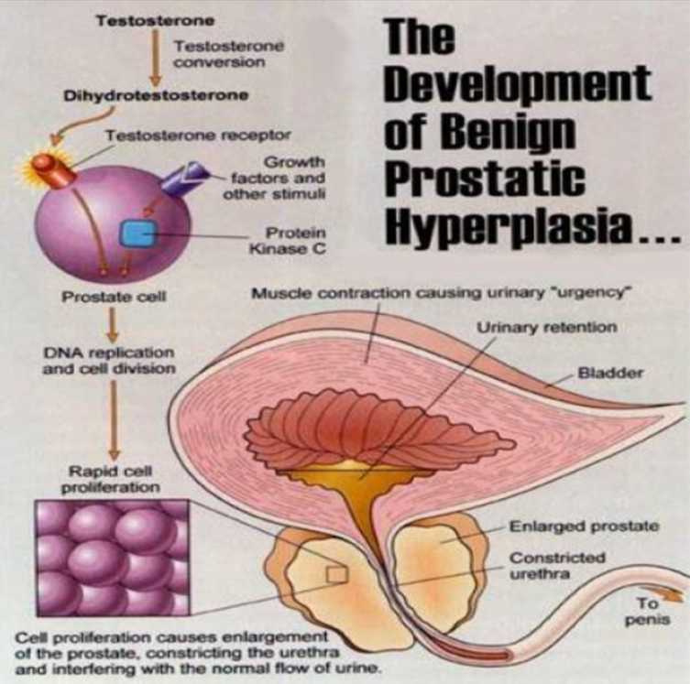
INTRODUCTION
BENIGN PROSTATIC HYPERPLASIA
Associated with the proliferation of prostatic cells.
A common condition that occurs in aging men, which results in an enlarged prostate gland.
It is caused by hormonal changes and family history
It causes a compression of the prostatic urethra and the flow of urine from the bladder is restricted (Dhingra & Bhagwat, 2011; Kapoor, 2012).
Also causes uncomfortable symptoms such as urgency, nocturia, intermittency, hesitancy and decreased stream. Development of bladder stones or urinary tract infection may occur as BPH progresses (Kapoor, 2012).
Figure 1: How Testosterone causes BPH (Avantgarde urology, 2013).

Slide 3
FINASTERIDE
Finasteride is a 5α-reductase inhibitor which blocks testosterone activation.
Commonly used for the treatment of BPH, because the influence of androgen hormones causes prostate enlargement (Chung et al., 2015).
Tends to have side effects like erectile dysfunction, impotence and decreased libido (Anitha et al., 2009).
Figure 2: Inhibition of testosterone by 5α reductases (Coetzer, 2013).

Slide 4
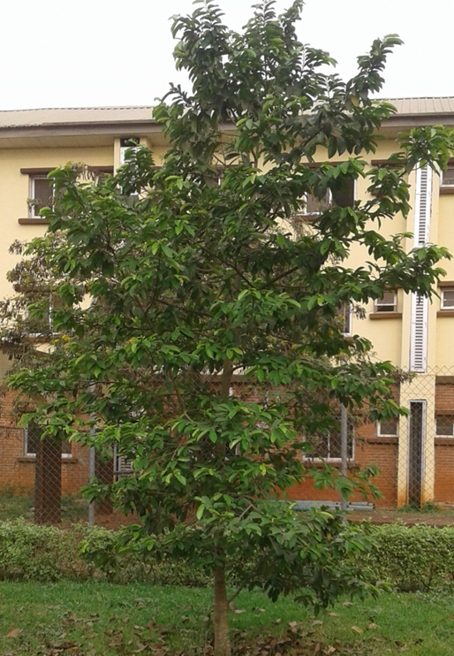
ANNONA MURICATA
Commonly known as soursop, guanabana, graviola.
Family- annonaceae, Species- muricata and Genus- Annona (Moghadamtousi, 2015).
It is an evergreen, terrestrial, erect tree reaching 5–8 m in height and has glossy, dark green leaves.
The fruits are large, heart shaped, dark green, covered with soft spines. The inner flesh is white, meaty, creamy and slightly acidic.(Moos, 2014; Moghadamtousi, 2015).
Phytochemical evaluations on the parts of the plant showed the presence of different compounds like alkaloids that have wide range of pharmacological effects and as such have been widely used as drugs in the medical field.
A
Figure 3: (A) Tree of A. Muricata (B) Fruits of A. Muricata taken in Babcock University
B

Slide 5
JUSTIFICATION
Despite the in vitro cytotoxic effects of Annona muricata on prostate cells, little or no work has been done on the effect it has on BPH cells and in vivo studies targeting the prostate organ

Slide 6
AIM
This scientific research was generally aimed to evaluate the effects of the leaves of Annona muricata on Testosterone induced benign prostatic hyperplasia rat model.

Slide 7
METHODOLOGY
Twenty Wistar male rats were separated into 4 groups (each n=5): the control group (CON), untreated BPH group (BPH) and treated groups using finasteride and ethyl acetate extract of Annona muricata (AMEE) respectively. BPH was induced by subcutaneous injection of testosterone propionate (TP). The administrations were done for 18 days

Slide 8
RESULTS (1/8)
Effect of AMEE on Prostate weight and Prostatic Index
Figure 4: Data as mean ± S.E.M; n=5, ª p<0.05, ^{c} p<0.01 or ^{e} p<0.001 when compared with CON, ^{b} p<0.05, ^{d} p<0.01 or ^{f} p<0.001 different from BPH

Slide 9
RESULTS (2/8)
Effect of AMAE on Testicular Index
Figure 5: Data as mean ± S.E.M; n=5, ª p<0.05, ^{c} p<0.01 or ^{e} p<0.001 when compared with CON, ^{b} p<0.05, ^{d} p<0.01 or ^{f} p<0.001 different from BPH.

Slide 10
RESULTS (3/8)
Effect of AMAE on Liver Biomarkers
Figure 6: Data as mean ± S.E.M; n=5, ª p<0.05, ^{c} p<0.01 or ^{e} p<0.001 when compared with CON, ^{b} p<0.05, ^{d} p<0.01 or ^{f} p<0.001 different from BPH

Slide 11
RESULTS (4/8)
Effect of AMAE on Liver Biomarkers
Figure 7: Data as mean ± S.E.M; n=5, ª p<0.05, ^{c} p<0.01 or ^{e} p<0.001 when compared with CON, ^{b} p<0.05, ^{d} p<0.01 or ^{f} p<0.001 different from BPH

Slide 12
RESULTS (5/8)
Effect of AMEE on Liver tissue
A
B
C
D
Figure 8: Photomicrographs of LIVER tissue show (a) CON: No significant lesion (b) BPH: Focal area of granulation tissue and mild microvascular steatosis (c) FINA: Mild periportal inflammation (d) AMEE: NR. NR: Normal

Slide 13
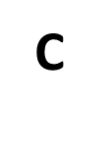
RESULTS (6/8)
Effect of AMEE on Testes tissue
Figure 9: Photomicrographs of Testes tissue show (a) CON: NR (b) BPH: Mild congestion of blood (c) FINA: NR (d) AMEE: NR

Slide 14
RESULTS (7/8)
Effect of AMEE on prostatic tissue
Figure 10: Photomicrographs of prostatic tissue show (a) CON: Normal secretion of EC (b) BPH: Proliferation of gradular EC (c) FINA: Many secretions (d) AMEE: Normal secretion of EC. EC: Epithelia cells

Slide 15
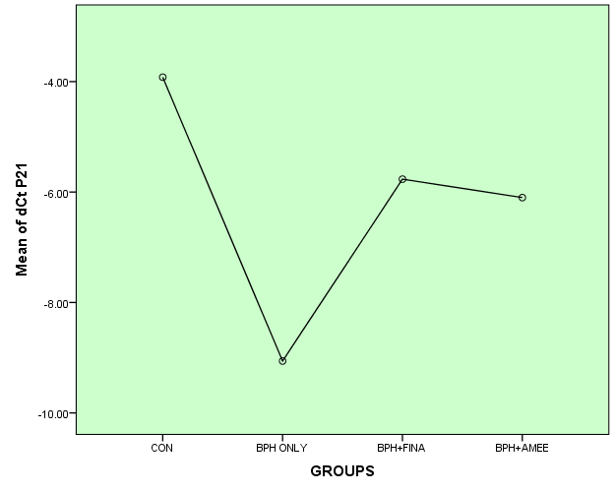
RESULTS (8/8)
Effect of AMEE on 5 α-reductase and P21 mRNA expression
Figure 11: Data as mean ± S.E.M; n=5, ª p<0.05, ^{c} p<0.01 or ^{e} p<0.001 when compared with CON, ^{b} p<0.05, ^{d} p<0.01 or ^{f} p<0.001 different from BPH

Slide 16
DISCUSSION (1/4)
A vital indicator which has been used for BPH is increased prostate weight (Pais, 2010).
The mean value of the prostate weight (40.850 ± 13.0375g) of BPH + AMEE group decreased significantly at p<0.05 and p<0.01 when compared to the mean value of the prostate weight of BPH only group (74.160 ± 44.218g).
The mean value of the prostatic index (29.60 ± 10.45) of BPH + AMEE group decreased significantly at p<0.05 and p<0.01 when compared to the mean value of the prostatic index (49.60 ± 11.45) of BPH only group.
These results indicated that BPH was induced and AMEE alleviated the prostatic enlargement induced by testosterone, similar results using other plant extracts were observed by Lee et al., (2012), Bharali et al., (2014), Mosli et al., (2015).

Slide 17
DISCUSSION (2/4)
There was a significant reduction in the level of AST (55.50 ± 4.95 U/I), ALT (39.0± 0.0 U/I), and ALP (238.45 ± 39.10 U/I) in BPH+AMEE group as compared to BPH only group.
This result showed that BPH affects liver integrity however, the administration of AMEE helped to restore or ameliorate the effects of BPH on liver biomarkers enzymes as seen above. Based on this, it can therefore be concluded that oral consumption AMEE is not toxic to the liver.

Slide 18
DISCUSSION (3/4)
Histologic analysis of the testicular tissue of the AMEE group showed optimal maturation of the germ cells with presence of spermatogonia, spermatocytes, spermatids and abundant presence of spermatozoa compared with BPH only group which showed moderate maturation of the germ cells with mild congestion of blood vessels and sloughing of germinal cells into the lumen. This indicates that BPH causes a reduction in maturation of germ cells, while AMEE was able to ameliorate the effect of BPH on germ cells maturation.
Histologic analysis of prostatic tissue of the BPH only group showed marked stratification of endothelial linings. In contrast to BPH only group, AMEE group showed slight dilation of ducts. These results suggest that AMEE was able to alleviate the effect of BPH on prostatic tissue similar to that reported by Bharali & Chetry (2014).

Slide 19
DISCUSSION (4/4)
Quantitative real-time polymerase chain reaction revealed that AMEE group (-6.10±0.14) showed increased mRNA expression of P21 compared to BPH only group (-10.70±12.56) which had a decreased mRNA expression of P21 which is similar to the findings of Mosli et al., (2015).
It also implies that AMEE has the ability to regulate cell cycle, and inhibit proliferation by blocking the cyclin dependent kinases.

Slide 20
CONCLUSION
In conclusion, oral administration of AMEE at a dose of 300mg/kg/day significantly alleviated benign prostatic hyperplasia in the testosterone induced BPH rat model.
The evidence presented here on the ethyl acetate leaf extract of A. muricata and its possible anti-BPH properties provides the basis for further studies on this plant extract.

Slide 21
REFERENCES
Anitha, B., Inamadar, C. & Ragunatha, S. (2009). Finasteride-its impact on sexual function and prostate cancer. Journal of Cutaneous and Aesthetic Surgery, 2(1): 12-16.
Avantgardeurology, (2013). Benign Prostatic Hyperplasia. Retrieved March 27, 2017 from avantgardeurology.com/details.php?id=294
Bharali, M. & Chetry, L. (2014). Aqueous Methanolic Bark Extract of Oroxylum indicum Inhibited Testosterone induced Prostate Hyperplasia in Rat. Pharmacognosy journal, 6, 3.
Chung, K., An, H., Cheon, S., Kwon, K., Lee, K. (2015). Bee venom suppresses testosterone- induced benign prostatic hyperplasia by regulating the inflammatory response and apoptosis. Experimental Biology and Medicine, 240: 1656- 1663.
Dhingra, N. & Bhagwat, D. (2011). Benign prostatic hyperplasia: An overview of existing treatments. Indian Journal of Pharmacology, 43(1): 6-12.

Slide 22
REFERENCES
Kapoor, A. (2012). Benign prostatic hyperplasia (BPH) management in the primary health care setting. The Canadian Journal of Urology, 19: 10-17.
Moghadamtousi, S., Fadaeinasab, M., Nikzad, S., Mohan, G., Ali, H. & Abdul Kadir, H. (2015). Annona muricata (Annonaceae): A Review of Its Traditional Uses, Isolated Acetogenins and Biological Activities. International Journal of Molecular Sciences, 16: 15625-15658. http://dx.doi.org/10.3390/ijms160715625
Mosli, H., Esmat, A., Atawia, R., Shoieb, S., Mosli, H. & Abdel-Naim, A. (2015). Metformin Attenuates Testosterone-Induced Prostatic Hyperplasia in Rats: A Pharmacological Perspective. Scientific reports, 5,15639.
Varien Moos. (2014). Leaves and sourpop pulp. Cancer Information and Resources. Retrieved February 7, 2017 from www.cancer.vg/en/annona-muricata-soursop

Slide 23
THANKS FOR LISTENING

