Slide 1
Haematological and Hepatic responses of the African catfish Clarias gariepinus to sublethal exposure of industrial effluents from Ologe lagoon environs, Lagos.
Adeboyejo, O. Akintade, Clarke, O. Edwin and
Whenu, O.O
Department of Fisheries, Faculty of Science, Lagos State University, Ojo-Lagos
,.

Slide 2
INTRODUCTION
Industrialization has led to huge waste generation over the decades
Water pollution
Alterations in the blood as biomarkers of exposure and the effect have been the subject of intense study over the past 20 years in toxicology.
Haematological and hepatological indices have proven extremely useful toos in the early detection of low- doses chemical effects (Vahter, 2003).
The main anthropogenic pressure on Ologe lagoon is from the adjacent Agbara industrial estate, where over 20 factories (food and beverages, pharmaceutical, breweries, metal finishing, chemical, pulp and paper industries) presently occupy the industrial area
This study determines the significance and severity of lesions observed in fish liver and. changes in the blood profile of the fish; relative to the contaminated aquatic locations of the study area.
The test species is the fingerlings and juvenies of Clarias gariepinus, was selected for use as a local sentinel species for the investigation on the basis of its market value in Nigeria.

Slide 3
METHODOLOGY
Sample Collection:
The effluents (text materials) collected from each of the three stations were mixed together at ratio 1:1. The composite mixture was analyzed for physicochemical parameter.
Fish samples, fingerlings and juveniles of Clarias gariepinus (test organism) were collected from Fisheries Hatchery/farm of the Lagos State University.
Effluents were collected from three point sources: Guinness Nigeria Ltd, Nigerian bottling companies and a confluence from Hotels (as a domestic source). See Table 1
These were identified point of effluent entry into the lagoon. The effluents samples were collected once every month.
Table 1 Map of Lagos lagoon complex inset Ologe Lagoon
Source: Adeboyejo, et al, (2011).

Slide 4
METHODOLOGY CONT.
Sublethal Toxicity:
Thirty (30) rectangular glass tanks of 50 liters capacity were constructed using glass of 5mm thickness and silicone.
600 healthy specimens of the species were obtained from Lagos State University fish farm and randomly distributed into the glass tanks.
Twenty (20) specimens were randomly distributed into each tank and exposed to five toxicant concentrations and a control.
Five dilutions of the toxicants were made in geometric progression: 0% (Control), 5%, 15%, 25%, and 35% (Reish and Oshida, 1987 & Vincent-Akpu 2001).
Blood samples obtained from live specimens for haematological analyses.
Water quality parameters are Temperature, Conductivity, pH and Dissolved oxygen (DO), were monitored weekly in replicates using standard methods (APHA, 1998).

Slide 5
METHODOLOGY CONT.
Haematological Examination:
Blood was obtained from two fishes from each treatment by cardiac puncture.
The blood was drawn out using insulin syringe and needle rinsed with Ethylene Diamine Terra - Acetic Acid Disodium salt (EDTA).
The blood gotten was used for estimation of the red and white blood counts(RBC, WBC), differential counts (lymphocytes and Neutrophil) and Haematocrit. (packed cell volume PCV)
Hepatological Examination:
Fishes were weighed, total and standard lengths were recorded, and liver were excised.
These were fixed with 10% formalin in phosphate buffer for 36 hours.
Fixed specimen were dehydrated in graded levels of ethanol and transferred into xylene for five minutes.
Liver samples were then embedded in paraffin and histological sectioning subsequently done at 5 µm using a TBS® CUTTM rotary microtome.
Sections were mounted on glass slides and air-dried prior to staining, and then viewed under a light microscope,
This was done at the pathological Department of the University of Ibadan.

Slide 6
RESULTS
The summary of data on the water quality parameters of the industrial effluent treated tanks with sub-lethal concentrations for Clarias gariepinus fingerlings and juveniles are presented in Tables bellow.
Table 1: Water quality parameters of medium during Sub-lethal bioassay studies (12 weeks) for C. gariepinus fingerlings
Note: Values in each column with similar superscripts are not significantly different (at P>0.05)
Concentration (%) | pH | Temperature (⁰C) | Dissolved Oxygen (mg/l) | Conductivity (ppm)
0 | 8.06±0.21ª | 26.38±2.28 ª | 4.43±1.24 ª | 486±45.81 ª
5 | 7.81±0.25 ª | 26.19±2.26 ª | 3.32±1.21 ^{b} | 408±42.28 ^{b}
15 | 7.83±0.23 ª | 26.16±2.19 ª | 2.91±0.99 ^{b} | 412±37.74 ^{b}
25 | 7.89±0.19 ª | 26.12±2.18 ª | 2.11±0.86 ^{c} | 426±40.99 ^{b}
35 | 7.81±0.25 ª | 26.07±2.14 ª | 1.97±0.66 ^{c} | 384±32.82 ^{c}

Slide 7
Table 2: Water quality parameters of medium during sub-lethal bioassay studies for C. gariepinus juveniles
Concentration (%) | pH | Temperature ( ºC) | Dissolved Oxygen (mg/l) | Conductivity (ppm)
0 | 7.86±0.25ª | 25.03±0.62 ª | 4.72±1.75 ª | 390.74±12.00 ª
5 | 7.81±0.26 ª | 25.05±0.73 ª | 4.70±1.12 ª | 402.74±30.92 ª
15 | 7.77±0.23 ª | 25.04±0.61 ª | 3.06±1.01 ^{b} | 362.89±13.27 ª
25 | 7.25±1.69 ª | 25.07±0.74 ª | 2.72±0.78 ^{c} | 385.00±20.50 ª
35 | 7.69±0.78 ª | 25.05±0.66 ª | 2.89±2.17 ^{c} | 339.78±10.47 ª

Slide 8
Haematology of Clarias gariepinus After Sub –Lethal Exposure
Table 3: Haematological changes of C. gariepinus exposed to various concentration of industrial effluent for 12 weeks
Note: The dissimilar letters as superscripts indicate that the mean values at the different concentrations differ significantly (P<0.05).PCV = Packed Cell Volume (%), RBC = Red Blood Cell (RBC/mm³), and WBC = white blood cells (mm⁻³).
Stage | Conc. | PCV (%) | RBC/mm³ | WBC/mm-³ | Differential WBC Count (%)
 |  |  |  |  | Neutrophil | Lymphocyte
fingerlings | 0 | 27.7±0.6ª | 9.1±0.1ª | 7100±100.0ª | 61.0±1.0ª | 34.0±4.6 ª
 | 5 | 19.0±1.0 ^{b} | 6.4±0.3 ^{b} | 6333±115.5 ^{b} | 50.7±2.3 ^{b} | 36.3±3.5 ª
 | 15 | 17.3±1.2 ^{b} | 5.7±0.4 ^{c} | 8133±208.2 ^{c} | 25.0±4.0 ^{c} | 63.0±1.0 ^{b}
 | 25 | 14.7±3.1 ^{c} | 5.0±1.0 ^{c} | 9133±115.5 ^{d} | 32.7±3.1 ^{c} | 55.7±1.5 ^{b}
 | 35 | 13.0±1.7 ^{c} | 4.7±0.6 ^{d} | 10800±200.0 e | 26.7±1.5 ^{c} | 63.0±1.90 ^{b}
juveniles | 0 | 92.97±1.66ª | 9.4±0.4 | 6300.0±10.0 ª | 175.0±5.0 ª | 88.4±2.1 ª
 | 5 | 115.43±3.4 ^{b} | 7.8±0.4 | 12533.3±39.1 ^{b} | 102.9±20.5 ^{b} | 92.43±1.4 ^{b}
 | 15 | 108.73±8.2 ^{b} | 8.07±1.4 | 23800.0±18.5 ^{b} | 54.33±0.31 ^{c} | 94.63±2.2 ^{b}
 | 25 | 115.9±0.9 ^{b} | 7.5±0.15 | 82000.0±30.0 ^{c} | 96.9±1.85 ^{d} | 96.7±1.5 ^{b}
 | 35 | 102.07±2.0 ^{b} | 7.5±1.23 | 97330.3±50.2 ^{d} | 64.97±3.0e | 96.2±1.1 ^{b}

Slide 9
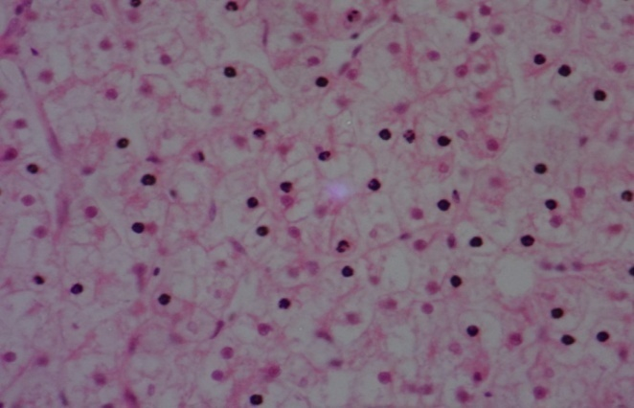
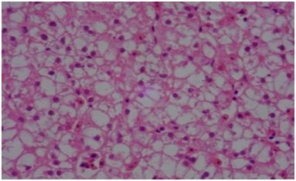
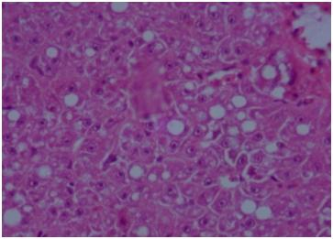
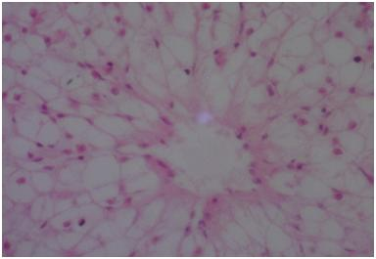
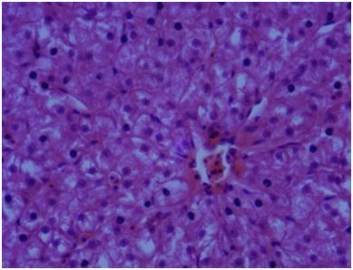
Histology of liver of Clarias gariepinus fingerlings exposed to Sublethal Concentration of industrial effluents for 12 weeks
0%
5%
15%
MV
B N
Showing normal liver cells with no lesions; hepatic cord is normal
Showing that nucleus are becoming disoriented and fusing together to form bi-nucleated (BN) cells (showing indications slight toxic condition).
At 15% E.C, there was progressive increase in vacoulation and micro-vesicle formation (MV). Onset of fatty degeneration and the cell are becoming more damaged.
25%
35%
The photomicrograph showed total destruction of the hepatic cord and aggregation of cell towards severely damaged area (arrow).
The photomicrograph showed vacuolar degeneration and severe disruption of the hepatic cord architecture (see arrows), fusion of the hepatic cord. Adaptive responses are observed.

Slide 10
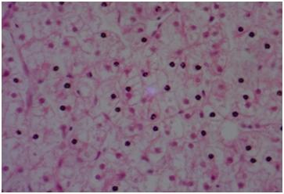
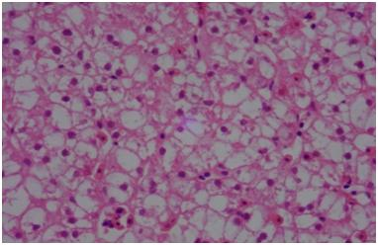
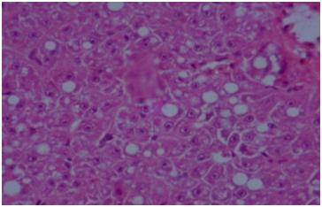
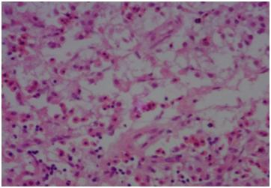
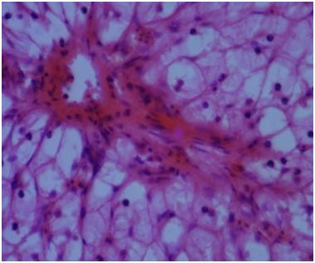
Histology of liver of Clarias gariepinus Juveniles exposed to Sublethal Concentration of industrial effluents for 12 weeks
0%
5%
15%
At 0% Effluent Concentration, showing normal liver cells with no lesions; hepatic cord is normal.
The nuclear are becoming disoriented and fusing together to form bi-nucleated (BN) cells (showing slight toxic condition).
There is progressive increases in vacoulation and micro-vesicle (MV)formation.
25%
35%
There is total destruction of the hepatic parenchyma and necrosis.
There is total destruction of the hepatic parenchyma, the organ is becoming eosinophilic, haemorrhage (bleeding) and necrosis of the areas shown by the arrows.

Slide 11
DISCUSSION AND CONCUSION
Water Quality Responses
Mean temperature range obtained are within range reported for tropical aquatic bodies.
Minimum temperature values were observed at 0% effluent (control),
while maximum temp. was recorded at 25% effluent.
Mean Dissolved oxygen(mg/l) value in the control tank (0%) was 4.72±1.75, but dropped drastically in the next level of treatment (5%) and continue to drop steadily to 2.89±2.17 in 35%.
This suggest that the effluent is mainly an oxygen limiting effluent, which has negative impact on the health and physiology of the fish.
Haematological Responses
Alterations in the blood as biomarkers of exposure to toxicants have been the subject of intense study over the past 20 years in toxicology.
This study has delineated a number of chemical- specific responses, this is useful in early detection of low- doses chemical effects.
Several workers have investigated the toxicity and heamatological changes in fish (Omoregie et al., 1990; Chindah et al., 2005, Akinrotimi et al., 2007), and the data is very important in toxicological research and environmental monitoring in predicting fish health conditions (Akinrotimi et al., 2009).
The result of hematological parameters in the study showed significant differences between control tanks and the treatments tanks.

Slide 12
Haematological Responses Cont.
Anaemic condition of Clarias gariepinus exposed to effluent is observed with reduction in the red blood cells (RBC) with increase in effluent concentration.
There was also decrease in packed cell volume (PCV) during the trials which results in the low level of haemoglobin (Hb) in the test organisms.
The above responses maybe due to Inhibition of erythropoiesis due to effluent toxicity by its action on erythrocytes cell membrane (erythropoiesis is the formation and production of the red blood cells resulting in the release of matured red blood cells erythrocytes into circulation).
Allin and Wilson (2000) and Chrowdhury et al. (2004) have made similar report.
It might also be due to accumulation of effluents in the gill region which may have damage the structure of the gill resulting in haemolysis
(rupturing (lysis) of the red bood cells and the release of their content (cytoplasm) into surrounding fluid ).
While this investigation reports that there was significant (p<0.05) decrease in PCV, RBC, neutrophil. There was however increase in the white blood cells and the lymphocytes.
This reverse response by the WBC and Neutrophils indicate some defensive action to protect the fish from further severe injuries.
Witeska, (2004) opined that increase in WBC in stressed animals indicates a protective response to stress.
The increase in WBC count during this study may be due to extended toxic effect of the effluent on the liver tissues, which are the primary sites of haematopoiesis, provoking immunosuppression.

Slide 13
Hepatological Responses
The histological examination revealed several lesions as expressed by the livers.
The histopathology of liver showed that the control (0% effluent) had normal liver cells.
Observation in the treatment tank showed: vacoulation, destruction of the hepatic parenchyma, tissue becoming eosinophilic (i.e. tending towards Carcinogenicity) and severe disruption of the hepatic cord architecture.
Also, formation of progressive increases in micro-vesicle (MV).
There is total destruction of the hepatic parenchyma, haemorrhage and necrosis.
The study has shown that industrial effluents from the study area affected the fish health status and impaired vital processes with long exposure, even at lower concentrations (Sublethal).

Slide 14
THANK YOU FOR LISTENING.

