Slide 1
Mosquitocidal Potentials of Hyptis suaveolens against Anopheles gambiae
Ajelara¹, K.O; Denloye¹, A. A. B; Alafia¹, A.O & Awusinu¹, K

Slide 2
Introduction
Mosquito has been described as the most dangerous animal in the world.
Anopheles is the World’s most important malaria vector because it is highly have long life span, occurs in high population density, breeding sites are hard to target for control.
It transmits malaria parasite with great detriment to man; other diseases vectored by mosquitoes includes: filariasis, dengue, yellow fever, encephalities and so on.
Malaria is the world’s most important and dreadful tropical disease.
It causes more than 600,000 deaths annually and puts half of the world's population at risk of the disease and death.
It is found in most African countries South of Sahara, adults feeds on host’s blood.
Larvae can be found in any water receptacles pools, puddles, hoof prints, rice fields and some water receptacles

Slide 3
Aim of the study
To determine the insecticidal pontentials of Hyptis suaveolens on Anopheles gambiae
Objectives
I. Determine toxicity of essential oil of Hyptis suaveolens on Anopheles gambiae larvae.
II. Determine knockdown effect of dried powdered leaf extract as improvised coils on adult Anopheles gambiae.
III. Determine the constituents of Hyptis suaveolens essential oil using Gas chromatography - mass spectroscopy (GC-MS) analysis

Slide 4
Materials and Methods
Plant materials and Test Insects
Powder and extracts
Essential oils
Test Insects
Toxicity of essential oil extract of Hyptis suaovelens on An. gambiae larvae
Toxicity of powder extract on adult An. gambiae

Slide 5
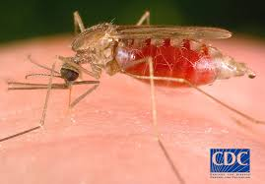
Plate 1: Female Anopheles mosquito
Source: www.cdc

Slide 6
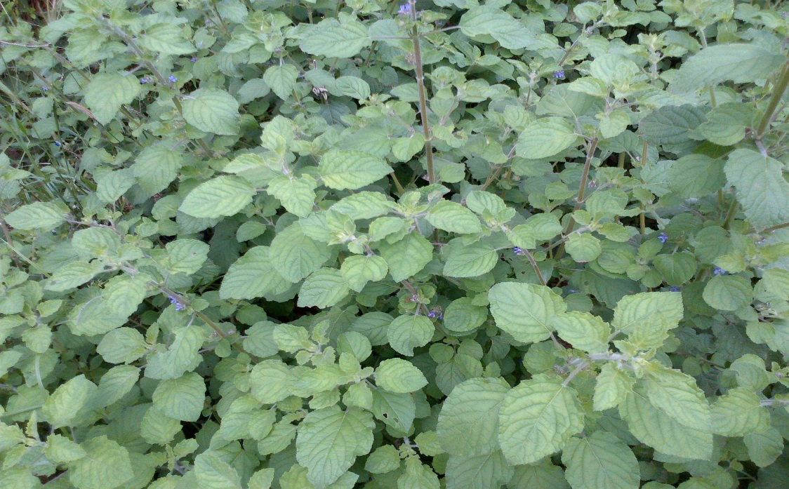
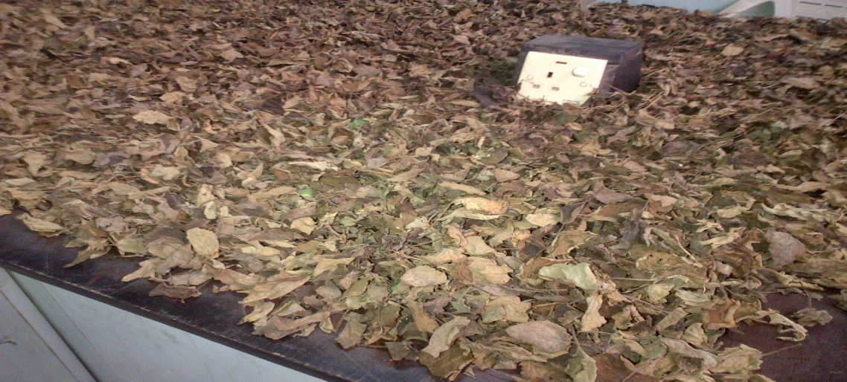
Materials and Methods
Plates 1 and 2 fresh and dried Hyptis suaovenlens

Slide 7
Results

Slide 8
Table 1: Toxicity effect of essential oil of Hyptis suaveolens against larvae of Anopheles gambiae
Concentration | 24hr | 48hr | 72hr | 96hr | Total mortality | Mean | %
control | 0 | 0 | 0 | 0 | 0 | 0 | 0
50ppm | 0 | 0 | 0 | 0 | 0 | 0 | 0
100ppm | 5 | 5 | 10 | 11 | 11 | 0.55 | 55
150ppm | 8 | 13 | 13 | 14 | 14 | 0.07 | 70
200ppm | 4 | 8 | 13 | 15 | 15 | 0.75 | 75
250ppm | 9 | 11 | 14 | 14 | 14 | 0.70 | 70
300ppm | 6 | 7 | 11 | 12 | 12 | 0.6 | 60
350ppm | 7 | 10 | 11 | 12 | 12 | 0.6 | 60
400ppm | 7 | 9 | 13 | 17 | 17 | 0.85 | 85
450ppm | 4 | 5 | 11 | 16 | 16 | 0.80 | 80
500ppm | 6 | 8 | 12 | 16 | 16 | 0.80 | 80

Slide 9
Table 2: Effect of essential oil of Hyptis suaveolens against larval of Anopheles gambiae.
Insecticide | Time of exposure (hr) | LC_{50PPM} | 95% Confidence limits |  |  | LC_{99PPM} | 95% Confidence limits |  | Df | Chi-square
 |  |  | Lower | Upper |  |  | Lower | Upper
Essential oil | 24hr | 1448.27 | 565.09 |  | 1576052992.00 | 1939868.00 | 27982.66 | 100000002.00 | 3 | 3.16
Essential oil | 48hr | 551.47 | - |  | - | 361940.47 | - | - | 3 | 6.87
Essential oil | 72hr | 187.43 | 16.608 |  | 454.182 | 20582.38 | 2299.95 | 100000002.00 | 3 | 1.23
Essential oil | 96hr | 142.10 | 57.280 |  | 213.630 | 2776.83 | 1008.997 | 14628.00 | 3 | 1.23

Slide 10
Figure 1: Effect of Hyptis suaveolens essential oil against larvae of Anopheles gambiae.

Slide 11
Table 3: Toxicity of Coil of Hyptis suaveolens to adult Anopheles gambiae
Concentration (%) | Total mortality | Mean mortality | % mortality | % protection
Control | 0 | 0 | 0 | 0
20 | 5 | 0.25 | 25 | 25
40 | 7 | 0.35 | 35 | 35
60 | 8 | 0.40 | 40 | 40
80 | 8 | 0.40 | 40 | 40
100 | 10 | 0.50 | 50 | 50

Slide 12
Table 4: Effect of insecticide stick of Hyptis suaveolen against adult Anopheles gambiae
Insecticide |  | LC₅₀ (ppm) | 95% confidence limits |  | LC₉₉ (ppm) | 95% confidence Limits |  | df | Chi-square
 |  |  | Lower | Upper |  | Lower | Upper
Coil | 30minutes | 250.84 | _ | _ | _ | _ | _ | 3 | 7.575
Coil | 60minutes | 128.57 | ­­_ | _ | _ | _ | _ | 3 | 7.815
Coil | 90minutes | 20.75 | 0.188 | 35.605 | 373.93 | 133.842 | 53689564.00 | 3 | 7.815
Coil | 120minutes | 41.874 | 5.589 | 75.722 | 988.004 | 237.722 | 1584631513088.00 | 3 | 7.815

Slide 13
Figure 2: Effect of insecticidal stick of Hyptis suaveolens against adult Anopheles gambiae.

Slide 14
Table 5: GCMS analysis of Hytis suaveolesis
S/N | COMPOUNDS | PERCENTAGES
1. | Oxime-,methoxy-phenyl | 2.870%
2. | Alpha.-cubebene | 3.215%
3. | Caryophllene | 15.102%
4. | Santolinatrienee | 9.201%
5. | Bicyclo(6.1.0)nonane,9-(1-methyle | 0.907%
6. | Bergamotol,Z-alpha-trans- | 4.894%
7. | 3.beta.,17.dihydroxyestr-4-e | 3.344%
8. | Hydrophenantherene | 10.658%
9. | Phenanthrene | 27.094%
10. | 4”a-Methyl-8”-methylidene-decahy | 5.317%
11. | Diazoprogesterone | 2.878%
12. | Caryophyllene | 8.878%
13. | Heptadeca-1,9-dien-4,6-diyn | 5.643%

Slide 15
Discussion
The result showed that the test plant is actually an effective biopesticide.
The longer the exposure, the higher the toxicity.
The result agrees with previous works

Slide 16
Conclusion
Phytochemicals may serve as suitable alternative to synthetic insecticide in future as they are relatively safe, inexpensive and are readily available and sustainable means of vector control.

Slide 17
Recommendation
Further studies be carry out in future to determine the constituent that possess mosquitocidal potentials and find a way to isolate the pure compounds and expose them to mosquitoes.
Further studies on the chemical analysis of the plant oil extracts, insecticidal activities and its mode of action.
Propagation with a view to preventing its extinction, if it will be considered for its insecticidal properties.

Slide 18
Acknowledgements
Central Research Laboratory, University of Lagos, Akoka, Lagos
Department of Disease surveillance and Notification, Environmental Services and Primary Health care, Badagry Local Government.
Respondents from Badagry Areas of Lagos State.
Volunteers/Students that gave blood meal to test mosquitoes

Slide 19
THANKS FOR LISTENING

