Slide 1
FUNCTIONAL PROPERTIES OF ACID-THINNED SOURSOP STARCH (Annona muricata) .
by
Oderinde, A. A., Oguntade, B. K., Adebona F. O., Jimoh H. A.
The Federal Polytechnic, Ilaro, Ogun State, Nigeria

Slide 2
PRESENTATION OUTLINE

Slide 3
INTRODUCTION
Background information
Statement of problem
Significance of the research
Aim and Objectives of the research
Scope of the study

Slide 4
PRESENTATION OUTLINE Cont’d
MATERIALS AND METHODS
Sample Collection and Treatment
Procedures
RESULTS AND DISCUSSIONS
CONCLUSIONS
SELECTED REFERENCES

Slide 5
INTRODUCTION

Slide 6
Background Information
Starch abundance and versatility.
STARCH USE
FOOD
NON-FOOD
Canning
Frozen Foods
Confectionary
Dairy products
Textile
Paper
Cosmetics/Pharm
Adhesives

Slide 7
The problem
Limitations in native form
Over-dependence on conventional sources
Significance of this work
Overcoming native starch limitations by modification
Breaking new grounds to augment existing ones

Slide 8
PHYSICAL
CHEMICAL
BIOTECH
PHYSICAL
CHEMICAL
BIOTECH
Use of temperature/moisture combinations, pressure, shear, irradiation and mechanical attrition to alter the physical size of starch granules
Introducing desirable alterations in the starch structure by glycosidic bond cleavage, forming new functional groups, substitution of free available hydroxyl groups or bridging of molecular chains
STARCH MODIFICATION
Biotechnological modifications are mostly achieved during the growth of the plant to produce starches with different amylose/amylopectin levels, phosphorus contents, etc or by enzymatic activities of single or multiple enzymes

Slide 9
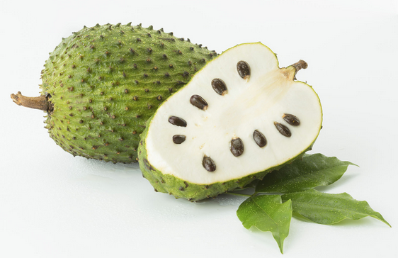
Unconventional Starch source
Soursop (Annona muricata)

Slide 10
AIM OF STUDY

Slide 11
The aim of this work is to isolate starch from a lesser-known source and enhance its properties through modification.

Slide 12
OBJECTIVES

Slide 13
The objectives of this work are to:
Isolate starch from soursop mesocarp;
Modify the isolated starch by acid-thinning;
Determine the physicochemical and functional
properties of native and modified soursop starches.

Slide 14
MATERIALS AND METHODS

Slide 15
Sample Collection and Treatment
Isolation and Purification of Starches (Lawal, 2004)

Slide 16
Functional properties
Swelling power and solubility
Oil and water absorption capacities
Gelation
Bulk and tapped densities
Light transmittance
Pasting properties

Slide 17
STATISTICAL ANALYSIS
Analyses were done in triplicate. Analysis of variance was performed to calculate significant differences in treatment means and LSD (P < 0.05) was used to separate means (SigmaPlot 12.0).

Slide 18
RESULTS AND DISCUSSIONS

Slide 25
Table 1. Pasting Properties of Native and Acid-Thinned Soursop Starches.
Sample | Peak Viscosity | Trough | Breakdown | Final Viscosity | Set back | Peak time | Pasting temperature
Native | 6992.00 | 2944.00 | 4048.00 | 4048.00 | 1120.00 | 6.93 | 84.10
Acid-Thinned | 395.50 | 20.50 | 375.00 | 59.50 | 39.00 | 4.44 | 82.85

Slide 26
Table 3. Gelation properties of Native and Acid-Thinned soursop starches.
Concentration (%w/v) | Starch Sample
 | Native | Acid Thinned
2 | -Liquid | -Liquid
4 | -Liquid | -Liquid
6 | -Liquid | -Viscous
8 | -Viscous | +Gel
10 | -Viscous | +Gel
12 | +Gel | +Gel
14 | +Gel | +Firm gel
LGCª | 12 | 8

Slide 27
CONCLUSIONS

Slide 28
Acid-thinning increased soursop swelling capacity and solubility with increased temperature and pH;
Acid-thinning increased oil absorption capacity of soursop starch;

Slide 29
Gelation property of the starch also improved
The pasting temperature of modified starch was reduced.

Slide 30
Selected References
Karmakar, R., Ban, D., and Ghosh, U., (2014). Comparative study of native and modified starches isolated from conventional and non-conventional sources. Journal of international food research, 21(2), 597-602.
Kolawole, S., Igwemmar, N., and Bello, H., (2013). Comparison of the physiochemical properties of starch from Ginger (Zingiber officinale) and Maize (Zea mays). Journal of International science and research, 2, 2319-7064.
Lawal, O. S., (2004). Composition, physicochemical properties and retrogradation characteristics of native, oxidised, acetylated and acid-thinned new cocoyam (Xanthosoma sagittifolium) starch. Food Chemistry 87, 205–218.
Nwokocha, L., and Williams, P., (2009). New Starches: Physiochemical properties of sweetsop (Annona squamosal) and soursop ( Annona muricata) starches, Carbohydrate polymer, 78(3), 462-468.
Wang, L., & Wang, Y. (2001). Structures and physicochemical properties of acid- thinned corn, potato and rice starches. Starch, 53, 570–576.
Zhang, H., Zhou, X., He, J., Wang, T., Luo, X., Wang, R., … Chen, Z., (2017). Impact of amylosucrase modification on the structural and physiochemical properties of native and acid-thinned waxy corn starch. Journal of food chemistry, 220, 413- 419.

Slide 31
THANK YOU FOR LISTENING

