Slide 1
THE STATE OF ZIKA VIRUS IN NIGERIA: A REVIEW

Slide 2
SUMMARY OF PRESENTATION
HISTORICAL BACKGROUND
VIROLOGY OF ZIKA VIRUS
MODE OF SPREAD/EPIDEMIOLOGY
PATHOGENESIS
CLINICAL MANIFESTATION/SYMPTOMS
DIAGNOSIS
PREVENTION/CONTROL
CONCLUSION
REFERENCES

Slide 3
HISTORICAL BACKGROUND
Origin of Zika virus: Zika forest in Uganda
First reported and isolated from sentinel monkey in 1947 according to Dick et al., 1952
Dick et al in 1952 reported the isolation of Zika virus from Aedes (stegomyia) africanus
1954 in Nigeria, the first human case was reported by MacNamara et al.
First major outbreak in 2007 in Micronesia (about 73% of their population infected)
Available at:
https://healng.com/i/2016-02-03-Zika-virus-birthplace-Ugandas-Zika-Forest-CNN-com and http://www.newsweek.com/could-east-africans-be-immune-zika-425230 ( assessed on October 6th, 2017)

Slide 4
HISTORICAL BACKGROUND continues…
At Okwoga in Benue State, Monath et al., 1970 in a study stated that antibodies for Zika virus were found most frequently in the samples analysed.
He concluded that dengue and Zika viruses appeared to be most frequently responsible for infections prior to the yellow fever epidemic in Nigeria.
He discovered that of 51 persons with prior immunity infected with fever, 78% had Zika antibodies
In Jos Plataeu, Carey et al., 1972 reported that 20 out of 24 sera of his samples inhibited Zika virus antigen in a 1:80 serum dilution.

Slide 5
HISTORICAL BACKGROUND continues…
5 years later, Fagbami et al, reported two Zika virus isolations from humans who were having a mild febrile illness in a research carried out in Oyo State
He noted that 31% of the samples (189) tested positive of Zika virus
49 persons (38%) of those with positive haemagglutination-inhibition test have Zika N-antibodies in a neutralization test
Adekolu-John et al., 1983 reported that 56% of 267 samples showed prevalence of antibodies to individual Zika virus antigen in a research carried out at Kainji Lake Basin
Three ZikV lineages: Eastern African lineage, West African lineage and Asian lineage (Lanciotti et al., 2007).

Slide 6
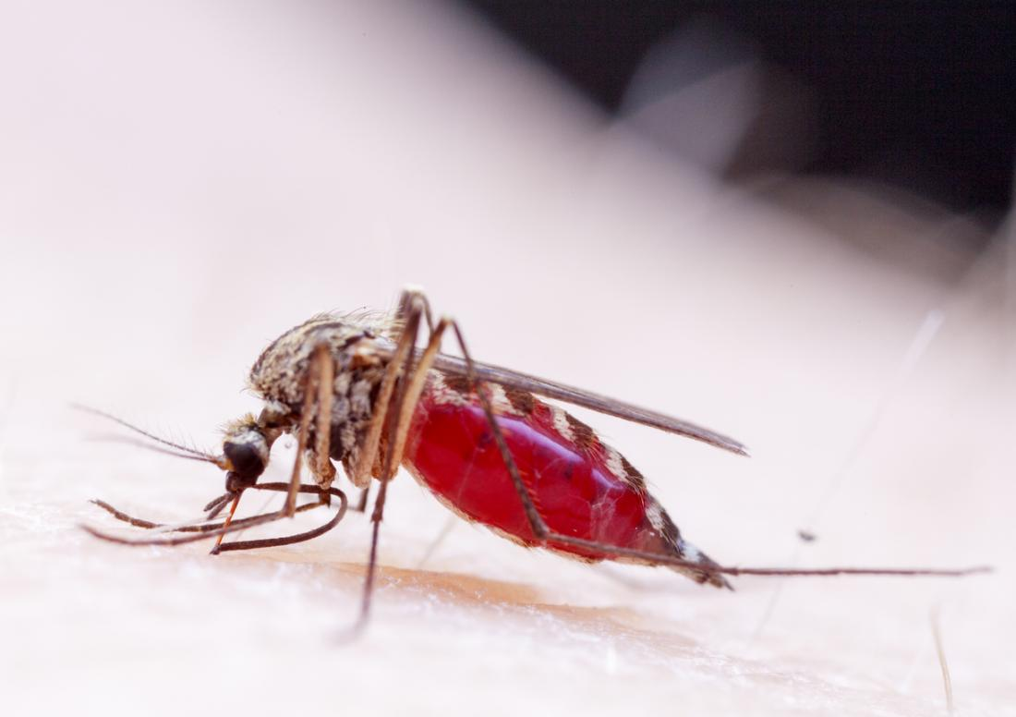
VIROLOGY OF ZIKA VIRUS
It is an Arbo virus.
Family - flaviviridae and Genus - flavivirus (Malone et al., 2016).
Non-segmented, enveloped and icosahedral in shape
Positive-sense single stranded virus (+ssRNA)
Genome length of approximately 11000 Kb encoding 3,419 amino acids (Kuno et al., 2007)
Two flanking non-coding regions (5’ and 3’ NCR) and a single long open reading frame (ORF)

Slide 7
VIROLOGY OF ZIKA VIRUS continues…
VIRAL PROTEINS
3 Structural proteins
- Precusor of Membrane (prM)
- Capsid (C)
- Envelope (E)
7 Non-structural proteins
- NS1 ( subverts immune system)
- NS 2a ( inhibits interferon responses)
- NS 2b ( viral protein cleavage)
- NS 3 ( viral replication)
- NS 4a ( viral replication)
- NS 4b ( suppresses host Rnase and
interferon)
- NS 5 (carries the enzyme RNA
dependent RNA polymerase)
Available at: http://viralzone.expasy.org/6756 ( assessed on October 6th, 2017)

Slide 8
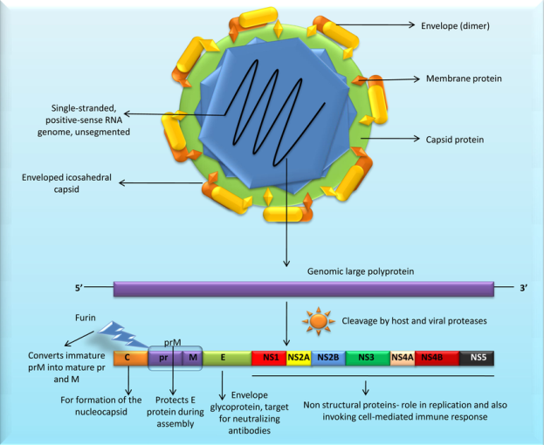
FIG 1: Structure of Zika virus and its genome
( Raj et al., 2017)
VIROLOGY continues…

Slide 9

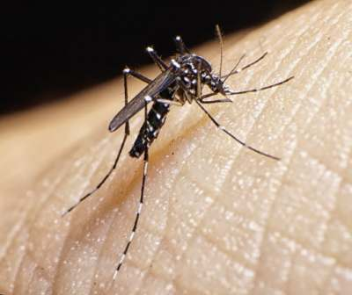
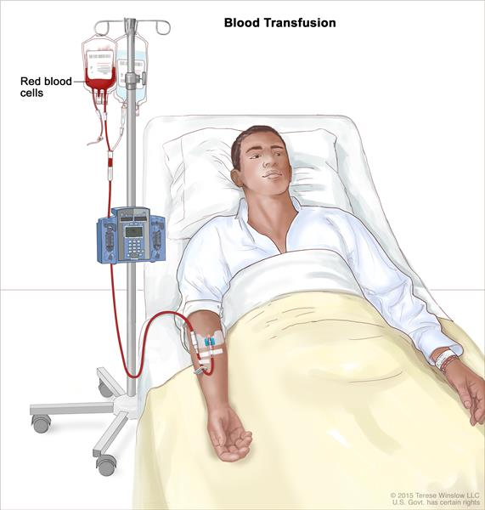
MODE OF SPREAD/EPIDEMIOLOGY
Through vector (Aedes spp of mosquitoes)
Intrauterine Mother-to-child (Petersen et al., 2016)
Blood transfusion (Vasquez et al., 2016)
Sexual contact (Oster et al., 2016)

Slide 10
2007: First major outbreak in Pacific Island of Yap, Federated State of Micronesia with prevalence rate of 73%
2013-2015: Outbreaks in French Polynesia, Eastern Islands, The Cook Island, New Caledonia resulting in several confirmed cases.
Globally, over 80 nations have reported cases of Zika virus infection
500,000-1.5 million people are estimated to have been infected in Brazil alone between 2015 and 2016.
Thus far, much research has not been carried out in Africa including Nigeria
MODE OF SPREAD/EPIDEMIOLOGY continues…

Slide 11
MODE OF SPREAD/EPIDEMIOLOGY continues…
In Africa, only about 11 countries have reported cases of Zika virus
14 strains have been sequenced and characterized in Africa thus far.
In 1968, a strain (IBH30656) was isolated in Nigeria and later sequenced.

Slide 12
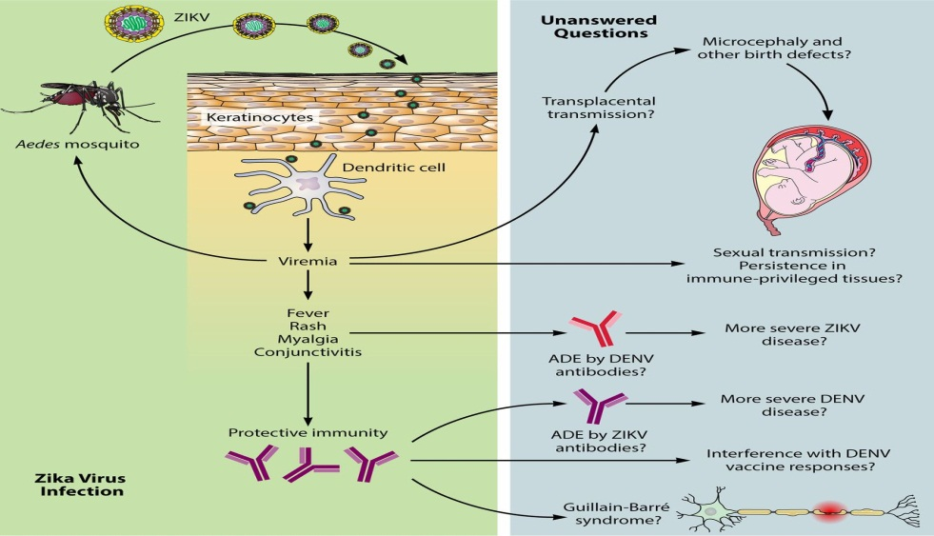
PATHOGENESIS
There is no clear cut pathogenic pathway yet.
Currently it is assumed to emulate other flaviviruses.
Virus replicates in mosquitos’ mid-gut epithelial cells
Inoculation of the virus into humans at mosquito bite
Virus enters human skin epithelial cells
It is hypothesized to infect epidermal keratinocytes
Then, spreads to lymphnodes and blood stream (Musso et al., 2014)
Pathogenesis of Zika virus
Available at: http://jvi.asm.org/content/90/10/4864/F2.expansion.html (assessed on 7th of October, 2017)

Slide 13
Symptoms include:
- headache
- conjuctivitis
- asthenia
- maculopapular rash
- pruritis
- myalgia
- fever
- arthralgia
Complications include:
- Hearing loss
- Microcephaly
- Guillain-Barre syndrome
- Ocular malformations
- Brain damage
- Neurological malformation
- Miscarriages
CLINICAL MANIFESTATIONS/SYMPTOMS
Incubation period is approximately 3-12 days.
About 80% of infections do not present tangible signs and symptoms (Duffy et al., 2009)
Symptoms are majorly similar to those of dengue and chikungunya viral infections.
They are typically mild and self-limiting

Slide 14
CLINICAL MANIFESTATION/SYMPTOMS CONTINUES…
Table 1: Case of microcephaly and deaths associated to Zika viral infection in some American countries
S/N | Year | Country | Number of cases of microcephaly reported | Number of deaths | Reference
 | 28/11/2015 | Brazil | not reported | 4 | WHO, 2016
1 | 30/12/15 | Brazil | 2975 | not reported
2 | 21/1/16 | Brazil | 3893 | 49
3 | 29/1/16 | Suriname | 1107 | not reported
4 | 1/2/2016 | Cabo Verde | 7081 | not reported

Slide 15
DIAGNOSIS
ZIKV RNA can be detected in serum, urine, saliva, semen of an infected person.
Three basic methods that are used for diagnosis are:
- Molecular using RT-PCR (Real Time and conventional)
- Serological:
ELISA (IgM and IgG)
PRNT
- Isolation using cell lines

Slide 16
PREVENTION AND CONTROL
No vaccine yet but researches are on going in the development of vaccines
No specific medications yet
Management of cases
CONTROL MEASURES
Pregnant women should avoid endemic areas
Keeping of good environmental hygiene
Avoid exposure to mosquito bite.
Use condom

Slide 17

CONCLUSION
Where are we now in Nigeria
What is the likely prevalence of Zika virus in Nigeria
What are the strain(s) currently present in the country
What next
17 of 24

Slide 18
REFERENCES
Adekolu-John EO, Fagbami AH. Arthropod-borne virus antibodies in sera of residents of Kainji Lake Basin, Nigeria 1980. Trans R Soc Trop Med Hyg 1983;77:149–51. doi:10.1016/0035-9203(83)90053-6Abstract/FREE Full TextGoogle Scholar
Carey DE, Kemp GE, Troup JM, et al. Epidemiological aspects of the 1969 yellow fever epidemic in Nigeria. Bull World Health Organ 1972;46:645–51. PubMedWeb of ScienceGoogle Scholar
Chambers TJ, Hahn CS, Galler R, Rice CM (1990) Flavivirus genome organization, expression, and replication. Annu Rev Microbiol 44: 649–688 doi:10.1146/annurev.mi.44.100190.003245 PubMed/NCBI.
Duffy MR, Chen TH, Hancock WT, Powers AM, Kool JL, Lanciotti RS, et al. Zika virus outbreak on Yap Island, Federated States of Micronesia. N Engl J Med. 2009. June 11;360(24):2536–43. 10.1056/NEJMoa0805715 [PubMed] [Cross Ref]

Slide 19
REFERENCES continues…
Fagbami AH. Zika virus infections in Nigeria: virological and seroepidemiological investigations in Oyo State. J Hyg (Lond). 1979;83(2):213-9. Epub 1979/10/01.
Kuno G, Chang GJ. Full-length sequencing and genomic characterization of Bagaza, Kedougou, and Zika viruses. Arch Virol. 2007;152:687–96. 10.1007/s00705-006-0903-z [PubMed] [Cross Ref].
Lanciotti RS, Kosoy OL, Laven JJ, Velez JO, Lambert AJ, et al. Genetic and serologic properties of Zika virus associated with an epidemic, Yap State, Micronesia, 2007. Emerg Infect Dis. 2008;14:1232–1239. [PMC free article] [PubMed].
Macnamara FN. Zika virus: a report on three cases of human infection during an epidemic of jaundice in Nigeria. Trans R Soc Trop Med Hyg. 1954;48:139–145. [PubMed].

Slide 20
REFERENCES continues…
Malone, Robert W.; Homan, Jane; Callahan, and Michael V. (2 March 2016). "Zika Virus: Medical Countermeasure Development Challenges". PLOS Neglected Tropical Diseases. 10 (3): ISSN 1935-2735.
Monath TP, Wilson DC, Casals J. The 1970 yellow fever epidemic in Okwoga District, Benue Plateau State, Nigeria: (3) serological responses in persons with and without pre-existing heterologous group B immunity. Bull World Health Organ 1973;49:235–44. PubMedWeb of ScienceGoogle Scholar
Musso, D.; Nilles, E. J.; and Cao-Lormeau, V.-M. (2014). "Rapid spread of emerging Zika virus in the Pacific area". Clinical Microbiology and Infection. 20 (10): O595–6.
World Health Organization, avenue Appia 20, 1211 Geneva 27, Switzerland. Zika: the origin and spread of a mosquito-borne virus. (Submitted: 09 February 2016 – Published online: 09 February 2016.) Bulletin of the World Health Organization 2016. doi: http://dx.doi.org/10.2471/BLT.16.171082

Slide 21
REFERENCES continues…
Petersen, Emily E. et al.,(2016). "Update: Interim Guidance for Preconception Counseling and Prevention of Sexual Transmission of Zika Virus for Persons with Possible Zika Virus Exposure — United States, September 2016". MMWR. Morbidity and Mortality Weekly Report. 65 (39): 1077–1081.
Vasquez, Amber M.; Sapiano, Mathew R.P.;and Basavaraju, Sridhar V. (2016). "Survey of Blood Collection Centers and Implementation of Guidance for Prevention of Transfusion- Transmitted Zika Virus Infection — Puerto Rico, 2016“
Oster, Alexandra M. et al.,(2016) "Update: Interim Guidance for Prevention of Sexual Transmission of Zika Virus — United States, 2016". MMWR. Morbidity and Mortality Weekly Report. 65 (12): 323–325.

Slide 22
REFERENCES continues…
Raj Kumar Singh, Kuldeep Dhama, Yashpal Singh Malik, Muthannan Andavar Ramakrishnan, Kumaragurubaran Karthik, Ruchi Tiwari, Sharad Saurabh, Swati Sachan & Sunil Kumar Joshi (2016): Zika virus – emergence, evolution, pathology, diagnosis, and control: current global scenario and future perspectives – a comprehensive review, Veterinary Quarterly, DOI: 10.1080/01652176.2016.1188333

Slide 23
THANK YOU

