Slide 1
In vivo effects of black tea on the male reproductive system
CS Opuwari¹, TK Monsees²
¹Dept. of Pre-Clinical Sciences, University of Limpopo
²Dept. of Medical Biosciences, University of the Western Cape
LASU FoSC, 11/10/2017, Lagos, Nigeria

Slide 2
Outline
Introduction
Methodology
Results
Discussion & Conclusion

Slide 3
Introduction
Camellia sinensis (CS) for over a 1000 years has been an important drink due to its health benefits.
Most of these benefits are linked to its antioxidant properties.
It is produced as:
unfermented (green tea; GT)
fermented (black tea; BT)
oolong (semifermented)

Slide 4
Introduction
Traditional healers recommend black tea to improve sexual functions and delay ejaculation. ¹
Scientifically, oral administration of black tea to male rats increased aphrodisiac activity by the:¹
prolongation of latency of ejaculation
shortening of mount and intromission latencies
elevation of serum testosterone level
However, it decreased testosterone level in vitro in TM3 Leydig cells.²
¹Ratnasooriya & Fernando, 2008; ²Opuwari, C.S., Monsees, T.K., 2015

Slide 5
Introduction
Aim & objectives:
To investigate the effects of black tea on the male reproductive system in vivo.
To do this:
Antioxidant status and testosterone level in serum.
Body and reproductive organ weight.
Sperm quality- sperm concentration, vitality, and motility.
Fertilizing capacity of the sperm- acrosome reaction.
Histology and morphometric measurement of the testis and epididymis.

Slide 6
Methodology
2%; 5% aqueous extract of BT
Male rats (63d; 200-250g; n=6) 52 days; control (tap water); ad libitum
Daily fluid intake
Weekly body weight
After 52 days of treatment
Final body and reproductive organ weight
Serum for hormone (testosterone) and antioxidant assay (FRAP)
Testes and epididymis for histology and morphometric measurements
Sperm from epididymis for sperm concentration, vitality, motility, acrosome reaction

Slide 7
Results
Statistical analysis was done using Medcalc statistical software (Version 12.1.3.0, Mariakerke, Belgium).
Data was expressed as mean ± standard deviation and a p value < 0.05 was considered statistically significant.

Slide 8
Fluid intake
 | C | 2% BT | 5% BT
Fluid intake (ml/100g BW) | 13.4±5.2 | 12.5±2.0 | 11.6±2.1*
Intake of 5% BT decreased significantly
Values are mean ± SD; N = 6; *, p<0.05

Slide 9
Body and relative organ weight
Weight (g) | Control | 2% BT | 5% BT
TBWG | 151.8±25.0 | 173.2±43.0 | 129.4±18.6
Testis^{X} | 0.47±0.05 | 0.47±0.05 | 0.42±0.12
Epididymis^{X} | 0.18±0.02 | 0.16±0.02 | 0.16±0.04
Seminal vesicles^{X} | 0.41±0.03 | 0.38±0.03 | 0.42±0.06
Prostate^{X} | 0.13±0.03 | 0.10±0.03 | 0.15±0.03
BT caused no significant change in the body and reproductive organs weight
Values are mean ± SD; N = 6; *= P<0.05. ^{X} Relative organ weight= organ weight/final body weight x 100

Slide 10
Ferric Reducing Antioxidant Power (FRAP) level
No significant effect in FRAP level
Values are mean ± SD; N = 6.

Slide 11
Testosterone level
No significant effect caused by BT but a lower trend was observed.
Values are mean ± SD; N = 6

Slide 12
Acrosome Reaction
≠
Increased significantly by 5% BT
Values are mean ± SD; N = 6; ≠, p < 0.01

Slide 13
Sperm Concentration
BT caused no significant effect.
Values are mean ± SD; N = 6

Slide 14
Sperm Vitality
≠
≠
BT significantly improved sperm vitality.
Values are mean ± SD; N = 6; ≠, p<0.01

Slide 15
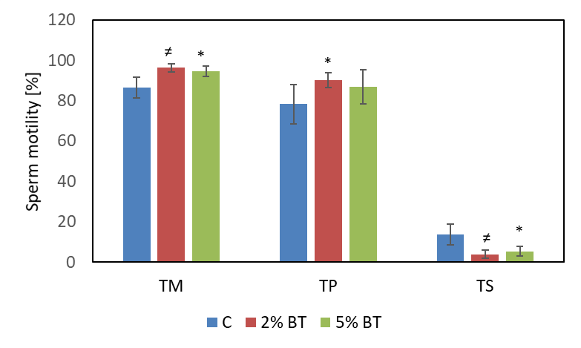
Sperm Motility
BT significantly improved sperm motility
TM, Total motility; TP, total progressive, TS, Total static; *, p<0.05; ≠, p<0.01;

Slide 16
Histological Section of Testes
Normal morphology
A) Control; B) 2% BT C) 5% BT; Bar = 50 μm.

Slide 17
Morphometric Measurement of Testis
 | Seminiferous Tubule [µM]
 | Diameter | Epithelial height
Control | 281.4±29.7 | 92.8±14.5
2% BT | 255.6±31.7† | 83.8±12.2†
5% BT | 254.1±23.5† | 84.9±11.7†
BT significantly increased seminiferous tubule diameter and epithelial height.
Values are mean±SD; N=6; †p<0.001

Slide 18
Histological Section of Epididymis
Normal morphology
A) Control; B) 2% BT C) 5% BT; Bar = 50 μm.

Slide 19
Morphometric Measurement of Epididymis
 | Epididymis Epithelial Height [µM]
 | Caput | Cauda
Control | 24.1±2.8 | 16.8±2.8
2% BT | 27.6±3.6≠ | 18.2±3.6
5% BT | 25.4±3.9 | 20.8±1.8†
BT significantly increased caput and cauda epithelial heights.
Values are mean±SD; N=6; ≠, p<0.01; †p<0.001

Slide 20
Discussion & Conclusion
BT maintained the serum FRAP level.
BT caused no significant change in body weight gain, reproductive organ weight, histology of the organs and testosterone level.
Androgen dependent organs were not affected due to no change in the testosterone level.
BT, however, enhanced sperm motility & vitality but not concentration.
BT enhanced sperm parameters, but caused subtle structural changes in the testis and epididymis and may negatively affect the fertilizing capacity of the sperm.

Slide 21
Acknowledgement
National Research Foundation.
University of the Western Cape Research grant.
Andrology laboratory, UWC.

