Slide 1
SOME IMMUNE FACTORS AND HORMONES DETERMINED IN FEMALE ALBINO RATS INDUCED WITH INFERTILITY AND ADMINISTERED WITH Anthocliesta vogelii
Oladimeji S.O ¹ * ,Steve A and Lawal O.A.
¹ Department of Biochemistry, Lagos State University, Ojo.
*corresponding author

Slide 2
INTRODUCTION
The plant Anthocleista vogelii belongs to the family Loganiaceous.
The leaves and stem-bark are used for treating swellings in the body (anti-inflammatory).
The root-bark and leaves are used in local medicine (Dalzel, 1997).
Some traditional healers claimed that some medicinal plants in Nigeria like Anthocleista vogelii could be used to treat obesity, (Burkill, 1985).
Sexual function is an important component of quality of life and subjective well-being in humans.

Slide 3
AIMS OBJECTIVE
The present investigation was designed to evaluate the claims of the traditional medicine practitioners on the usage of Anthocleista vogelii Planch; as fertility enhancer in females.
To study the effect of the extract on the liver and to check for other biochemical parameters elicited by the plant using female albino rats as model.

Slide 4
MATERIALS AND METHODS:
PREPARATION OF THE ETHANOLIC EXTRACT
The leaves of the plant were washed well with water, dried under shade for 14days and powdered to fine grade using electric blender.
PHYTOCHEMICAL STUDIES
Phytochemical screening of the extract was carried out using standard procedures to identify the constituents (Trease and Evans, 1989) in modified methods of Somkuwar and Kamble (2013).
2.3.2.TOXICITY TEST
Acute toxicity test was performed according to Guessom, et al., (2013).

Slide 5
ANIMAL STUDY:
Sixty (60) healthy female Wister albino rats of average weight of 100g were procured from an inbred stock of University of Ibadan, Oyo State, Nigeria. The animals were acclimatized to the laboratory environment for 3 weeks. The experiment was guided by the Ethical committee report of the College of Medicine along side with the Guide for care and use of Laboratory Animals (National Research Council, 1996)
Animal Treatment
Forty-two (42) female Wister albino rats with an average weight of 120g were randomly selected and divided into seven (7) groups with six (6) animals per group. The infertile group was generated using N-acetylcysteine (NAC) or Micronor (Norethisterone, a proven female contraceptive) used to induce reversible infertility in this rat groups. The treatments for each group were as follows:
Group I: Rats were administered with 1ml of distilled water once a day for 21days.
Group II: Rats were administered with micronor (norethisterone) at dose of 20μg/kg b.w. once a day in a volume of 1ml for 7 days.
Group III: Rats were administered with NAC (N-Acetylcysteine) at a dose of 1000mg/kg b.w. once a day in a volume of 0.74ml for 7 days.

Slide 6
Group IV: Anthocleista vogelii extract was administered to rats at a dose of 100mg/kg b.w. once a day in a volume of 0.25ml for 21 days.
Group V: Rats were administered with micronor (norethisterone) at a dose of 20μg/kg b.w. once a day in a volume of 1ml for 7 days and thereafter administered with Anthocleista vogelii extract at a dose of 100mg/kg b.w. in a volume of 0.25ml for 14 days.
Group VI: Rats were administered with micronor (norethisterone) at a dose of 20μg/kg b.w. once a day in a volume of 1ml for 7 days and thereafter administered with Anthocleista vogelii extract at a dose of 200mg/kg b.w. in a volume of 0.5ml for 14 days.
Group VII: Rats received NAC (N-Acetylcysteine) at a dose of 1000mg/kg b.w. once a day in a volume of 0.74ml for 7 days and thereafter administered with Anthocleista vogelii extract at a dose of 100mg/kg b.w. in a volume of 0.25ml for 14 days.
All administration were performed orally with the aid of cannula. On completion of administration, the rats in the different groups were anaesthesia with diethyl ether via inhalation. Blood samples were collected from the animals through cardiac puncture and collected into properly labelled K3EDTA vacutainer tubes and plain tubes for analysis.

Slide 7
IMMUNOLOGICAL BIOMARKERS ANALYSIS
CD4+ and CD8+ analysis were performed using the BD FACS Count automated CD4+/CD8+absolute count technique. A successful control run was necessary before running the test samples to ensure reliable results.
HORMONAL ASSAY
Estradiol , Prolactin, Testosterone and luentinising hormone analysis were performed on the serum samples obtained from the animals using commercial standard Enzyme – Linked Immunosorbent Assay (ELISA) kit.
VITAMIN E ASSAY
The vitamin E analysis was performed using HPLC
2.8 STATISTICAL ANALYSIS
Data were analysed using One Way Analysis of Variance (ANOVA, SPSS Version 20) and expressed as mean $±$ Standard Error Mean (SEM). Differences between groups were regarded significant at P ≤ 0.05 and post-hoc tests were then performed using the Tukey’s test.

Slide 8
RESULTS:

Slide 9
Table 1: Phytochemical investigation of the leaf of Anthocleista vogelii
TEST | INFERENCE
Reducing Sugar | -ve
Terpenoids | +ve
Flavonoids | +ve
Saponins | +ve
Tannins | -ve
Alkanoids | -ve
Cardiac glycosides | -ve
Protein/Amino Acids | -ve
Phenols | +ve
Phytosterols | +ve
-ve : absent , +ve : present

Slide 10
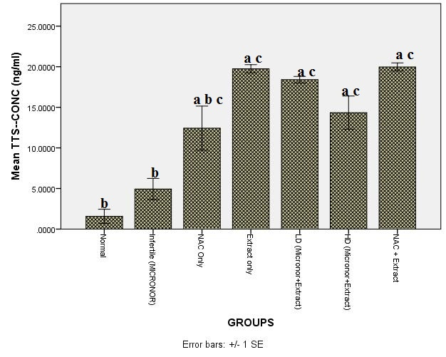
Figure 1: Graphical representation of Testosterone level count.
ªrepresents significant value compared to Normal group (i.e. Distilled Water) , ^{b}represents significant value compared to extract group, ^{c}represents significant value compared to infertile( micronor) (P ˂ 0.05, ANOVA post hoc Tukey HSD test).

Slide 11
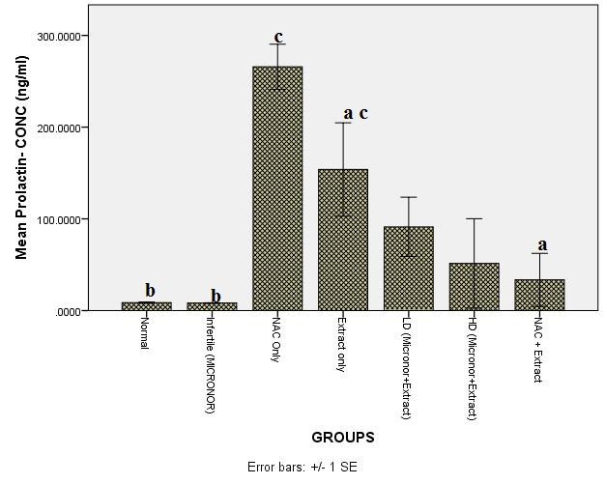
Figure 2: Graphical representation of Prolactin count.
ªrepresents significant value compared to Normal group (i.e. Distilled Water) , ^{b}represents significant value compared to extract group, crepresents significant value compared to infertile( micronor) (P ˂ 0.05, ANOVA post hoc Tukey HSD test)

Slide 12
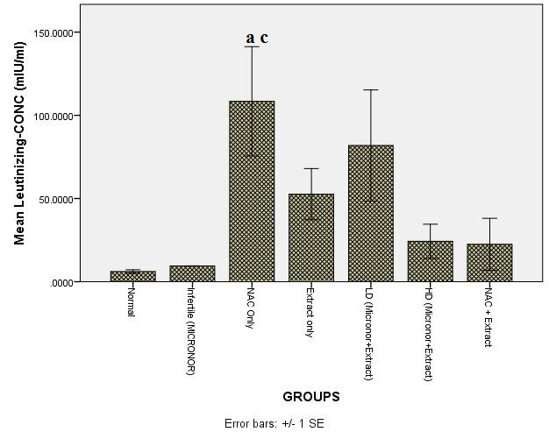
Fig.3: Graphical representation of leutinizing count
ªrepresents significant value compared to Normal group (i.e. Distilled Water) , ^{c}represents significant value compared to infertile( micronor) (P ˂ 0.05, ANOVA post hoc Tukey HSD test).

Slide 13
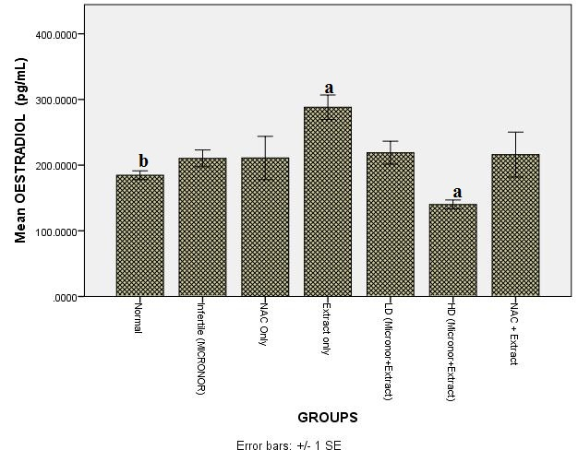
Figure 4: Graphical representation of estradiol concentration
ªrepresents significant value compared to Normal group (i.e. Distilled Water) , ^{b}represents significant value compared to extract group (P ˂ 0.05, ANOVA post hoc Tukey HSD test).

Slide 14
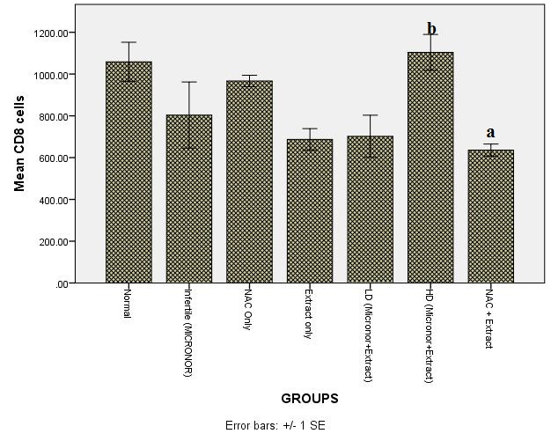
Figure 5: Graphical representation of CD4+ cells count.
ªrepresents significant value compared to Normal group (i.e. Distilled Water) , ^{b}represents significant value compared to extract group (P ˂ 0.05, ANOVA post hoc Tukey HSD test).

Slide 15
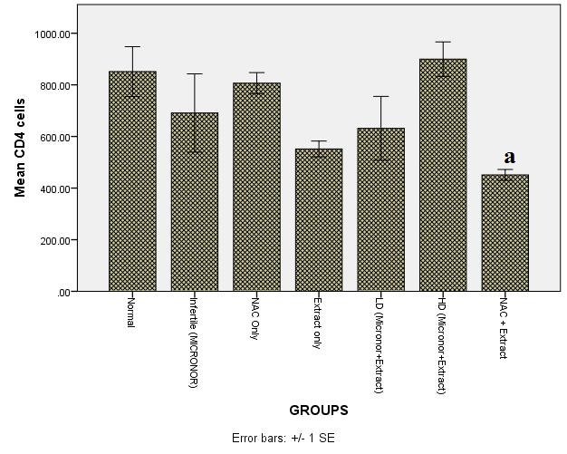
Figure 6: Graphical representation of CD4+ cells count.
arepresents significant value compared to control group (i.e. Distilled Water) (P ˂ 0.05, ANOVA post hoc Tukey HSD test).

Slide 16
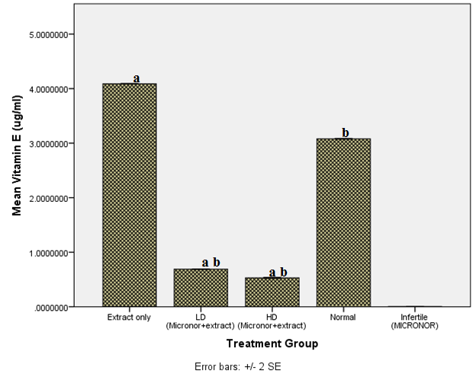
Figure 7: Graphical representation of vitamin E CD4+ cells count.
ªrepresents significant value compared to Normal group (i.e. Distilled Water) , ^{b}represents significant value compared to extract group, ^{c}represents significant value compared to infertile( micronor) (P ˂ 0.05, ANOVA post hoc Tukey HSD test).

Slide 17
DISCUSSION:
The Anthocleista vogelii significantly decrease the total fat of the group of animal administered with extract which suggest that the body weight may have been restored to normal establish limit necessary for fertility. Some of the chemical constituents, such as saponins, flavonoids and some triterpenoids have been reported for their antiobesity effect in various plants (Yun, 2010).

Slide 18
CONCLUSION:
It is suggestive that the ethanolic extract of Anthocleista vogelii used in this present study which contains saponins reduced the fat accumulation and thereby increasing chances of fertility by correcting their body weight disorder.
In the albino rat administered with Anthocleista vogelii ethanolic extract in which the sex steroid hormone –testosterone (the principal female hormone) are lipid soluble i.e.; they dissolve in fat but not in water

Slide 19
THANK YOU FOR LISTENING

