Slide 1
ecological risk assessment of heavy metals in dredged sediment in lagos, nigeria: an index approach analyses
MAJOLAGBE A.O. AND YUSUF K. A.
Lagos State University.

Slide 2
Outline of presentation
Introduction
Aim of the study
Materials and Methods
Results and Discussions
Conclusion
References

Slide 3
INTRODUCTION
Lagos, a maritime hub with75% coastal communities
commercial nerve of Nigeria
Fishing, dredging of sediment, and trading
Sediment dredging
Navigating water
Economical reasons
Ecological justifications
Local dredging
Commercial dredging
Sediment, a sink of contaminants
Organic compounds: pesticides, PCBs, and PAHs
Metals: copper, lead, mercury, zinc
Non biodegradability
Toxicity
Multiple sources in environment

Slide 4
Introduction contd.
Sediment therefore a potential major source of heavy metal originating from natural and anthropogenic activities with possible adverse effect on man and environment.
Guidelines and Indices
Use of Sediment Quality Guidelines (SQG): evaluating adverse effect of pollutant in sediment
Canadian council of minister of environment (CCME)
Use of quality indices
Pollution index (Pi)
Pollution classification (Pc)
Geo accumulation index (Igeo)
Use of Potential Ecological Risk Index (RI)

Slide 5
Introduction contd.
Aim and objectives of the study
determine the level of trace and heavy metals in dredged sediments in various part of coastal area of Lags state.
apply Sediment Quality Guidelines (SQG) to characterize the dredged sediments
conduct the ecological risk assessment on the environment.

Slide 6
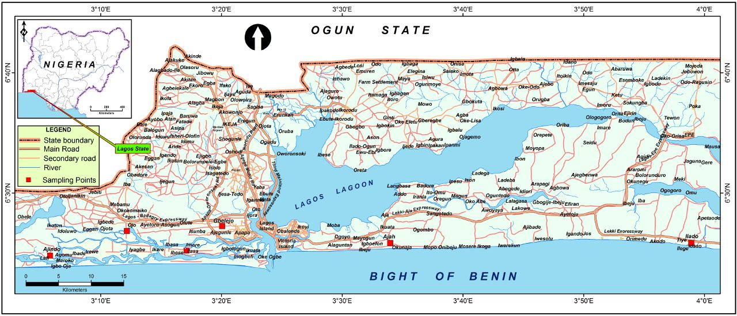
Materials and Methods
Study Area
Six coastal communities from five (5) different Local Government Councils as the study area
Figure 1. Lagos State map showing the sampling locations
*Ajindo *Ojo *Imore *Gbelejo *Ajah *Ilado
Ten (10) composite samples were taken from each coastal area

Slide 7
Materials and Methods
Sample treatment
Drying
Grinding
Sieving
Sample Analyses
pH - using A blot dried pH meter (Mettler Toledo IP67 model)
Metal Analsis - Atomic Absorption Spectrometer (Pye Unicam Philips Model 900 X).
Blank and Control samples analysed
Metals analysed – Zn, Cu, Pb, Ni, and Cd

Slide 8
Results and Discussions
Table 1.0 :Descriptive statistics of pH and heavy metals (µg/g) in sediment in coastal communities in Lagos
Site | pH |  |  | Zn |  |  | Cu |  |  | Pb |  |  | Ni |  |  | Cd
 | Mean ± SD | SEM | CV | Mean ± SD | SEM | CV | Mean ±SD | SEM | CV | Mean ± SD | SEM | CV | Mean ± SD | SEM | CV | Mean ± SD | SEM | CV
Ajah | 7.74a ± 0.1 | 0.03 | 1.4 | 92.3a ± 34 | 11 | 38 | 4.24a± 2.5 | 0.8 | 58 | 27.4a± 2.9 | 0.9 | 10 | 30.6a±1.8 | 0.6 | 60 | 2.87a± 0.2 | 0.1 | 8.0
Imore | 7.94b±0.1 | 0.01 | 0.7 | 109a± 30 | 9.7 | 27 | 2.58a± 0.5 | 0.5 | 0.2 | 23.8b± 2.1 | 0.7 | 8.8 | 15.5b±1.4 | 0.5 | 9.2 | 1.89b± 0.3 | 0.1 | 17
Ojo | 7.93b ±0.08 | 0.03 | 1.0 | 35.4b± 2.3 | 1.03 | 6.5 | 3.6b± 0.34 | 0.15 | 9.4 | 43.0c± 7.2 | 3.2 | 17 | 31.9a±2.9 | 1.3 | 9.1 | 2.62a± 0.3 | 0.03 | 1.0
Ilado | 7.35c±0.1 | 0.08 | 1.5 | 39.5c± 0.2 | 0.15 | 0.4 | 5.05c± 0.6 | 0.4 | 11 | 32.3d± 11 | 7.9 | 35 | 41.5c±0.4 | 0.25 | 0.8 | 4.13c± 0.7 | 0.36 | 12
Ajindo | 7.81d± 0.1 | 0.1 | 1.8 | 36.5d± 1.4 | 0.8 | 3.8 | 4.8d± 0.3 | 0.23 | 6.6 | 24.0b± 1.5 | 1.1 | 6.1 | 24.3d±2.5 | 1.8 | 10 | 3.45c± 0.6 | 0.45 | 18
Gbelejo | 7.82d±0.06 | 0.07 | 1.1 | 35.4d± 3.1 | 3.1 | 5.3 | 4.2a± 0.7 | 0.4 | 10 | 23.3b± 6.2 | 0.8 | 11 | 28.5a±2.2 | 0.7 | 13 | 4.8c± 0.3 | 0.5 | 11
BV |  |  |  | 175.3 |  |  | 11.0 |  |  | 11.6 |  |  | 4.7 |  |  | 1.2
CCME TEL |  |  |  | 120 |  |  | 16 |  |  | 31 |  |  | 16 |  |  | 0.6

Slide 9
Results and Discussions contd.
pH of the sediments samples analysed ranged from7.74 to 7.94
International Sediment Quality Guidelines (ISQG) eg. Canadian council of minister of environment (CCME)
TEL /LEL – level of contaminant below which very low probability severe effect occur
SEL /PEL - level of contaminant above which very low probability severe effect occur.
Metals analysed – Zn, Cu, Pb, Ni, and Cd
i. Nutritive – Zn and Cu
ii. Toxic- Pb, Ni, and Cd
Both Zn and Cu were found below TEL and PEL
Zn trends Imore > Ajah > Ilado > Ajindo > Gbelejo > Ojo,
Cu trends Ilado > Ajindo > Ajah > gbelejo > Ojo > Imore.

Slide 10
Results and Discussions contd.
Pb was found higher than TEL Ojo / Ilado
Ni and Cd was found higher than PEL
thus suggesting monitoring
Environmental quality indices
Pollution index (Pi), is a degree of soil pollution of soil with reference to a specific metal
Pollution classification (Pc), helps to establish the distinction between soil contamination and soil pollution range. Pc Values above 1.0 depicts the pollution range, while those below 1.0 indicate the contamination range.
Geo accumulation index (Igeo), The I_{geo} of heavy metals in the sediment helps in determining the extent of heavy metal accumulation in sediments.
The pollution index across the study areas are as follow;
Cu < Zn < Pb < Cd < Ni - Ajah;
Cu < Zn < Cd < Pb < Ni - Imore;
Zn < Cu < Cd < Pb < Ni - Ojo
Zn < Cu < Pb < Cd < Ni - Ilado, Ajindo and Gbelejo.

Slide 11
Results and Discussions contd.
The pollution index across the study areas are as follow;
Cu < Zn < Pb < Cd < Ni - Ajah;
Cu < Zn < Cd < Pb < Ni - Imore;
Zn < Cu < Cd < Pb < Ni - Ojo
Zn < Cu < Pb < Cd < Ni - Ilado, Ajindo and Gbelejo.
Table 2.0. Pollution Index and Pollution Classification and Geo accumulation Index in sediment in coastal communities in Lagos
Site | Zn |  |  | Cu |  |  | Pb |  |  | Ni |  |  | Cd
 | P_{i} | P_{c} | I_{geo} | P_{i} | P_{c} | I_{geo} | P_{i} | P_{c} | I_{geo} | P_{i} | P_{c} | I_{geo} | P_{i} | P_{c} | I_{geo}
Ajah | 0.53 | -156 | -1.5 | 0.34 | -19.9 | -1.9 | 2.36 | 6.70 | 0.68 | 6.51 | 3.98 | 2.11 | 2.39 | 0.70 | 0.67
Imore | 0.62 | -106 | -1.2 | 0.23 | -36.5 | -2.4 | 2.05 | 5.95 | 0.49 | 3.30 | 3.27 | 1.14 | 1.58 | 0.43 | 0.07
Ojo | 0.20 | -635 | -2.9 | 0.23 | -32.1 | -2.1 | 3.71 | 8.46 | 1.32 | 6.78 | 4.1 | 2.81 | 2.18 | 0.65 | 0.54
Ilado | 0.22 | -617 | -2.7 | 0.32 | -18.6 | -1.7 | 2.78 | 7.45 | 0.89 | 8.83 | 4.17 | 2.59 | 3.41 | 0.86 | 1.19
Ajindo | 0.21 | -660 | -2.9 | 0.43 | -14.4 | -1.7 | 2.07 | 6.00 | 0.49 | 5.17 | 3.79 | 1.79 | 2.88 | 0.78 | 0.93
Gbelejo | 0.20 | -699 | -2.7 | 0.38 | -17.9 | -2.0 | 2.00 | 5.85 | 0.41 | 6.06 | 3.93 | 2.01 | 4.00 | 0.9 | 1.42

Slide 12
Results and Discussions contd.
The entire study area is classified (Pc)as polluted in respect of Pb and and Ni
Igeo showed study area with moderate – strong pollution is respect of Pb
Ilado / Gbelejo with moderate pollution in respect of Cd
The ecological risk of heavy metal in sediment analysed
Table 3.0: Heavy Metal Ecological Potential Risk Indices in sediment in coastal communities in Lagos
Site | Monomial Ecological Risk For Single Metal (E^{i}_{r}) |  |  |  |  | RI
 | Zn | Cu | Pb | Ni | Cd
Ajah | 0.53 | 1.70 | 11.2 | 32.6 | 71.7 | 117.7
Imore | 0.62 | 1.15 | 10.3 | 16.5 | 47.4 | 76.0
Ojo | 0.20 | 1.15 | 18.6 | 33.9 | 65.4 | 119.3
Ilado | 0.22 | 1.60 | 13.9 | 44.2 | 102.2 | 162.1
Ajindo | 0.21 | 2.15 | 10.4 | 25.9 | 86.4 | 125.1
Gbelejo | 0.20 | 1.90 | 10.0 | 30.3 | 42.6 | 85.0

Slide 13
Results and Discussions contd.
Zn /Cu /Pb / Ni showed low potential risks in all study area
Zn showed moderate risk in Ilado
Cd showed moderate to considerate potential risk
The entire study area reveal moderate potential risk except for Imore and Gbelejo with low potential risk (< 110)

Slide 14
CONCLUSION
Dredged sediment in coastal areas, Lagos State were characterized.
Pb, Ni,Cd were observed higher than the background values indicating health implications
The entire study area classified polluted in respect of Pb, and Ni (Igeo > 1)
The overall potential ecological risk reveal moderate (110 ≤ RI < 200), except for Imore and Gbelejo (RI<110)
This calls for a regular monitoring and various environmental policies that can avert continuous accumulation of heavy metals so as to ensure environmental sustainability

Slide 15
Some of the selected references
Balkis, N., Aksu, A., Okus, E., and Apak, R. (2010) .Heavy metals concentration in water,suspended matters and sediments from Gokova Bay, Turkey. Environmental monitoring and assessment, 167, 359-70.
Hollister, E.B., Engledow, A.S., Hammett, A.M., Provin, T.L., Wilkinson, H.H., Gentry, T.J. (2011) Shifts in microbial community structure along an ecological gradient of hypersaline soils and sediments. ISME J. 4: 829–838.
Lagos indicator, 2009. Ongoing transformation in Lagos: A rare blend of continuity, competence, cooperation and vision. Lagos indicator 2, 11-12.
Majolagbe, A.O., Osibanjo, O., Yusuf, K.A., Olowu, R.A. (2012).Trace Metals Distribution and Contamination in the Surface Marine Sediments of Roro Bay in Lagos, Nigeria. Chemistry Journal 2, 69-78.

Slide 16
THANKS
FOR
YOUR
ATTENTION
Majolagbe Abdulrafiu O . (Ph.D)

