Slide 1
Phytochemical Screening And Biocidial Studies Of Stem Bark Chrysophyllum Albidum (Linn) And Straw Aristolochia Ringens
Moses S. Owolabi^{1*}, Omowonuola, A. Adenike¹, Oladipupo A. Lawal¹, Avoseh N. Opeyemi¹., Ogunwande I. Ajani¹. and William N. Setzer²
¹Department of Chemistry, Lagos State , University, PMB 001, Ojo, Lagos, Nigeria
²Department of Chemistry, University of Alabama in Huntsville Huntsville, Alabama 35899, USA.

Slide 2
OUTLINE
Introduction
Materials and Methods
Results and Discussion
Conclusion
Acknowledgement
References

Slide 3
Introduction
Medicinal plants play a significant role in the health maintenance in under-developed countries, Extracts from herbs and spices continue to serve as a new sources for herbal medicines in all divisions of human population as folk medicines.
Chrysophyllum albidum (Linn) commonly known as white star apple is a Tropical forest fruit tree belongs to the Sapotaceae family with about 800 species (Ehiagbonare et al, 2008) .Native to West and central Africa countries
Locally the plant is named ‘Agbalumo’, (Yoruba) been used traditionally as antimalaria and yellow fever concoction, as an emollient for skin eruption, treatment of stomach ache and diarrhea (Idowu et al., 2006).
Studies have reported that seeds and roots extracts of C. albidium have demonstrated good antimicrobial, anti-inflammatory, anti-diarrheal and anti-hemorrhoidal properties (Okoli and Okere, 2010).

Slide 4
Chrysophyllum albidum
Figure 1: The seeds, fruit and leaves of Chrysophyllum albium

Slide 5
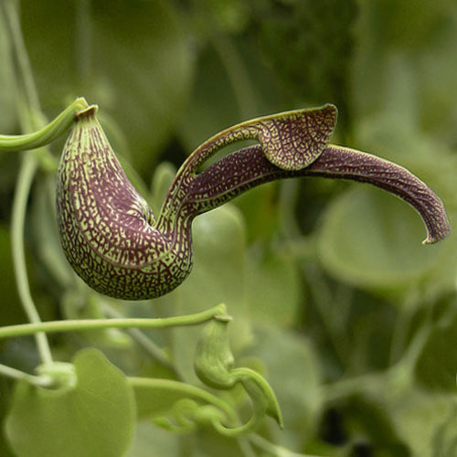
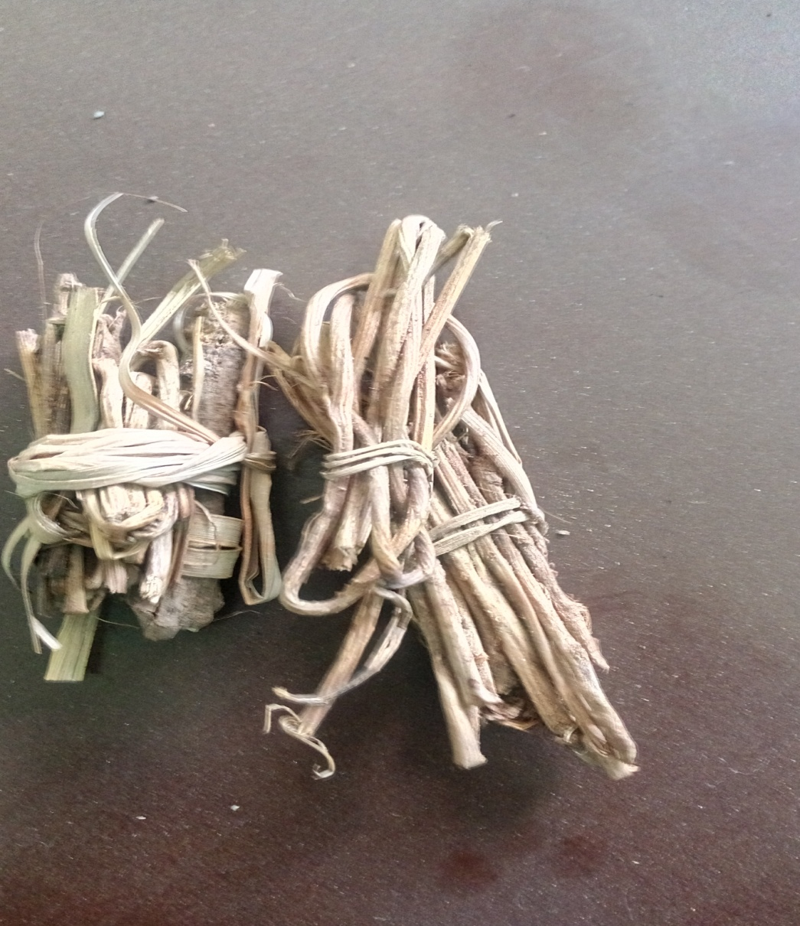
Aristolochia ringens Vahl
Aristolochia ringens Vahl, a native plant of Southern America, Brazil: commonly ‘akogun’ in Yoruba, Aristolochia species are known to contain alkaloids
Used for the treatment of obstetrics, snakebite venom, leprosy, and poisonous bites.
Previous report shows high content of sesquiterpenoids
characterised (E)-caryophyllene .
The study aimed at ascertaining the phytochemical constituents,
antimicrobial and cytotoxic activities of chloroform extracts of
C. albidum and A. ringens as an ingredient in the production of herbal
medicine growing in Nigeria.
a
b
Fig. 2 : Pictures of the leaves (a) and stem bark (b) of A. ringens Vahl

Slide 6
MATERIALS AND METHODS
Plant preparation and extraction: Chrysophyllum albidum and Aristoclohia ringens
Phytochemical screening :(Sofowora, 1993a,1993b,:Trease and Evans, 1989 and Harborne, 1973) methods with little modification.
(Screening for alkaloids,flavonoids, phenols, tannins, anthraquinones, Cardiac Glycosides, Phlobatannins, Terpenoids and Steroids.
Quantification of Phytochemicals
Preparation of fat free sample: using diethylether
Determination of total alkaloids using (Harborne, 1973) method : reagent (CH₃ COOH /ethanol and NH₃ )
Flavonoid determination by (Boham and Kocipai, 1974) method : reagent (CH₃ OH )

Slide 7
Antimicrobial Screening
The chloroform extract was screened for antimicrobial activity against Gram-positive bacteria( Bacillus cereus, Staphylococcus aureus, Staphylococcus epidermidis) Gram-negative bacteria, (Pseudomonas aeruginosa, Serratia marcescens and Escherichia coli )
Minimum inhibitory concentrations (MIC) were determined using the microbroth dilution technique (Satyal et al., (2012) in which the crude extract were prepared in cation-adjusted Mueller Hinton broth (CAMHB)and serially diluted in 96-well plates.
Microorganisms were added to each well. Plate were incubated at 37oC for 24hr.
. Gentamicin was used as a positive antibiotic control; DMSO was used as a negative control.
Antifungal activity was determined as described above using Candida albicans in yeast-mold (YM). Amphotericin B was the positive control.

Slide 8
Cytotoxicity Test
Hepatocarcinoma cell line of human being marked (HepG2, CRL-11997™)
Cells were grown in DMEM: F12 made up of L-glutamine and sodium bicarbonate, 10% of
FBS, with 1% penicillin/streptomycin
Once about 90% confluent is observed, the cells were risen with phosphate buffered saline and were suspended in a fresh complete media . 5 × 10⁵ cells/well (100 µL) were seeded in a 96-well plates and warmed for 24 hr to attach to the wall .
Cells were treated with chloroform extracts at varying concentration for 72hrs.
DMEM: F12 media was replaced by MTT assay (3-(4,5-dimethylthiazol-2-yl)-2,5-diphenyl tetrazolium bromide) and then DMSO. Absorbance was measured at 550
nanometer. All extracts were tested in triplicate.
MCF-7 (human breast tumor marked ATCC No. HTB-22) cell
About 80% cell growth was achieved after culturing of cells in a 96-well cell culture plates for
2 days.
Growing medium, DMSO, and tingenone (100 μg/mL) were used as negative and positive control compounds, respectively. Eight replicate solutions were added to wells. The percent kill ratios (% kill_{compound} / % kill_{control}) were determined and average absorbance, standard deviations were also calculated.

Slide 9
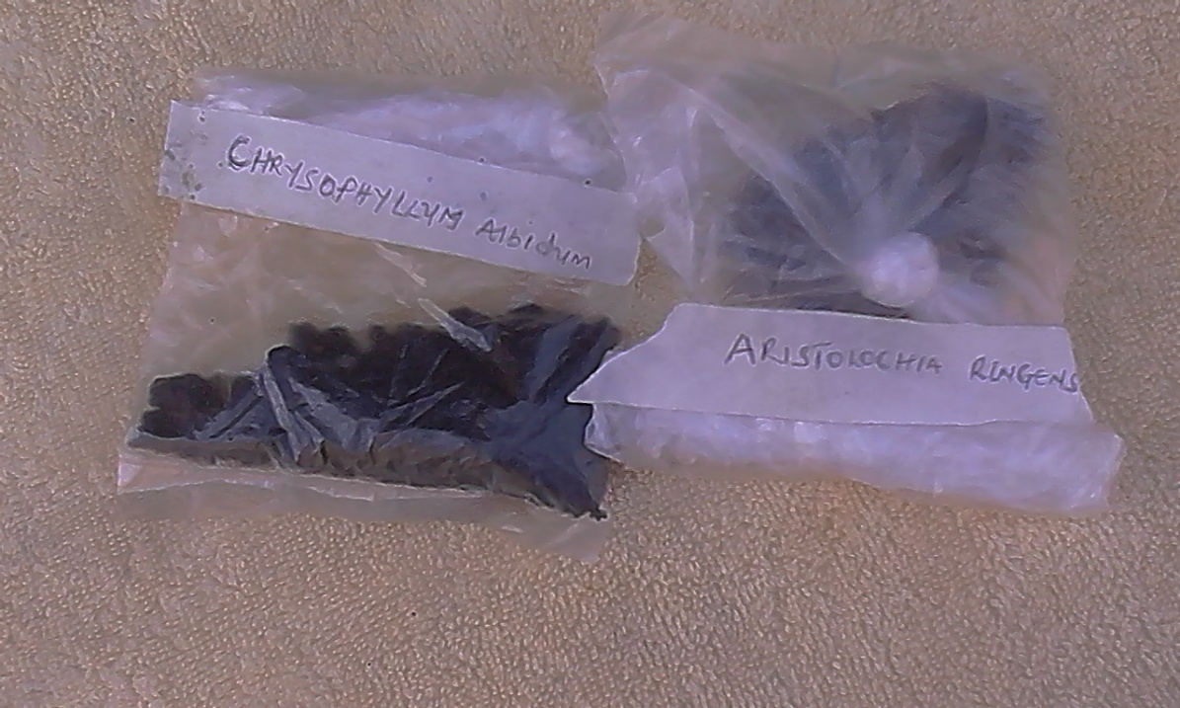
Results
Table 1. Nature and yield of chloroform crude extracts from the C. albidum and A. ringens
Plant Extract | Extract | Extract Texture | Extract yield | Percentages recovery (%)
C. albidum | Dark Green | Semi sticky powder | 120.00 g | 10.0
ringens | Dark Brown | Sticky semi solid powder | 84.00 g | 7.0
Table 2. Qualitative analysis of secondary metabolites found in C. albidum and A. ringens
 | Phenol | Tannins | Phlobatanin | Alkaloid | Flavonoid | Cardiac glycoside | Steroid | Terpenoids | Anthraquinone
C. albidum | - | - | - | +++ | ++ | ++ | + | - | -
ringens | - | - | - | +++ | ++ | - | + | - | +
+++ = Test strongly positive ; ++ = Positive; + = Weakly positive; - = No effect
Table 3. Quantitative analysis of the relative amount of secondary metabolites in C. albidum and A. ringens
 | Phenol mg/100g | Tannins mg/100g | Alkaloid mg/100g | Flavonoid mg/100g | Cardiac glycoside mg/100g
C. albidum | - | - | 52.50 ± 0.50 | 26.60 ± 0.80 | 27.10 ± 0.80
A. ringens | - | - | 45.82 ± 0.70 | 13.53 ± 0.30 | -

Slide 10
Antimicrobial and cytotocity
Table 4. Antimicrobial activity (MIC, μg/mL) of C. albidum and A. ringens
 | Bacteria | Bacteria | Bacteria | Bacteria | Bacteria | Bacteria | Fungi | Fungi | Fungi
Sample | P. aerug | E. coli | S. aureus | B. cereus | S. epi | S. mar | A.niger | Candida | Botrytis
C. albidum | 312.5 | < 19.5 | 2500 | 312.5 | > 2500 | > 2500 | 625 | 625 | 625
Ringens | 625 | > 2500 | > 2500 | < 19.5 | > 2500 | 1250 | 625 | 156 | 625
Table 5. Cytotoxicity (IC₅₀, g/mL) of the Chloroform Extracts of C. albidum and A. ringens
Extract | Hep-G2 | MCF-7
A. ringens | 16.4 ± 1.8 | 81.6 ± 12.8
C. albidum | 23.1 ± 4.8 | > 100

Slide 11
Discussion
The phytochemical screening revealed some differences in their Compositions, these differences imparts different physiological activities in the tested microorganisms , these support the idea that plant materials antimicrobial efficacy (Sofowora, 1993)
The concerted synergistic or antagonistic activities of the phytochemicals could lead to antimicrobial activities (Felix, 1982; Kubmarawa et al., 2008)
This could be attributed to the presence of alkaloid, flavonoids, cardiac glycosides, steroid and anthraquinone present in the chloroform extracts in the plant studied
The pharmacological effect of the metabolites are;
Alkaloid (Powerful anti-malaria agent )
Cardiac Glycosides (effective in congestive heart failure )—Aboaba, et al, 2006
Flavonoids (An antioxidant and lowers the risk of heart failure)

Slide 12
Conclusion
The Medicinal plants studied demonstrated the presence of secondary metabolites with good potential biological activities , support the idea that traditional medicines remain useful healthcare in developing countries.
Further research work is ongoing towards bio-guided column chromatography and in-vivo studies of these plants.

Slide 13
Acknowledgment
We are grateful to Elizabeth Jaiyeola for botanical identification and collection of Chrysophyllum albidum and Aristoclohia ringens, used in this study and also to W.N.S group for carrying out the biological experiments and analysing of the data.

Slide 14
References
Aboaba, S.O., Smith, S.I., Olide, F.O., 2006. Antimicrobial effect of edibles plant extracts on escherichia coli 0157: H7 Pakistan. Journal of Nutrition. 5(4), 325-327.
Boham, B.A., Kocipai, A.C., 1974. Flavonoids and Condensed Tannins from Leaves of Hawaiian Vaccinium Vaticulatum and V. Calycinium. Pacific Sci. (48) 458- 463.
Kubmarawa, D., Khan, M.E., Punah, A. M., Hassan, M., 2008. Phytochemical Screening And Antimicrobial Efficiency Of Extracts From Khaya Senegalensis Against Human Pathogenic Bacteria. African Journal Of Biotechnology. 7(24), 4563-4566
Felix, M. T., 1982. Medicinal Microbiology. Churchill Livingstone Publishers, London. 7-8.
Harbone, J.B., 1973. Phytochemical methods, London. Chapman and Hall, Ltd. 49-188.
Akter, R.; Uddin, S. J.; Grice, I. D. 2014. Tiralongo, E. Cytotoxic activity screening of Bangladeshi medicinal plant extracts. Journal of Natural Medicines, 68, 246–252.
Idowu, T.O., Iwalewa, E.O., Aderogba, M.A., Akinpelu, B.A., Ogundaini, A. O., 2006. Biochemical And Behavioural Effects Of Eleagnine From Chrysophyllum Albidum. J. Biol. Sci., (6) 1029-1034.
Ehiagbonare, J.E., Onyibe, H.I., Okoegwale, E.E., 2008. Studies On The Isolation Of Normal And Abnormal Seedlings Of Chrysophyllum Albidum: A Step Towards Sustainable Management of The Taxon In The 21st Century. Sci. Res Essay. 3(12), 567-570.

Slide 15
THANK YOU

