Slide 1
Petrophysical evaluation of Selected wells in the Upper Shallow Marine Reservoirs of the Eastern Bredasdorp basin, South Africa
By
Mimonitu Opuwari ¹,Roxzanne Prinsloo¹,Abuh Momoh²,Ono Daniel ³
Notes:
But what happens after you graduate? How does AAPG fufill it’s self described mission of becoming essential throughout your geoscience career?

Slide 2

Outline
Introduction
Key Research Questions
Materials & Methods
Results & Discussions
Concluding remarks

Slide 3
Key Research questions
We are ultimately trying to answer two questions?

Slide 4
Key Research questions…….
What is best approach to Analysis and Quantification of Sandstone Reservoir properties for fluid volumes?

Slide 5
Introduction
Petrophysical properties are the parameters that determine pore systems of potential reservoirs (Selley, 1985). These parameters includes:
Percentage of shale volume
Porosity
Permeability
Water saturation
Thickness and extent of reservoir formation and depositional environment.

Slide 6
Introduction………..
South Africa is rich in natural resources and coal generates about 90% of the country’s electricity. Although coal is in abundance in South Africa, other means of generating electricity is being explored (Petroleum Agency SA, 2010).
South Africa has a number of Offshore sedimentary basins, the search for hydrocarbons in the Bredasdorp Basin, south of South Africa remains an area of interest.

Slide 7
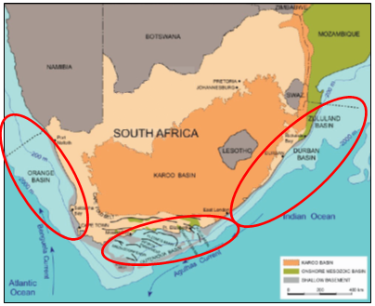
Study area
The basin has an aerial extent of roughly 18 000 km² and begins off the southeast of Cape Town and stretches up the south-east coast, up until west-south-west of Port Elizabeth (Wood, 1995).
(Petroleum Agency of South Africa,2010.

Slide 8
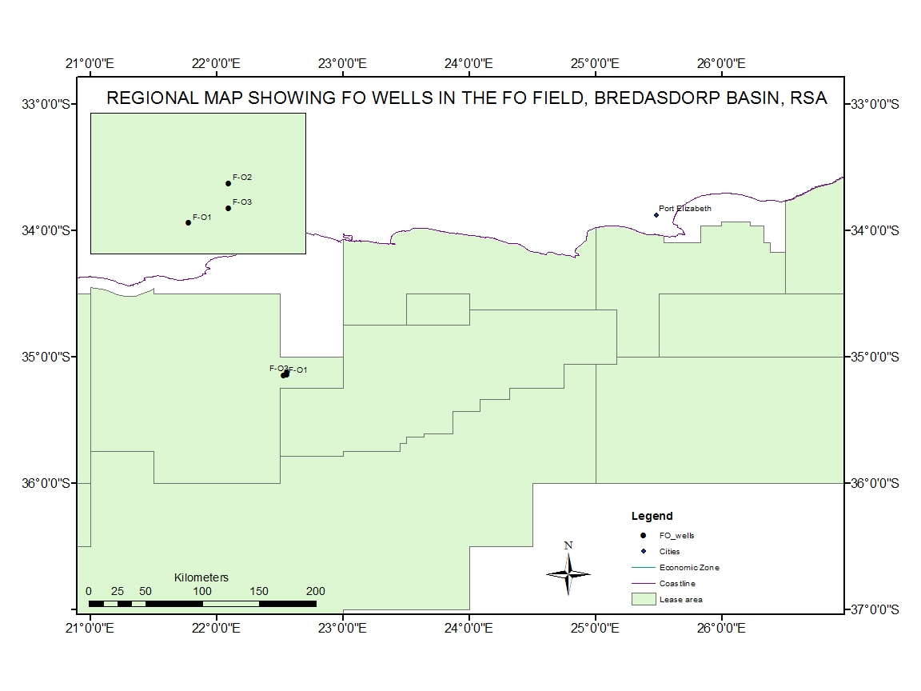
Well Location

Slide 9
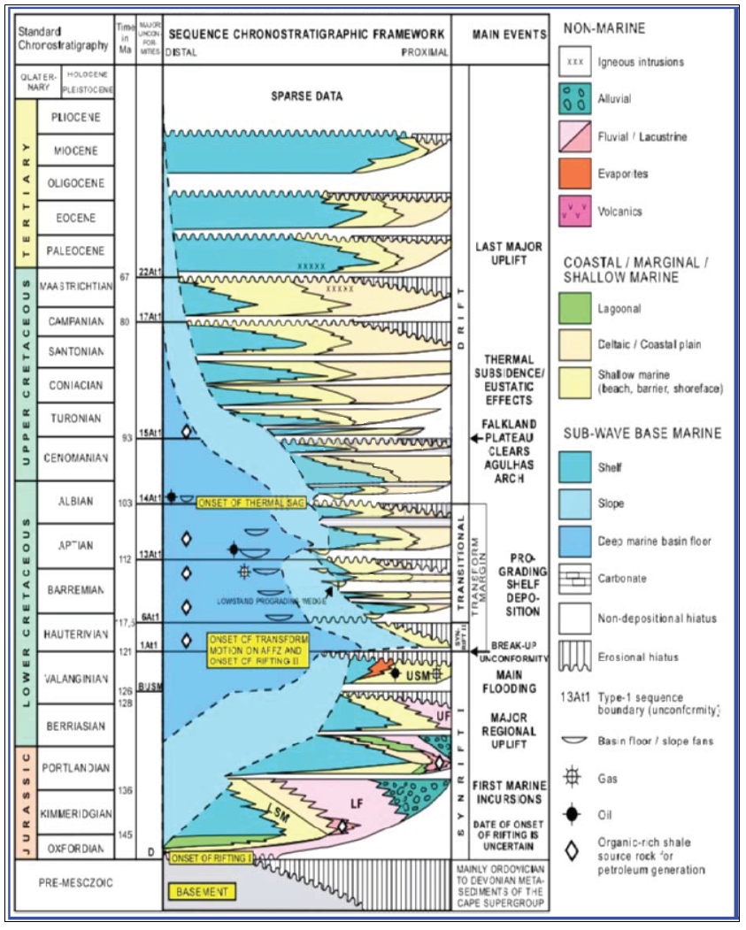
Chronostratigraphic Sequence
(Petroleum Agency of South Africa,2010.

Slide 10
Materials and Methods

Slide 11
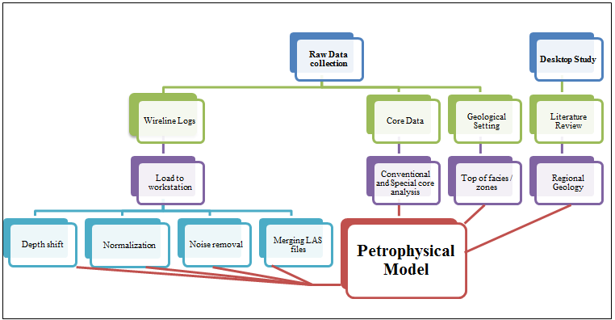
Evaluation flow chart (stage I)

Slide 12
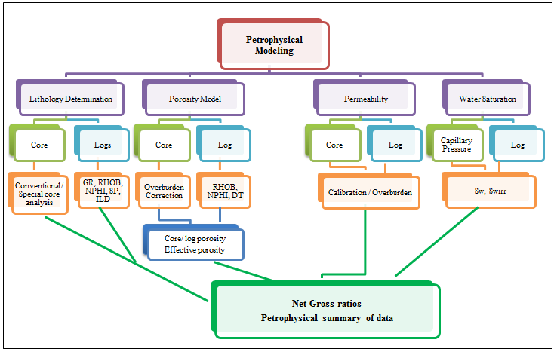
Evaluation flow chart (stage II)

Slide 13
Results & Discussions

Slide 14
Identification of USM Reservoirs
F-O3
F-O1
F-O2

Slide 15
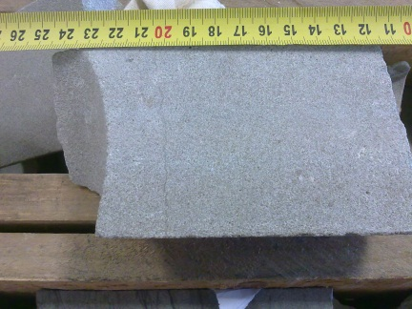
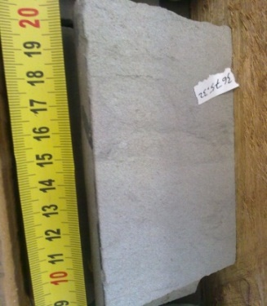
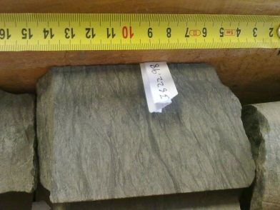
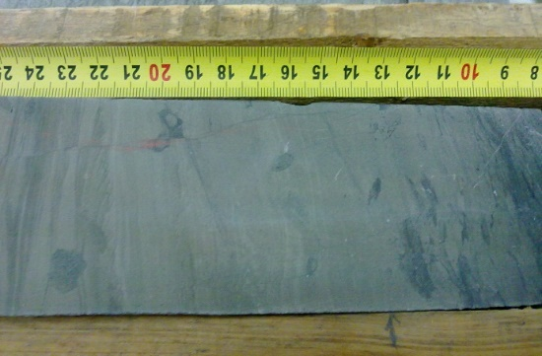
LITHOFACIES CLASSIFICATIONS
A. Sandstone, medium grained, well sorted.
Good
B. Sandstone fine to very fine grained, moderate sorting
Fair
C. Very fine grained siltstone,light to medium grey, lamination
Poor
D. Claystone, laminated, minor bioturbation,
poorly sorted.
Non Reservoir

Slide 16
Calibration of Log & Core
Cluster Analysis was used to determine different lithofacies in our wells
After multiple cluster combinations were run, it was apparent that 4 clusters best represent our data.

Slide 17
FACIES A
FACIES B
FACIES C
FACIES D
With collaboration with the lithofacies, clusters were classified as FACIES A-D.

Slide 18
Clay Volume (VCL)
The following GR min. and max. parameters were applied :
Well | GR_{min} api | GR_{max} api
F-O1 | 17.4 | 128.1
F-O2 | 21.8 | 132.5
F-O3 | 24.0 | 137.0

Slide 19
Porosity (PHI)
Effective porosity was computed from the density log using the following standard equation:
where:
ρ_{ma} - matrix density, 2.67 g/cc from histogram of core grain densities
ρ_{log} - bulk formation density from density log – g/cc
ρ_{cly} - clay density, 2.65 g/cc, selected from examination of reservoir shale
ρ_{fl} - pore fluid density, 0.86 g/cc, derived from cross plot of compaction corrected core porosities vs log density.
V_{cl} - final estimated clay volume

Slide 20
Water Saturation (SW)
Water saturations were computed using the Indonesia equation:
where:
Φ - effective porosity – v/v
a - pore geometry constant, 1.0
m - cementation factor, 2.06, from SCAL data in F-O2
n - saturation exponent, 1.81, from F-O2 SCAL data
Rt - True formation resistivity
Rcl - clay resistivity, 7 ohmm, from resistivity responses in shales
Rw - formation water resistivity, 0.08 ohmm at reservoir temperature, 18,000 ppm NaCl equivalent salinity.

Slide 21
Permeability (PERM)
Ambient permeability predictions were derived using well based functions relating ambient core permeability to compaction corrected core porosities. A subsequent correction to in-situ conditions was applied based on overburden data:
Well F-O1: k_{ha,amb} =10^{((φ-0.0847)/0.0228)}
Well F-O2: k_{ha amb} =10^{((φ-0.1117)/0.0248)}
Well F-O3: k_{ha,amb} =10^{((φ-0.0964)/0.0260)}

Slide 22
Flow Zone Indicator (FZI)
Proposed originally by Amaefule 1993 it is a derivative of his Rock Quality Index (RQI) and Normalised Porosity (NPI) where:
(where K is Permeability – mD, Φe is Effective Porosity– fractions, RQI & FZI - microns)

Slide 23
Results of FZI
Hydraulic Unit | FZI (microns) | RQI (microns) | NPI (v/v) | Ave. Permeability (mD)
1 | 1.25 – 2.5 | 0.38 | 0.03 – 0.267 | 5.4
2 | 0.5 – 1.25 | 0.08 | 0.10 -0.22 | 3.7
3 | ˂ 0.5 | ˂0.02 | ˂0.10 | ˂0.1

Slide 24
Example of Summary results

Slide 25
Well Name | Reservoir Gross (m) | Net (m) | N/G | Av. Phi % | Av. Sw % | Av.Vcl % | Av.K mD
F-O1 | 98.00 | 12.65 | 0.129 | 13.1 | 12.4 | 10 | 1.3
F-02 | 66.33 | 42.98 | 0.64 | 15.3 | 36.6 | 14 | 0.8
F-03 | 68.5 | 48.00 | 0.70 | 9.8 | 42.26 | 12.45 | 0.21

Slide 26
Well Name | Average Effective KH | Hydraulic Unit
F-O1 | 1.68 | 2
F-02 | 6.57 | 1
F-03 | 4.7 | 3

Slide 27
Concluding Remarks
A relationship was established between core facies and wireline log.
An effective petrophysical evaluation was successfully achieved with well F-02 identified as the most productive well based on comparison of petrophysical properties.
The developed model could be used as input parameter for hydrocarbon volume determination in the field.

Slide 28
Thank you!

