Slide 1
Information Retrieval Metrics for Speech Based Systems: A Systematic Review
¹Micheal T. Adenibuyan, ²Oluwatoyin A. Enikuomehin and ²Benjamin S. Aribisala
¹Department of Computer Science & Information Technology
College of Natural and Applied Sciences
Bells University of Technology
Ota, Ogun State, Nigeria
²Department of Computer Sciences
Faculty of Science
Lagos State University
Ojo, Lagos, Nigeria

Slide 2
Outline
Introduction
Methodology
Study Selection and Data Collection Process
Results
Study Characteristics
IR Evaluation Metrics
Summary
Limitations
Conclusion

Slide 3
Introduction
Information overload.
Spoken query.
Performance and efficiency raise interesting research issues in IR.
Spoken query impact retrieval performance (Turunen, Kurimo et al. 2013).

Slide 4
Methodology
We used Google scholar repository to retrieve some selection of peer-reviewed articles.
Resources checked includes: conference proceedings, journals, and books.
RESOURCE | TOTAL RESULTS OBTAINED | INITIAL SELECTION | FINAL SELECTION
Google Scholar | 179 | 32 | 25
Total | 179 | 32 | 25

Slide 5
Study Selection and Data Collection Process
This systematic review of articles was conducted using the Preferred Reporting Item for Systematic Reviews and Meta-Analyses (PRISMA) guidelines .
PRISMA guideline helps to establish studies that were included and those excluded for this research.

Slide 6
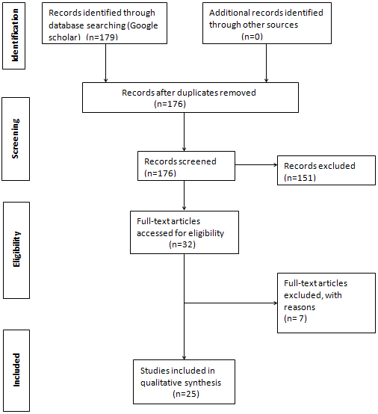
PRISMA

Slide 7
Inclusion Criteria
Studies on spoken queries for information retrieval and metrics used for evaluating the adhoc retrieval systems were reviewed.
Criterias:
Spoken query
Evaluation Metrics, Performance.
Research from notable IR conferences such as TREC (Text REtrieval Conference), CLEF.

Slide 8
Exclusion Criteria
Studies that only report ASR (Automatic Speech Recognition) or speech recognition.
Studies that focus on retrieval technique without evaluating it.

Slide 9
Publication Quality Assessment
To assess the quality of each publication, the following measures were set to avoid sway.
Was an experiment done to retrieve document using spoken queries?
Was there any evaluation done?
Is the corpus source known?

Slide 10
Coding Scheme
We extracted the following data from each publication in our dataset as shown in the table below.
Class | Item
Publication | Year, Source
Contributors | Name and affiliation, Country
Study purpose | Research questions, hypotheses and the use of theory Objectives
Method | Subjects, Corpus, Search task
Measures | Output measures
Cited works | Genres, Years, Source titles, Item titles, Cited authors

Slide 11
Data Synthesis

Slide 12
Results
8 studies were on Mean Average Precision (MAP)
1 study applied Average Precision and R-Precision
1 applied a combination of Precision, Recall and F-Measure
1 combined Average Inverse Rank (AIR) and MAP
1 combined Average Precision and Recall
1 combined Precision and Recall
2 adopted F-measure and MAP
1 applied the Generalised Average Precision (GAP) and MAP
1 applied Precison Recall Curve, F-Measure and MAP
1 used Precision, Recall and MAP
1 combined Normalized Discounted Cummulative Gain (NCDG), Mean Reciprocal Rank (MRR) and MAP.

Slide 13
Included Studies Characteristics
Characteristics | Number of included studies (n=25)
Median year of Publication | 2005 (1998-2015)
Country of Publication Canada China Finland Ireland Germany UK United States of America (USA) Japan Singapore Thailand, Indonesia, China | 2 6 1 1 1 3 4 2 1 1 3

Slide 14
Studies Characteristics Cont’d
Majority of the articles (60%; n = 15) were published between 2007 and 2017, about 40% (n = 10) were published between 1997 – 2006.
36% of the articles were from four publications: Speech Communication, IEEE Transactions on Audio, Speech & Language, Acoustics Speech & Signal Processing ICASSP, NTCIR workshop, while the remaining 64% were scattered across sixteen (16) different publications

Slide 15
Distribution of publications across Sources

Slide 16
IR Evaluation Metrics
Precision and Recall
Mean Average Precision (MAP)
Average Inverse Rank (AIR) / Mean Reciprocal Rank (MRR)
Normalized Discounted Cumulative Gain (NDCG)

Slide 17
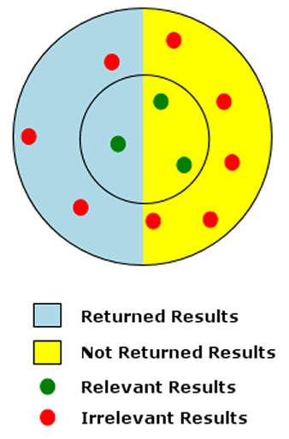
Precision and Recall
Traditional IR evaluation metric

Slide 18
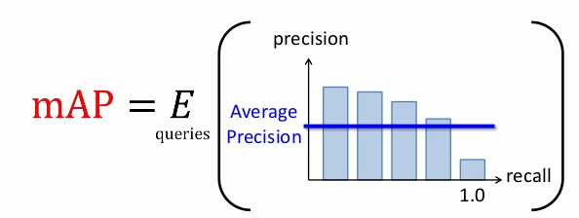
Mean Average Precision (MAP)

Slide 19
Mean Average Precision (MAP)
This is the most used evaluation metric for an IR System performance.
It account for 60% of publication studied for this review.
It ranks relevant documents higher than irrelevant documents
MAP result range from 0.4191 to 0.620 with relative improvement in retrieval performance by 13.8%.

Slide 20
Mean Reciprocal Rank
Also known as Average Inverse Rank (AIR)
It achieved as much as 14% improvement in IR performance with range between 0.747 to 0.826

Slide 21
Normalized Discounted Cumulative Gain (NDCG)
It returns the document with the highest relevance level, then the next highest relevance level.
The higher the better
Normalization for contrasting queries with varying numbers of relevant results.
4% of publications studied applied the NDCG metric to measure IR performance.
Result range from 0.089 to 0.284.

Slide 22
Conclusion
This review has documented the evolution of speech based IR evaluation metrics.
One important outcome of this research is the speech based IR metric research bibliography.

