Slide 1
COMPARISON OF MONTHLY VARIATION IN TEMPERATURE PROFILE FOR EIGHT STATIONS IN NIGERIA
O. O. Ometan, E. O. Somoye, T. V. Omotosho, E. O. Onori, M. A. Adewusi, S. A. Akinwunmi, C. O. Ogabi, A. Ogwala, R. A. Adeniji-Adele, O. A. Adejo
(LASU Ionospheric and Radio Propagation Research Group)
Department of Physics, Lagos State University, Ojo, Lagos, Nigeria
@
Faculty of Science Conference
on
Cutting Edge Scientific Research: A gateway to National Development
10th 14th October, 2017

Slide 2
Outline
Introduction
Aim
Materials and Methods
Result and Discussion
Conclusion
References

Slide 3
“Climate is what you expect, weather is what you get”
Heinlein, 1974.

Slide 4
Introduction
One of the factors amongst others that causes climate change is temperature (Audu, 2012; Amadi et al., 2014).
The heating of land and ocean as a result of radiative energy from the sun causes temperature contrast that results from the different temperature responses in the tropics.

Slide 5
Introduction
The tropics is that part of the world where atmospheric processes differ decidedly and sufficiently from those in higher latitudes according to Riehl (1979).
According to Audu et al., 2004, temperature increased by 0.34ºC while the average minimum temperature increased by 3ºC per decade between 1971 and 2010.

Slide 6
Introduction
Ogolo and Adeyemi, 2009, Egbinola and Amobichukwu, 2013 observed a rise in surface temperature in Ibadan.
Audu, 2012 also observed an increase in surface temperature over Lokoja and Katsina.
Odjugo, 2010 observed a gradual increase of air temperature between 1901 and 1960, and a sharp increase from early 1970 till date.

Slide 7
Introduction
What could possibly be the reason behind the variation in temperature profile?
ITCZ
North-east trade winds come from the Tropical Continental (cT) air mass
South-west trade winds which come from the Tropical Maritime (mT) mass

Slide 8
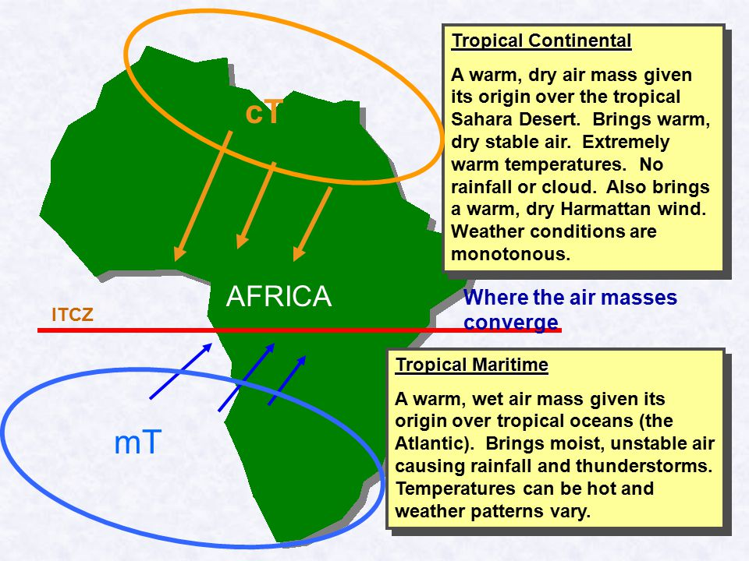
Introduction
Figure 1: Inter Tropical Convergent Zone across Africa

Slide 9
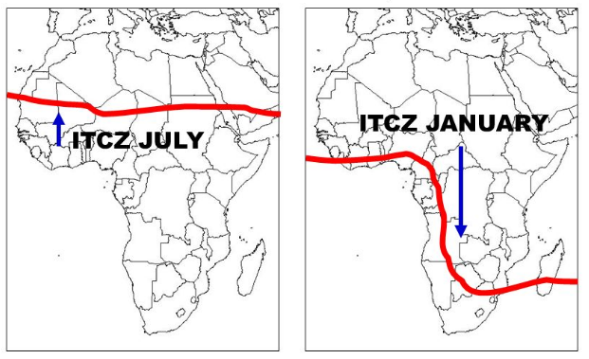
Introduction
Figure 2: The maps of Africa showing the locations of the ITCZ in (a) in July (rainy season sets in) and (b) January (dry season sets in).

Slide 10
Aim
The aim of this paper is to show the variation in temperature across five geopolitical zones in Nigeria using the data from 2003 to 2008 obtained at NIMET, Oshodi, Lagos, Nigeria.

Slide 11
Materials and Methods
Secondary data were obtained from Nigerian Meteorological Agency (NIMET), Oshodi, Lagos, Nigeria.
Statistical tools employed are:
Histogram
Arithmetic Mean
Time series

Slide 12
Results and discussion
Figure 3: Variation in wet bulb temperature in Kano
Figure 4: Variation in wet bulb temperature in Jos
Figure 5: Variation in wet bulb temperature in Lokoja
Figure 6: Variation in wet bulb temperature in Ibadan
Figure 7: Variation in wet bulb temperature in Ikeja
Figure 8: Variation in wet bulb temperature in Calabar
Figure 9: Variation in wet bulb temperature in PH
Figure 10: Variation in wet bulb temperature in Enugu

Slide 13
Results and discussion
Figure 11: Yearly variation in the average minimum temperature (wet bulb) in all the stations

Slide 14
Results and discussion
The mean minimum temperature obtained from each station were 25.1º C, 25.0º C, 23.7º C, 25.2º C, 23.4º C, 24.1o C, 17.2º C and 19.5º C for Port-Harcourt, Calabar, Enugu, Ikeja, Ibadan, Lokoja, Jos and Kano respectively.
The maximum temperature (dry bulb) in all the stations was significantly higher than the minimum temperature (wet bulb).

Slide 15
Result and discussion
The moisture content of air in the North is far less than in the South.
This also show that the amount of water vapour will also be different.
According to ITU-R, the temperature of moist air in the tropics is predicted to be 20º C.

Slide 16
Conclusion
The variations in temperature is due to the shift in ITCZ position.
This also account for the amount of rainfall expected in each station.

Slide 17
References
[1] Amadi SO, Udo SO and Ewona IO (2014). Trends and Variations of monthly mean, minimum and maximum temperatures data over Nigeria for the period 1950-2012. International Journal of Pure and Applied Physics, 2(4):1- 27
[2] Egbinola C. N., Amobichukwu A. C., (2013) Climate Variation Assessment Based on Rainfall and Temperature in Ibadan, South-Western, Nigeria. Journal of Environment and Earth Science. 3(11), 32
[3] Ekpoh IJ (2011). Extreme climatic variability in North-western Nigeria: an analysis of rainfall trends and patterns. Journal of Geographical Geology, 3(1) :51- 62.
[4] IPCC (2007). Climate Change 2007: The Physical Science Basis: IPCC Working Group I, Fourth assessment Report: Summary for Policy makers.
[5] International Telecommunication Union (2003), Characteristics of precipitation for propagation modelling, Recommendation. ITU-R P.837–4, Geneva, Switzerland
[6] Odekunle TO (2004). Rainfall and the length of growing season in Nigeria. International Journal of Climatology, 24: 467- 479.
[7] [5] Odekunle TO (2010). An Assessment of the Influence of the Inter-Tropical Discontinuity on Inter-Annual Rainfall Characteristics in Nigeria. Journal of Geographical Research, 48(3): 314–326
[8] Odjugo P. A. O. (2010). General Overview of Climate Change Impacts in Nigeria. Journal of Human Ecology, 29(1): 47-55
[9] Riehl, H., 1979. Climate and weather in the tropics. Department of Atmospheric Science, Colorado State University, Fort Collins, Colorado, USA. 613.
[10] Waliser D. E., Jiang X. (2014). Tropical Meteorology: Intertropical Convergence Zone. Encyclopedia of Atmospheric Sciences 2nd Edition.

Slide 18
Thank you for
listening

