Slide 1
FACULTY OF SCIENCE CONFERENCE
LAGOS STATE UNIVERSITY, OJO, LAGOS STATE, NIGERIA
Friday, 13th October, 2017.

Slide 2
THE GENETICS AND INCIDENCE OF THE TOE-PATTERN TRAITS IN SOME NIGERIAN POPULATIONS
by
Khalid Adekoya – Department of Cell Biology and Genetics, University of Lagos, Nigeria
Ime Etim – Department of Biological Sciences, Akwa-Ibom State University, Akwa-Ibom, Nigeria
Mutiu Sifau - Department of Cell Biology and Genetics, University of Lagos, Nigeria
Gideon Alimba – Department of Zoology, Cell Biology and Genetics Unit University of Ibadan, Nigeria
Adebayo Ogunkanmi - Department of Cell Biology and Genetics, University of Lagos, Nigeria
Bolanle Oboh - Department of Cell Biology and Genetics, University of Lagos, Nigeria

Slide 3
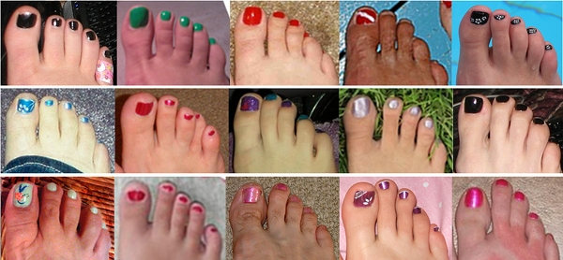
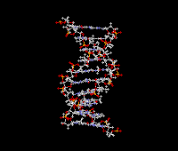

Slide 4
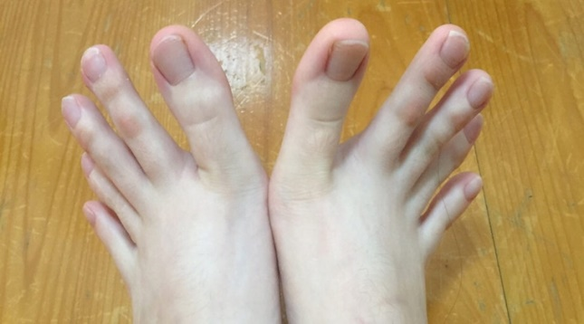
INTRODUCTION – Human Feet
Played roles in his survival and evolution.
Evolved as a platform to support the weight of the body
Strong, Complex and a Mechanical Structure
and the weight is spread round the toes.

Slide 5
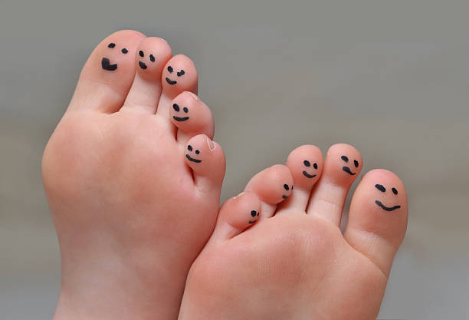
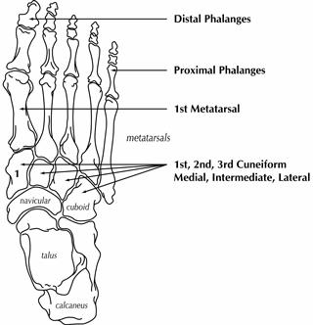
Toes
Twenty- six (26) bones, 33 Joints (20 articulated)
More than 100 muscles, tendons and ligaments
Fore-foot made up of 5 toes (Phalanges)
Technically, the hallux and the pinky toes are the most important ones as they are responsible for balancing

Slide 6
Toe Patterns
established as genetic trait from familial and population studies
could be used to determine ancestral lineage.
Various patterns and numerous modes of inheritance have been postulated for the toe trait in previous studies (Kaplan, 1964; Papadopoulos and Damon, 1973; Macdonald, 2011; Eupedia, 2013)

Slide 7
TOE PATTERNS
SLANTING HORIZONTAL ROOF HOOK STAIRS
BASED ON THE ABOVE WHAT ARE YOUR ROOTS???????

Slide 8
AIM OF THE STUDY
Assess the genetics and incidence of toe-pattern traits in some Nigerian populations

Slide 9
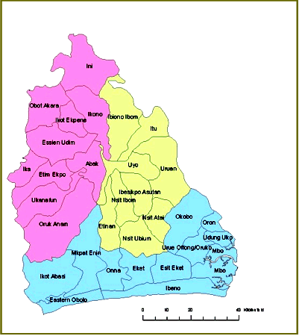
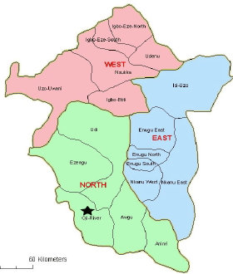
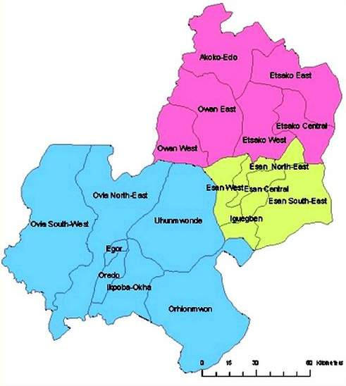
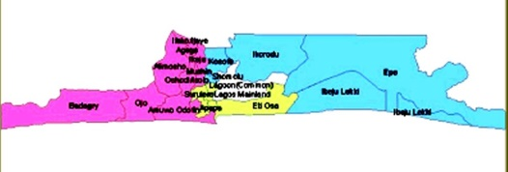
MATERIALS AND METHODS
107 Families
LAGOS
AKWA-IBOM
ENUGU
EDO

Slide 10
DISTRIBUTION OF SUBJECTS
519 = 42%
710 = 58%
682 = 57%
513 = 43%

Slide 11
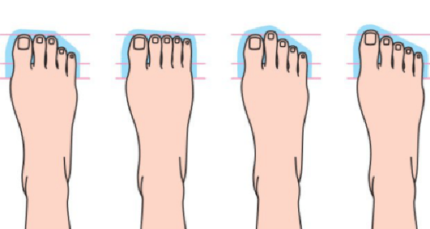
The toe patterns on both feet were drawn on white papers in sitting positions
Questionnaires were administered on all subjects
Statistical analysis using Chi square (p<0.05)

Slide 12
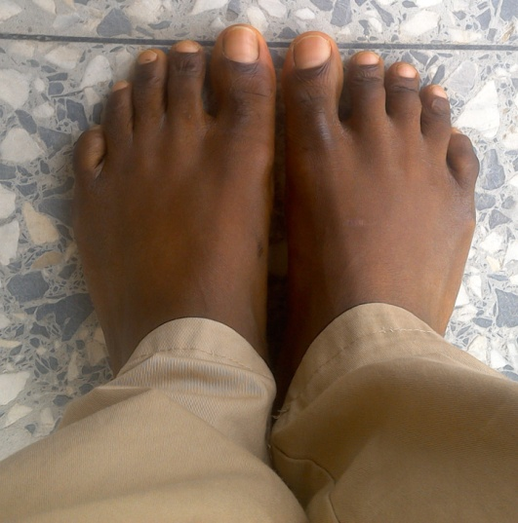
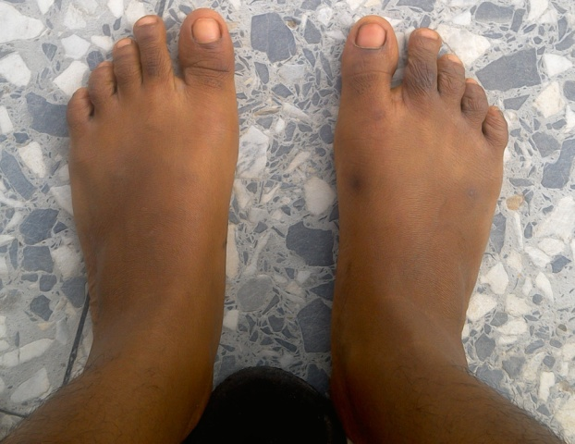
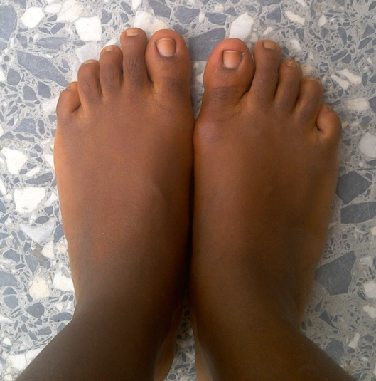
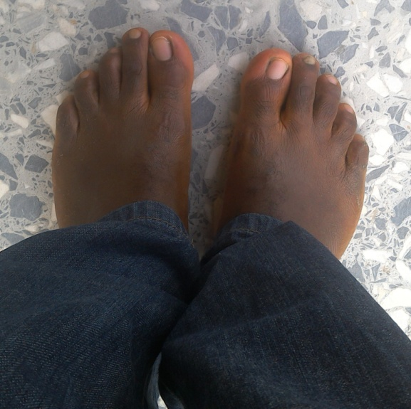
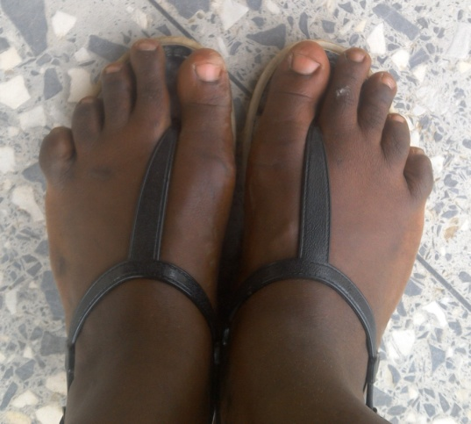
SOME TOE PATTERNS IN NIGERIANS
A
B
C
D
E
F

Slide 13
RESULTS
Table 1: Number of offspring from different toe -pattern matings
Parents mating types Fa. X Mo. | Number of Matings | Number of mating 1>2 2>1 1=2
1 X 2 | 12 | 25 | 23 | 2
1 X 1 | 54 | 191 | 12 | 0
1 X = | 1 | 2 | 0 | 2
2 X 1 | 10 | 21 | 17 | 2
2 X 2 | 13 | 11 | 38 | 0
= X = | 12 | 1 | 2 | 38
= X 1 | 5 | 6 | 0 | 12
Total | 107 | 257 | 92 | 56

Slide 14
Fig 1: Number of Offspring produced by different Toe –Pattern mating types
NUMBER OF OFFSPRING

Slide 15
RESULTS
Table 1 shows the longer hallux (1>2>3>4>5) was the most predominant trait in studied families with the highest incidence of 73.09%
The least prevalent toe-pattern trait was the equal hallux and second toe (1=2>3>4>5) with 18.01%.
Various mating types relative to the lengths of the hallux mostly produced progeny having their parental types.
No progeny has equal hallux and second toe in matings of longer hallux parents and longer

Slide 16
RESULTS
Table 2: Number of individuals with a toe trait on both feet
 | 1>2 | 2>1 | 1=2 | Total
Adult | 321 | 137 | 55 | 513
Children | 524 | 112 | 46 | 682
Total | 845 | 249 | 101 | 1195
Table 3: Number of male and female with a toe trait on both feet
 | 1>2 | 2>1 | 1=2 | Total
Male | 489 | 152 | 69 | 710
Female | 387 | 96 | 36 | 519
Total | 874 | 248 | 105 | 1229

Slide 17
RESULTS
Incidence
- Tables 2 and 3 show the longer hallux (1>2>3>4>5) still has the highest proportion
- The lowest proportion of the toe pattern goes to the equal hallux and second toe (1=2>3>4>5)

Slide 18
RESULTS
The incidence of the longer hallux was prevalent in the Nigerian populations
However, a rare case of (1<2>3>4>5) pattern was significant (P<0.05) among the Bini tribe studied.
Table 4: Proportion (%) of toe trait variants in the Nigeria tribes (a toe trait on both feet)
Tribe | 1>2 | 2>1 | 1=2
Bini | 13.33 | 73.33 | 13.33
Edo | 75.61 | 19.51 | 4.88
Hausa | 48.57 | 2.86 | 48.57
Ibibio | 87.50 | 8.93 | 3.57
Igala | 53.33 | 33.33 | 13.33
Igbo | 69.50 | 22.50 | 8.00
Urhobo | 75 | 12.50 | 12.50
Yoruba | 76.33 | 16.43 | 7.24

Slide 19
DISCUSSION
Pedigree analysis of the data cancelled out most modes of inheritance.
The toe pattern trait does not follow simple Mendelian laws as previous studies suggested.
Numerous variants of the patterns were observed. In other words, longer hallux has variants of its own likewise the longer second toe and, equal hallux and second toe.

Slide 20
DISCUSSION
The study proposes a polygenic nature for the mode of inheritance with the genes possibly having additive effects when expressed in the progeny

Slide 21
CONCLUSION
From the findings, toe-pattern traits seems to have a polygenic basis as the mode of inheritance.
Also, the genes tend to act additively to express the numerous forms of the observed patterns.

