Slide 1
INVESTIGATION OF THE SUITABILITY OF AVOCADO LEAF, RED KOLANUT LEAF AND WATER HYACINTH LEAF IN THE FABRICATION OF DYE SEN SITIZED SOLAR CELLS BY OKAFOR PAUL, ADENIKE BOYO,OLADEPO AYINDE AND AKINGBADE FATAI

Slide 2
INTRODUCTION
With the continued use of fossil fuels, global warming has become a major concern
in today’s society. There is therefore need
for alternative energy sources. A promising
new alternative for solar energy is the dye
sensitized solar cell.

Slide 3
INTRODUCTION CONTD
DSSc produce a current using natural plant dye pigment and there is therefore no toxic waste material. Dye sensitized solar
cells (DSSc) have potential to develop low cost alternative energy to traditional photovoltaic device [1,2] .

Slide 4
INTRODUCTION CONTD.
The electrolyte used in these cells are usually composed of an I¯/I¯₃ redox couple in organic sovents

Slide 5
INTRODUCTION CONTD.
The regenarable redox couple are usually dissolved in organic solvents which results
in high conversion efficiencies

Slide 6
INTRODUCTION CONTD (HOW DOES A DSSC WORK)

Slide 7
INTRODUCTION CONTD (HOW DOES A DSSC WORK?)
1 The dye is the photoactive material of DSSC, and can produce electricity once it is
sensitized by light.
2 The dye catches photons of incoming light(sunlight and ambient artificial light) and uses their energy to excite electrons

Slide 8
(HOW DOES A DSSC WORK?)
behaving like chlorophyll in photosynthesis.
3 The dye injects this excited electrons into
The titanium dioxde ( a white pigment commonly found in white paint).
4 The electron is conducted away by nanocrystalline titanium dioxde.

Slide 9
(HOW DOES A DSSC WORK?)
5 A chemical electrolyte in the cell then closes the circuit so that the electrons are
returned back to the dye.
6 It is the movement of these electrons that creates energy which can be harvested
into a rechargeable battery, super capacitor

Slide 10
SOURCE OF DATA
The source of the data is from dye sensitized solar cells fabricated in the physics laboratory, department of physics,
lagos state university, and from spectrophotometer readings, taken in the
laboratory

Slide 11
SPECTROPHOTOMETER MACHINE

Slide 12
ASSEMBLING THE CELL

Slide 13
METHODOLOGY
Avocado leaf, red kolanut leaf and water hyacinth leaves were gathered from a farm
in agbara Ogun state. 250g of each plant
material was then soaked in 500ml methanol for 24hrs. The cold extraction method was used.

Slide 14
AVOCADO
AVOCADO LEAF (Plate 1)
AVOCADO LEAF (Plate 1)

Slide 17
METHODOLOGY CONTD.
The plant extracts were then filtered and
stored in a reagent bottle. Spectrophotometer readings were carried out for each dye. The cells were assembled using TiO₂ thin films on FTO coated glass.

Slide 18
METHODOLOGY CONTD
After assembly, readings of current and
voltage were taken while the cells were
exposed to sunlight.

Slide 19
RESULTS

Slide 20
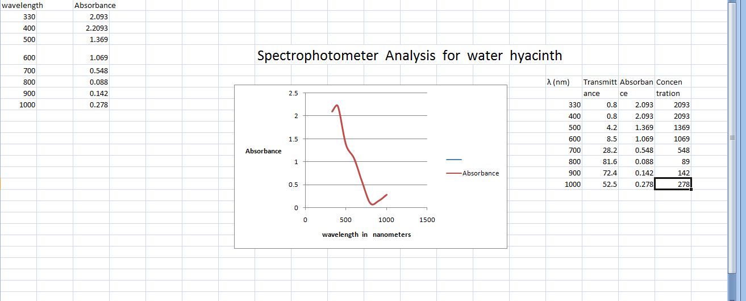
RESULTS

Slide 21
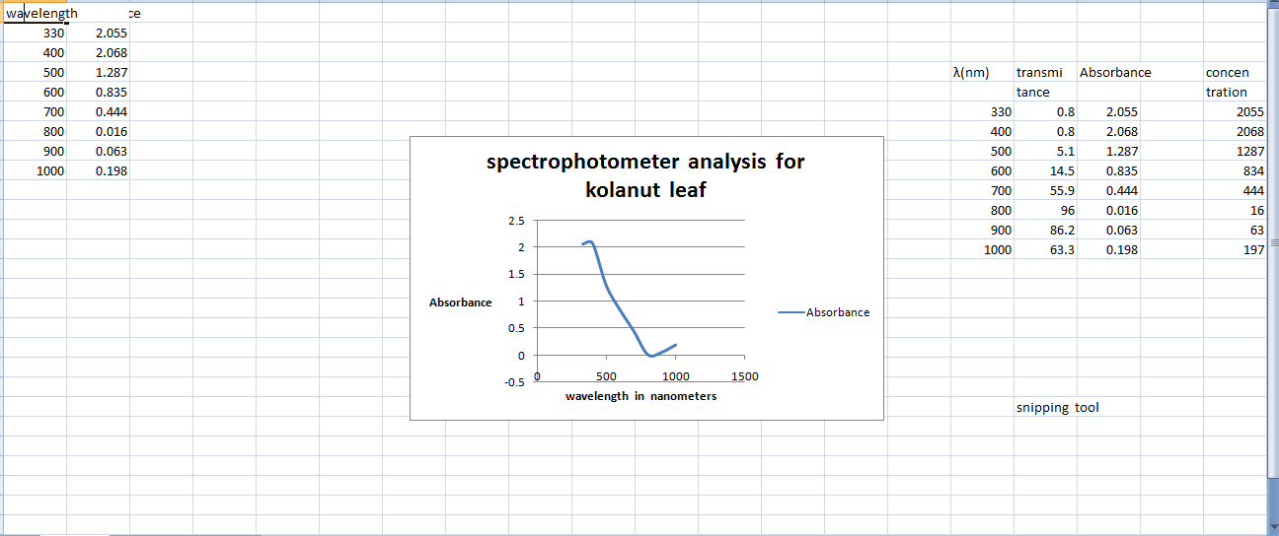
SPECTROPHOTOMETER ANALYSIS FOR KOLANUT LEAF.

Slide 22
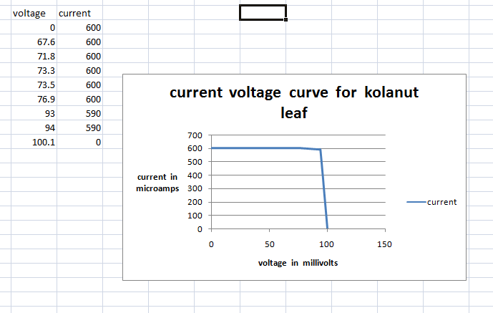
RESULTS CONTD

Slide 23
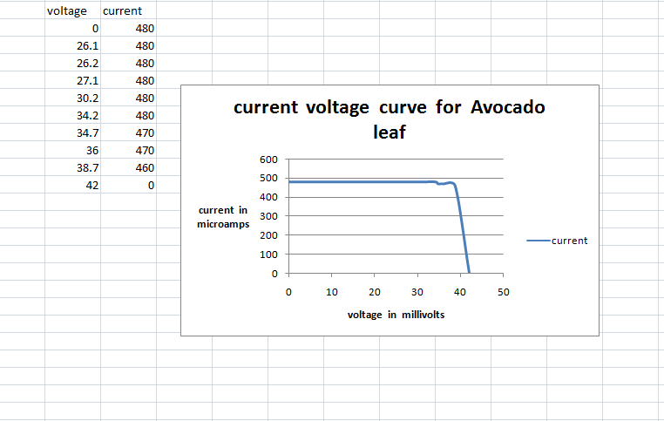

Slide 24
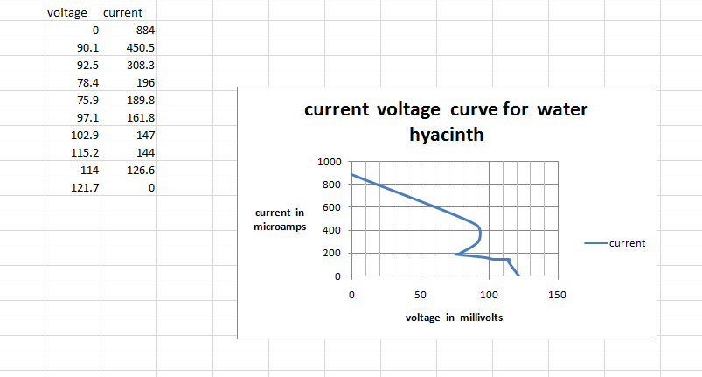

Slide 25
CALCULATIONS
Calculations
Efficiency of cell with kolanut leaf extract
The efficiency of the cell is given by Ƞ = ( FF x Isc x Voc) /Pin where FF is the fill factor. Isc is the short circuit current. Voc is the open circuit voltage. Pin is the incident solar radiation in watts per meter squared.
But FF = (Imax x Vmax)/ (Isc x Voc), where Imax is maximum cell current, Vmax is the maximum cell voltage. Imax is the maximum current obtained at the knee of the I-V curve. Vmax is the maximum voltage obtained at the knee of the I-V curve.
Imax for this cell is 580µA= 580 x 10⁻⁶A. Vmax = 80millivolts = 80 x 10⁻³V. (Note active area of cell =2cm by2cm = 4cm² = 4 x 10⁻⁴m²
Isc = 600µA = 600 x 10⁻⁶A
Voc = 100 millivolts = 100 x 10⁻³ volts, then FF = (580 x 10⁻⁶ x 80 x 10⁻³)/(600 x 10⁻⁶ x 100 x 10⁻³) = 0.7733. Cell efficiency =
Maximum power output per unit area
Maximum input power per unit area. Maximum power output = Imax x Vmax =
580 x 10⁻⁶ x 80 x10⁻³ = 4.64 x 10⁻⁵watts. Maximum power output per unit area = (4.64 x 10⁻⁵)/(4 x 10⁻⁴)watts per metre squared. = 11.6 x 10⁻²W/m². Solar intensity at time of experiment = 57.5W/m². So efficiency of cell = (11.6 x 10⁻²/57.5) x 100 = 0.2%

Slide 26
CALCULATIONS
Efficiency of cell with water hyacinth extract
For this cell, Imax = 400µA. Vmax = 90 millivolts, Isc = 900µA. Voc = 120millivolts
(See current - voltage graph). Then FF = (400 x 10⁻⁶ x 90 10⁻³)/(900 x 10⁻⁶ x120 x10⁻³)
=0.33. Cell efficiency = ( maximum power output per unit area)/(input power per unit area). Maximum power output per unit area = (36 x 10⁻⁶)/(4x 10⁻⁴) watts per meter squared. = 9x 10⁻²W/m² (Note active area of cell =2cmx2cm = 4cm² = 4 x 10⁻⁴m²).
Efficiency = (9 x 10⁻²)/(57.5) x 100 = 0.156%.

Slide 27
CALCULATIONS CONTD
Efficiency of cell with Avocado leaf extract
For this cell,
Imax = 470µA, Vmax = 38millivolts, Isc = 480µA, Voc = 43millivolts, then FF =
(470x 10⁻⁶ x38 x10⁻³)/(480 x 10⁻⁶x43 x10⁻³) =0.865.
Efficiency = (maximum power output per unit area)/(input power per unit area).
Maximum power output = Vmax x Imax = 38 x 10⁻³ x 470 x 10⁻⁶ =1.786 x 10⁻⁵W.
Maximum power output per unit area = (1.786 x 10⁻⁵)/(4x 10⁻⁴) = 0.044W/m², then efficiency = (0.044)/(57.5) x 100 = 0.07%.
Location of experiment, ie where readings were taken was Lagos State University, Ojo, Lagos on the 27th of july 2016 at 5:15 p.m.

Slide 28
CONCLUSION
Kolanut leaf has the highest efficiency of 0.2%. This is followed by water hyacinth with efficiency of 0.156%.
Avocado leaf has efficiency of 0.07%.
Generally, the efficiency of these cells can be
enhanced by using polymeric gel electrolytes.

Slide 29
CONCLUSION CONTD.
e.g. polyvinyl acetate and some organic acids, like benzoic acid, cholic acid.
This promotes long term stability of the cells
and makes the dye sensitized solar cell a reliable alternative source of energy to fossil
fuels.

Slide 30
Thank you
Thanks for listening

Slide 31
REFERENCES
References
[1] M.K. Nezeerudin P. Pechy, T. Renound Engineering of efficient panchromatic sensitizers for new crystalline TiO₂ based solar cells. Am Chem Soc 123(2001) 1613-1624
[2] M. K. Nezeerudin, A. Kay I. Rodico, M Gratzel. Conversion of light to electricity by cis -X₂ bis (2,2 bypyridil-4,4 dicarboxylate ruthenium (11). Charge transfer sensitizers. Am Chem Soc 115 (1993)63826390
[3] A.F. Noguira, J R Durrant M - A. D Paoli, Dye sensitized nanocrystalline solar cells employing a polymer electrolyte Adv. Mater 13(2004) 1455-1468
[4] A.F. Noguira, C. longo. M.A Paoli, Polymers in dye sensitized solar cells overview and perspectives, Coord chem.. Rev 248(2004) 145555-1468
[5] K. Murakoshi R. Kogure, Y Wada. S Yanagida, Fabrication of solid state dye Sensitized TiO₂ solar cells combined with polypyrrole, sol Energy Mater solar cells 55 (1998) 13-125

Slide 32
REFERENCES CONTD
[6]K. Tennakone, G.R.R.A. Kumara. A solid state photovoltaic cells sensitized with a ruthenium bypyridil complex. J phys D. APPS phys 31(1998) 1492 -1496
[7] E Chatzraslogue. T Sergio populous. A.G. Kentos. The influence of metal carbon and the filter on the performance of dye Sensitized solar cells using polymer gel redox electrolytes. J Photochem. Photobiol A chem. 192(2007)49-55
[8] L. Tennakone G.K.R. Senadecca. A quassi solid state dye sensitized solar cells based on a sol gel nanocomposite electrolyte containing ionic liquid chem mater 15(2003)1825-1829
[9] L. Wang,S.B. Fang. A 7.72% efficient dye sensitized solar cell based on nvel- heckale-like polymer gel electrolyte containing latent chemically cross linked gel electrolyte percussors. Chem. Commum. (2005) 5687-5689
[10] M. L., S feng X. Xian x L, X Zhon Y. Lin. The use of poly(vinylpyridine) co anglonitrile in polymer electrolysis for quassi solid dye sensitized solar cells based on composite polymer electrolytes containing fumed silica nanoparticles. Chem commum 14(2004) 1662-1663

Slide 33
REFRENCES CONTD.
[11] H Kim Ms Kang Y J Kim. Dye sensitized nanocrystalline solar cells based on composite polymer electrolyte containing fumed silica nanoparticles. Chem commum 14(2004) 1662-1663
[12] U Bach, D Lupo P conte. Solid state dye sensitized mesoporous TiO₂ solar cells with high photon to electron conversion efficiencies. Nature 395(1998) 583-585
[13] D Gebeyehu C.J. Brabee N.S. Sacrifti. Solid state organic/inorganic hybrid solar cells based on conjugate polymers and dye sensitized TiO₂ electrodes. Thin solid films 403(2002) 271-274
[14] H.X. Wang H.U. B.F. Xue Z.X. Wang, Q.B. Meng. Solid state composite electrolyte L.I./3 pydroxypropinitrile/SiO₂ for Dye Sensitized solar cells . J. Am. Chem Soc 127(2005) 6394-6401
[15] M. Matsumoto. H. Miyazaki. A dye sensitized photoelectrochemical cell constructed with polymer solid electrolyte solid state ions 89(1996)263-267

Slide 34
REFERENCES CONTD
[16] I. B. Oregan and M Gratzel, Nature, 353(1991) 737
[17] D. Wei and G. Amaratuga. Int. J. Electrochem Sci, 2(2007)897
[18] M.H. Lai M.W. Lee. G.J. Wang and M.F. Tai, Int J. Electrochemical science 6(2001)2122
[19] A Yella, H.w. Lee H.N. Tsao C.Y. Yeh S.M. . Zakeeeruddan and M. Gratzel, science 334(2004)127
[20] E. Figgermeir and A Hagfeldth Int J photoenergy 6(2004)127
[21] M. I. Asghar K Miettunen J. Halma. P. Vahermaa. M Toila. K. Aitola and P Lund. Energy Environmental sci 3(2010)418
[22] M. Gratzel Cr Chim, 9(2006)518
[23] M. Toivola. J. Halme P Lund Int J of photoenergy, DOI, 10, 1155/2009/786429
[24] A Hinsch J.M. Kroom R Keru I Ulendorf, J Ferber, Prog in photovoltaics 9(2001)425
[25]S.Y. Dai. J. Wang Y.F. Sui, S.H. Chen S.F. Xiao Y Huan Inorg F.T. Kong and K J Wang Inorganic Chim. Acta 36(2008)786

