Slide 1
SYSTEMATIC REVIEW OF COMPUTATIONAL MODELS FOR BRAIN PARCELLATION
By
OWATE, Patrick Adeomo
Co-authors: Benjamin Aribisala, Charles Uwadia and Philip Adewole

Slide 2
OUTLINE
Introduction
Aim of Study
Methods
Results from Database searched
Categorization of Automated Models for Brain Parcellation
Conclusion
List of References

Slide 3
INTRODUCTION
Brain is the most important organ in human body.
It is pertinent to carry out studies on the human brain in order to understand how it relates to medical conditions and good health.

Slide 4
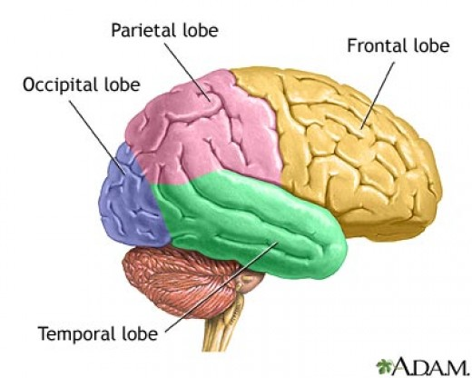
THE FOUR LOBAR SECTIONS OF THE HUMAN BRAIN
Human brain consists of four lobar sections, viz. Frontal lobe, Parietal lobe, Temporal lobe and Occipital lobe and each part does different things.
Researchers are always interested in parcellating (dividing) the brain into these lobar sections before studying them.
This division helps in the diagnosis and evaluation of the neurological diseases such as stroke.

Slide 5
FUNCTIONS OF THE LOBES OF HUMAN BRAIN
Frontal Lobe - reasoning, planning, movement, emotions, and problem solving.
Parietal Lobe - movement, orientation, recognition, perception of stimuli.
Occipital Lobe - visual processing.
Temporal Lobe - perception and
recognition of auditory stimuli, memory,
and speech.

Slide 6
BRAIN PARCELLATION METHODS
There are two major methods for parcellating the brain, viz. manual and automated methods.
Manual method is accurate.
Manual method has the following weaknesses:
It is time consuming (It can take a whole day for a trained neuro-radiology to parcellate one brain).
It has problem of repeatability.
It is subjective.
It is human resource intensive.
In view of these, automated method is preferred.
With automated method, computer algorithms can be used to parcellate human brain.

Slide 7
MOTIVATION OF RESEARCH
There is no standard model for parcellating ageing brain.
A common approach to parcellating ageing brain is to use existing automated models.
The existing automated parcellation models were developed for young adults.
These models have limited accuracy when used for ageing brains.
The limited accuracy problem is due to age related changes in the brain, e.g. atrophy.

Slide 8
AIM OF STUDY
The aim of this paper is to critically review existing models for the parcellation of human brain into lobar sections and identify the model with the best performance.

Slide 9
METHODS
Pubmed was searched.
Search terms used contain Parcellation, Brain, Magnetic Resonance Imaging (MRI)
Papers that contained connectivity, functional MRI, diffusion tensor imaging and PET were not included.
A screened abstract is included if parcellaion is done, subject is not animal and Imaging technique is MRI
Full texts were included if they satisfy the following:
Method of parcellation is clearly indicated
Image type used is T1W
Parcellated areas are lobar regions
The number of lobar sections is clearly indicted

Slide 10
RESULTS FROM DATABASE SEARCHED
The search resulted into 569 articles
167 papers were potentially relevant
7 papers were identified via references
Total of 174 abstracts were screened
66 Full-text papers were assessed for eligibility
39 articles met inclusion criteria

Slide 11
CATEGORIZATION OF AUTOMATED MODELS FOR BRAIN PARCELLATION
The following parcellation models were reviewed:
Supervised Learning Models.
Unsupervised Learning Models.
Region Growing Models.
Shape and Appearance Models.
Energy-based Models.
Atlas-based Models.

Slide 12
SUPERVISED LEARNING MODELS
Parcellation is based on developing algorithm from training data .
Strength:
They are not sensitive to the choice of the training data.
Weaknesses:
Implementation is slow.
Computational cost is very high.
The accuracy of these models can be decreased by the existence of noise.
(Moghaddam and Soltanian-Zadeh, 2009)

Slide 13
UNSUPERVISED LEARNING MODELS
They do not make use of training data to parcellate.
Strength:
They are fully automated.
Weaknesses:
They are computationally difficult.
They are inefficient if used for noisy images and artifacts.
(Kang et al., 2011; Yazdani et al., 2015)

Slide 14
REGION GROWING MODELS
They use seed and homogeneity criteria to carry out parcellation.
Strength:
Their parcellation results are more accurate than those of pixel-based models
Weaknesses:
They are not fully automated techniques (manual selection of seed).
Choice of seed point affects results.
These models only work well in homogeneous regions.
(Gao et al., 2011; Yazdani et al., 2015)

Slide 15
SHAPE AND APPEARANCE MODELS
They use shape relation and individual transformations to carry out parcellation.
Strength:
They do not depend on parameters and is robust.
Weakness:
Image quality must be very good before accuracy can be assured.
(Asl and Soltanian-Zadeh, 2008)

Slide 16
ENERGY-BASED MODELS
They carry out parcellation based on similarity (homogeneity) of image regions.
Strength:
They do not depend on parameters.
Weakness:
They can only take care of structures that have different intensity distribution from most of the surrounding tissues.
(Vineetha and Darshan, 2013)

Slide 17
ATLAS-BASED MODELS
Parcellation is based on the inference from manually labeled training data by clinical experts.
Strengths:
Can parcellate images with no well defined relation between regions and pixels’ intensities.
Very useful when objects of the same texture need to be parcellated or when there is lack of border or excessive noise.
It is established through experiments that the performance of atlas based models is the best.
Weaknesses:
Atlas construction time is enormous and may be subjective.
Performance depends on the method of registration, type and choice of atlases deployed.
(Aljabar et al., 2009; Aribisala et al., 2013; Babalola et al., 2009; Babalola et al., 2008; Ginneken et al., 2007; Heckemann et al., 2010; Igual et al., 2011)

Slide 18
CONCLUSION
Summary
The following parcellation models were reviewed:
atlas-based, supervised learning, shape and appearance and energy-based models, unsupervised learning, region growing models
Among all these models, atlas-based models perform the best.
Future Direction
Further research on atlas-based parcellation models will be conducted with a view of coming up with a framework that will enhance the existing atlas-based parcellation models.

Slide 19
THANK YOU.

