Slide 1
Genetic structure of some major Nigerian populations based on Y-SNP haplogroup
COLE-SHOWERS, C.L., ADIGUN, E. J., ADUAKA, P., ODEYALE , K. N. and OLADIMEJI, S.O.
Lagos State University, Department of Biochemistry, Forensic DNA Laboratory, Ojo

Slide 2
Introduction
The Human genomic DNA is > 3.1 billion base pairs
There are several genetic markers but two have been of significant value to Forensic and anthropological analyses: mtDNA and Y-Chromosome
While the mtDNA is maternally inherited by all humans, the Y chromosome is only found in the male
STRs and SNPs found in the non-recombining regions of the human Y-chromosomes could be used to investigate the paternal demographic history of a population due to there different mutation rates
The Y-chromosome SNP tree labeled Haplogroups A-T accommodates all male humans.
Haplogroups A , B, E, J and R have been reported in African populations
Nigerian populations have been grouped into more than 500 ethno-linguistic groups. These populations speak majorly Niger-Congo, Afro-asiatic and Nilo-Saharan languages
There are no major geographical barriers among these Nigerian populations increasing the potential for gene flow

Slide 3
Objectives of The Study
To investigate the association between genetics, linguistics and geographical variations among the three major populations of Nigeria namely the Hausa, Igbo and Yoruba, utilizing some Y-chromosome Single Nucleotide Polymorphisms (Y-SNPs)
To contrast the pooled overall Nigeria populations with some regionally representative African Countries from published literatures

Slide 4
Materials and Methods
Populations sampling
Y- SNPs Typing
Restriction Fragment Length Polymorphisms (RFLPs)
Restriction Enzyme Digest of PCR products
SNP resolution by High Resolution Melting
Statistical analysis

Slide 5
Table 1: Nigeria sampled populations
S/No | Region |  | Geographical location | Abbreviation | Geographical Latitude , longitude | Linguistic group | Ethnicity | Total sampled
No1 | North central | Niger |  | NG-AA | 10.2155388, 5.3939551 | Afro-asiatic | Hausa | 14
No2 | North | Jigawa |  | JG-AA | 12.4460001, 9.7232673 | Afro-asiatic | Hausa | 6
No3 | North | Kaduna |  | KD-AA | 10.1589593, 8.133855 | Afro-asiatic | Hausa | 9
No4 | North | Kano |  | KN-AA | 11.7574188, 7.6114217 | Afro-asiatic | Hausa | 10
No5 | North | Kebbi |  | KB-AA | 11.6781241, 4.0695454 | Afro-asiatic | Hausa | 7
No6 | North | Sokoto |  | SK-AA | 13.1177202, 5.3939551 | Afro-asiatic | Hausa | 32
No7 | South east | Abia |  | AB-NC | 5.4308, 7.5247 | Niger-congo | Igbo | 19
No8 | South east | Anambra |  | AN-NC | 6.2757656, 7.0068393 | Niger-congo | Igbo | 23
No9 | South south | Delta |  | DT-NC | 5.5324624, 5.8987139 | Niger-congo | Igbo | 8
No10 | South east | Ebonyi |  | EB-NC | 6.177973, 7.9592863 | Niger-congo | Igbo | 5
No11 | South east | Enugu |  | EN-NC | 6.6095187, 7.351658 | Niger-congo | Igbo | 12
No12 | South east | Imo |  | IM-NC | 5.5214533, 6.9209135 | Niger-congo | Igbo | 52
No13 | North central | Kogi |  | KG-NC | 7.561891, 6.5783387 | Niger-congo | Yoruba | 7
No14 | North central | Kwara |  | KW-NC | 8.9847995, 4.5624426 | Niger-congo | Yoruba | 22
No15 | South west | Ekiti |  | EK-NC | 7.6655813, 5.3102505 | Niger-congo | Yoruba | 24
No16 | South west | Lagos |  | LA-NC | 6.5232765, 3.5407909 | Niger-congo | Yoruba | 48
No17 | South west | Ogun |  | OG-NC | 6.9098333, 3.2583626 | Niger-congo | Yoruba | 38
No18 | South west | Ondo |  | ON-NC | 6.8959293, 4.8935627 | Niger-congo | Yoruba | 24
No19 | South west | Osun |  | OS-NC | 7.5875843, 4.5624426 | Niger-congo | Yoruba | 35
No20 | South west | Oyo |  | OY-NC | 8.119567, 3.4195527 | Niger-congo | Yoruba | 40
No21 | South south | Edo |  | ED-NC | 6.5438101, 5.8987139 | Niger-congo | Bini | 13
No22 | South south | Bayelsa |  | BY-NC | 4.86777767, 5.8987139 | Niger-congo | Ijaw | 15

Slide 6
Table 2: Sampled populations from Literature

Slide 7
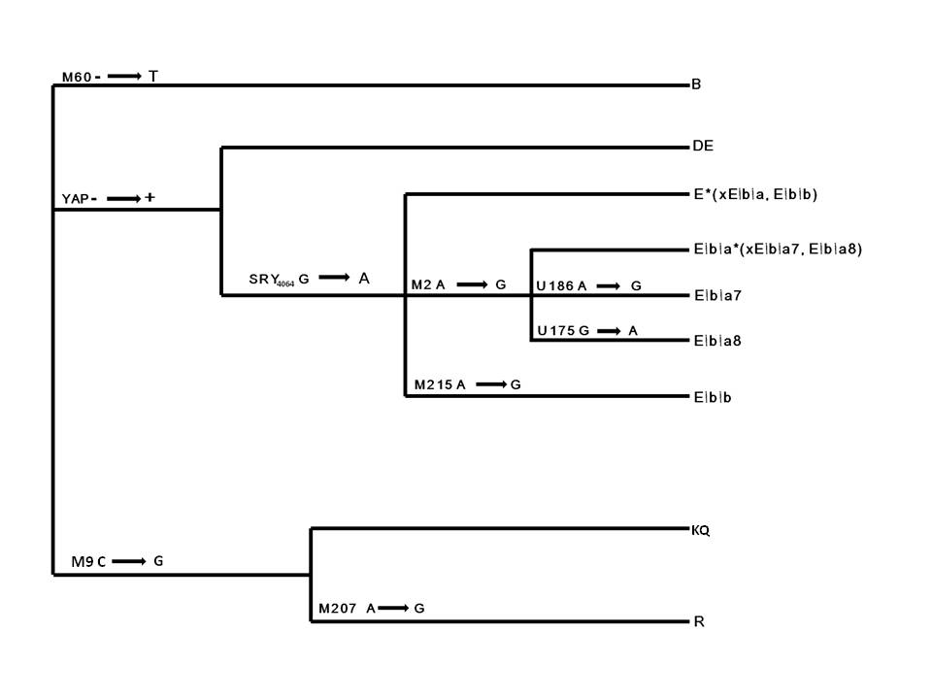
Y- SNPs Typing
Figure 1: The Tree of Y-SNPs evaluated in this study

Slide 9
Table 2 HRM primers

Slide 10
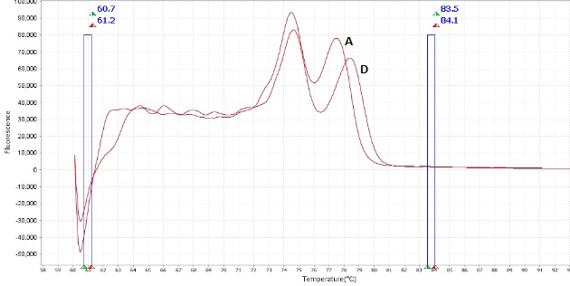
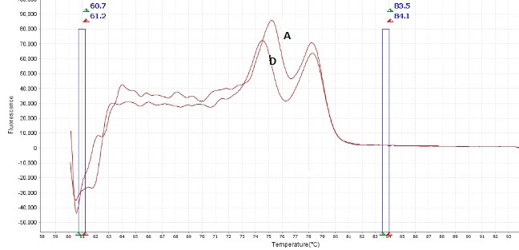
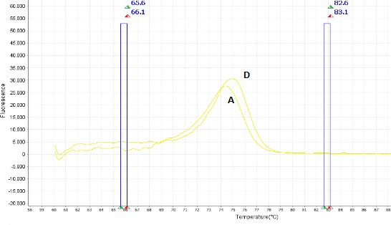
(a)
(b)
(c)
Figure 2 Derivative HRM plots of (a) E1b1a7, (b) E1b1a8 and (c) E1b1b Y-SNP haplogroups.
A and D represents the Ancestral and Derived versions of the haplogroups

Slide 12
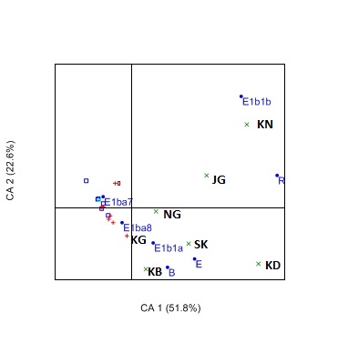
The major haplogroups driving the spatial genetic structure
Figure 3a: Correspondence plot based on the Y haplogroup frequencies of the five major Nigerian populations sampled across 22 different geographical locations.

Slide 13
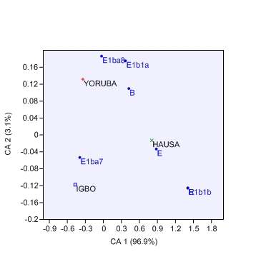
Figure 3b: Correspondence plot of the haplogroup frequencies of the three major Nigeria populations

Slide 14
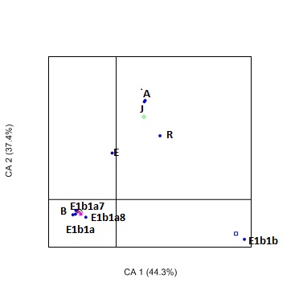
Figure.3c: Correspondence plot of African Country populations against their respective haplogroup frequencies
Notes:
The Blue dots represented the haplogroups labeled in blue. The Hausa populations are represented with Green Cross, the Yorubas with Red Cross, the Igbos with Blue Square, the Bini with Brown Bar and the Ijaw with Blue Triangle. The Bold abbreviated labels represented the sampling location as described earlier in Table 2.1 (shown only for the six Hausa populations and the Yoruba population from Kogi for clarity)

Slide 15
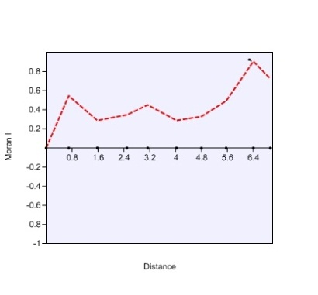
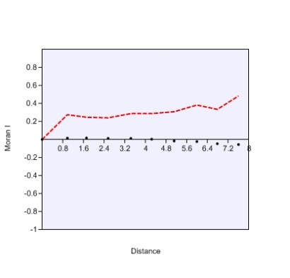
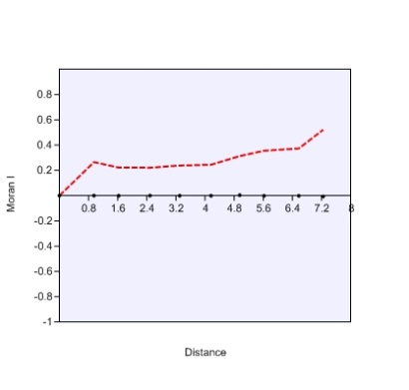
Figure 3.4 showed the spatial autocorrelations for the three most represented haplogroups in the Nigerian populations.

Slide 16
Table 3.4 : Analysis of Molecular Variance (AMOVA) of Nigerian populations
Marker | Categories | Par | Overall(n=22) |  |  | Population (n=5,22) |  |  | Geographic Region (n=5,22) |  |  | Linguistic (n=2,22)
 |  |  | Fst | Variance | P value | Fst | Variance | P value | Fst | Variance | P value | Fst | Variance | P value
 | Among Groups | Fst | 0.06218 | 6.22 | <0.00001 | 0.078 | 6.96 | <0.00001 | 0.0828 | 6.96 | <0.00001 | 0.1577 | 14.55 | <0.00001
SNP | Among populations within groups | Fsc |  |  |  | 0.0091 | 0.84 | 0.18573 | 0.0142 | 1.32 | 0.13587 | 0.0143 | 1.22 | 0.088
 | Within populations | Fct |  |  |  | 0.0696 | 92.2 | <0.00001 | 0.0696 | 91.72 | <0.00001 | 0.1455 | 84.23 | <0.00001

Slide 17
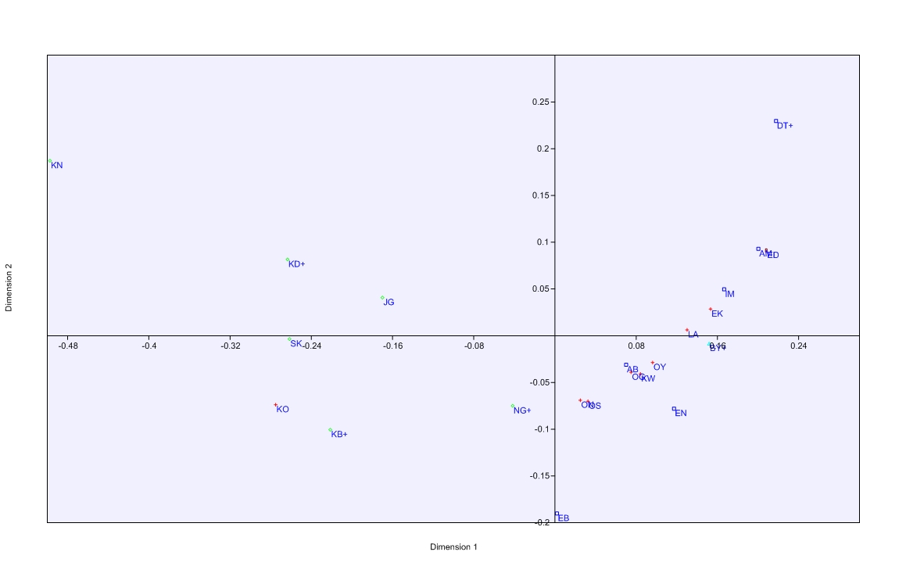
Multidimensional Scaling Plot based on Fst distances of Y-SNP Haplogroup frequencies of the sampled populations
Figure 6a: Multidimensional scaling plot of Pairwise Fst distance of Y haplogroup SNPs of Nigerian populations sampled across 22 different geographical locations

Slide 18
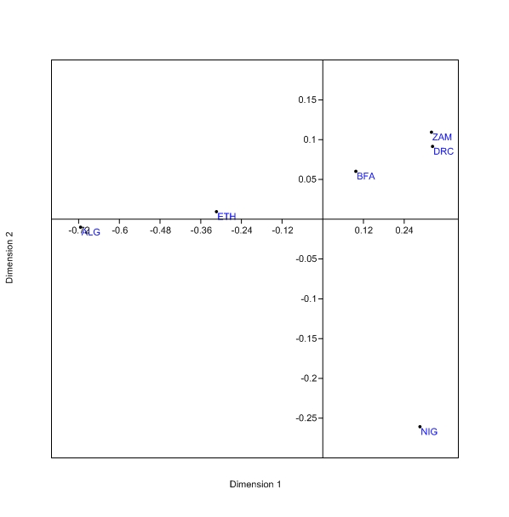
Figure 5c: Multidimensional Scaling plot of Pairwise Fst of the overall Nigerian (NIG) population contrasted with representative Africa populations SNPs from published literature

Slide 19
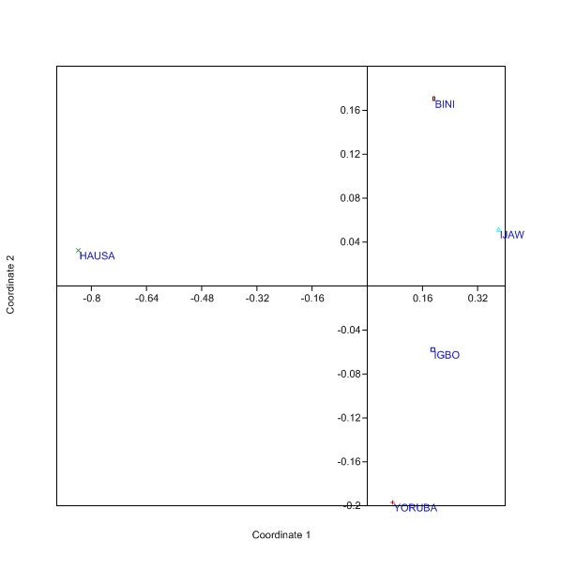
Figure 5b: Multidimensional scaling plot of pairwise Fst distance of the five major Nigerian populations SNPs.

Slide 21
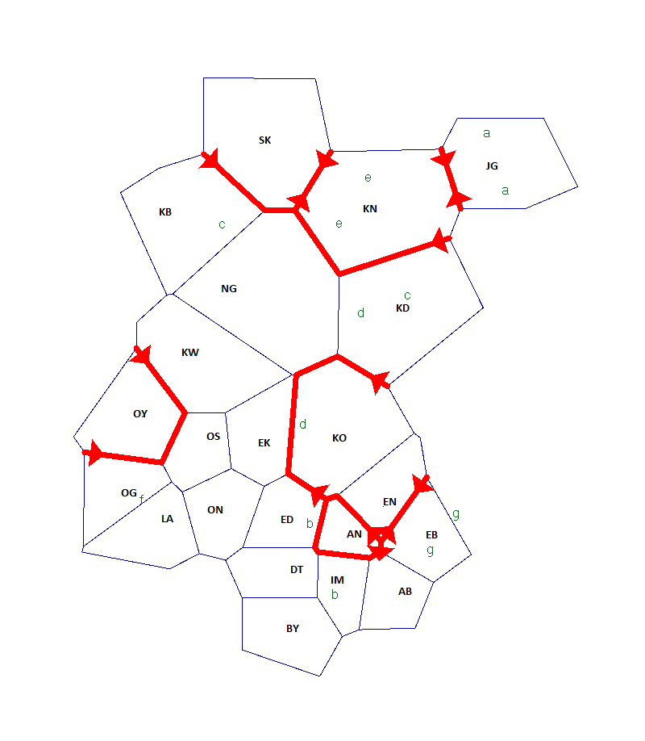
The MDS plot (Figure 3.5c) comparing the Nigerian population with African populations
Figure 6: Plot of putative genetic barrier across the geographical sampling of Nigerian population based on the Y SNP haplogroups

Slide 23
Discussion
The five major populations were resolved into 7 haplogroups based on Karafet et al’s nomenclature (Karafet et al., 2008).
The Hausa population had the highest diversities
While Haplogroup E1b1a7 and E1b1a8 were prevalent in the entire Country, they were not noticed in the Kaduna Hausa (KD) populations.
Even though Haplogroup E1b1b has been suggested as the signature Afro-Asiatic language haplogroup in the broader African context (De Filippo et al., 2011), it was only represented by 5% of the entire Afro-Asiatic Hausa of Nigeria. There was however a significant proportion of haplogroup R (18%) mainly found in Central Africa (Hassan et al., 2008).

Slide 24
Haplogroup R was almost exclusively found among the Hausas where it represented more than 90% of the entire Haplogroup in the Country.
On the background of the M2 mutation, this was found in less than 50% of the Hausa populations of Nigeria despite its been represented not less than 90% in the four different Southern Nigeria populations (Igbo – 94%, Yoruba –90%, Bini -92% and Ijaw 100%), which is not substantially different from the reported observation in some recent publications (Montano, et al., 2011; Barbieri et al., 2012).
Overall, on the background of M2 mutation, Nigeria had 84% ( -E1b1a 4%, E1b1a7 63% and E1b1a8 19%) of this mutation which was comparable to earlier report of Veeramah et al. (Veeramah et al., 2010) which reported more than 90% for Cross Rivers Nigerian populations. Haplogroups E1b1b and R were found in about 1% and 3% respectively while both haplogroup B and E were found in about 5% and 6% respectively.
Language was stronger than geography in driving the population structure. The Nigerian population was significantly distinct from her African neighbours suggesting a unique demographic history.

Slide 25
Thank you

