Slide 1
PARTIAL PURIFICATION AND CHARACTERIZATION OF CYSTEINE PROTEASE INHIBITOR FROM Canavalia ensiformis (WONDER BEAN)
5th FACULTY OF SCIENCE CONFERENCE
LAGOS STATE UNIVERSITY
OJO
LAGOS STATE.
PRESENTER :
KANMODI RAHMON ILESANMI
1

Slide 2
INTRODUCTION
Uncontrolled proteolysis resulting from an imbalance between cysteine proteases and their inhibitors play a critical role in a wide spectrum of pathological processes.
Cysteine proteases (EC 3.4.22) : also known as thiol proteases, are enzymes that degrade proteins (Jinka et al., 2009) .
Cysteine protease inhibitor (CPI): are responsible for the stringent regulation and control of activities of these enzymes (Corrion et al., 2010).
Plants distinguished by their ability to continuously grow under extreme environmental conditions such as nutrient-depleted, highly leached and acidic soil are rich sources of CPI.

Slide 3
INTRODUCTION CONT’D
Wonder bean (Canavalia ensiformis): is a climbing perennial legume widely cultivated in humid tropics of Asia and Africa (Malviya et al., 2010).
Investigation of C.ensiformis for CPI properties provided clue of its potential to efficiently regulate cysteine protease activities .

Slide 4
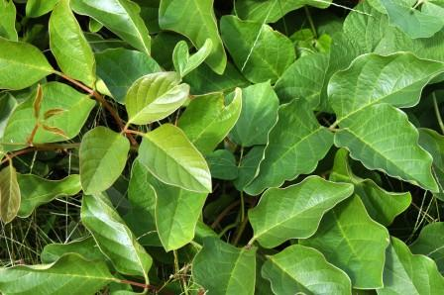
INTRODUCTION CONT’D
Fig. Canavalia ensiformis leaves

Slide 5
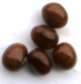
INTRODUCTION CONT’D
Fig : Canavalia ensifromis seeds

Slide 6
AIM
To isolate and characterise cysteine protease inhibitor from Canavalia ensiformis.

Slide 7
METHODS
SAMPLE COLLECTION AND PREPARATION
EXTRACTION AND ISOLATION
PURIFICATION
ION EXCHANGE CHROMATOGRAPHY
GEL FILTRATION
SPECTROPHOTOMETRIC ANALYSIS
SDS PAGE

Slide 8
RESULTS
Table 1. Purification table of cysteine protease inhibitor (CPI) from Canavaila ensiformis
Sample Total Inhibitory Specific inhibitory Protein Activity Purification Protein (mg) activity(units) activity( unit/mg) yield (%) yield (%) fold
Crude 90.0 1330 14.7 100 100 1 extract Ammonium 46.0 990 22 50 74.4 1.4 sulphate Fraction (65%) Ion Exchange 25.0 1220 48.8 27.8 91.7 3.3 chromatography (DEAE-cellulose) Gel filtration (Sephadex G-100) 11.0 1110 99.1 12.2 81.0 6.7

Slide 9
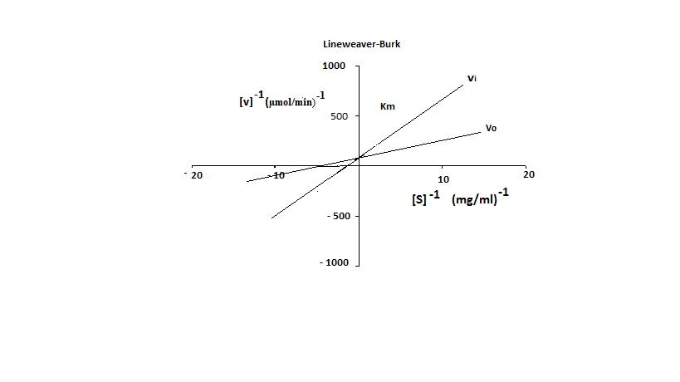
RESULTS CONT’D
Figure 1. Lineweaver-Burk plot of purified CPI. In the absence and presence of purified inhibitor extract, the reciprocal of the varying amount of substrate concentration [1/S] used and the reciprocal of the absorbance (1/V) at 280 nm were plotted against each other. The double reciprocal plot shows that inhibition is competitive having the same Vmax of 78.59μmol/min, different Km =209 μM and Ki= 137 μM. [Vi]= with inhibitor and [Vo] = without inhibitor

Slide 10
RESULTS CONT’D
pH
Temperature (ºc)
Figure 2. Optimum temperature of purified cysteine protease inhibitor.
Figure 3. Optimum pH of purified cysteine protease inhibitor

Slide 11
RESULTS CONT’D
Figure 4: Effect of metal on CPI activity. At concentration as low as 1mM, divalent metal ; Pb²⁺, Mg²⁺, Co²⁺, Mn²⁺, Zn²⁺ and Cu²⁺decreased the residual cysteine protease inhibitory activity .

Slide 12
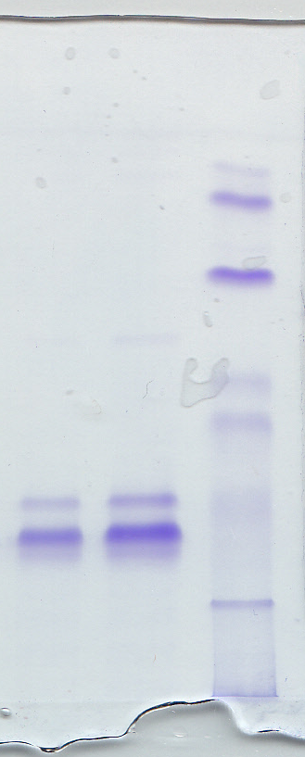
RESULTS CONT’D
S
M
KDa
112
74
52
45
32
28
18.4
14.4
Fig 5. SDS-PAGE analysis for the purified cysteine protease inhibitor. The gel pattern of the cysteine protease inhibitor fraction when subjected to SDS-PAGE yielded a double polypeptide band with a molecular weight of 28 and 32kDa. M= marker; S = sample.

Slide 13
DISCUSSION
CPI from C.ensiformis exhibited optimal activity at temperature and pH of 40°C and 8.0 respectively.
Maximum inhibitory effect of Isolated cysteine protease inhibitor from Canavalia ensiformis seeds was observed with 65% ammonium sulfate precipitation .
Interactions of metal ions such as Mg²⁺, Pb²⁺, Cu²⁺, Mn²⁺, Zn²⁺, and Co²⁺ with cysteine protease inhibitor from Canavalia ensiformis showed that some metals enhanced the inhibitory activity of cysteine protease inhibitor while some reduced its activity.

Slide 14
DISCUSSION CONT’D
The mechanism of inhibition of purified cysteine protease inhibitor from Canavalia ensiformis is competitive , yielding the same Vmax.
The result of SDS PAGE analysis revealed two polypeptide bands with molecular weight of 28 and 32 KDa. This suggests that a splitting of the polypeptide chain might have occurred or there might be two different cysteine protease inhibitors present.
The physiochemical properties exhibited by the CPI from Canavalia ensiformis is similar to that obtained in previous studies.
This makes it an attractive candidate for potential utilization as a pharmaceutical agent in the treatment of pathological conditions such as cancer and neurodegenerative diseases.

Slide 15
CONCLUSION
The cysteine protease inhibitor from Canavalia ensiformis were successfully isolated and there was an indication that it is composed of two polypeptide chains that might have been denatured under reducing condition in the presence of β-mercaptoethanol. However, further investigation is required to verify this.

Slide 16
REFERENCES
Arun A, Sridhar K, Raviraja N, Schmidt E and Jung K (2003) Nutritional and antinutritional components of Canavalia spp. seeds from the west coast sand dunes of India. Plant Foods for Human Nutrition 58:1-13.
Ashouri S, Abad RFP, Zihnioglu F and Kocadag E (2017) Extraction and purification of protease inhibitor (s) from seeds of Helianthus annuus with effects on Leptinotarsa decemlineata digestive cysteine protease. Biocatalysis and Agricultural Biotechnology 9:113-119.
Chee YKH, J. B.; Ramirez, L. ; Chen, C. P., (1992) Canavalia ensiformis (L.) DC. Record from Proseabase. Mannetje, L.'t and Jones, R.M. (Editors). PROSEA (Plant Resources of South-East Asia) Foundation, Bogor, Indonesia.
Obayomi A, Adeola S, Bankole H and Raimi O (2015) Characterization of partially purified cysteine protease inhibitor from Tetracarpidium conophorum (African walnut). African Journal of Biochemistry Research 9:26-34.
Udedibie A and Carlini C (1998) Questions and answers to edibility problem of the Canavalia ensiformis seeds–a review. Animal Feed Science and Technology 74:95-106.

Slide 17
THANK YOU FOR LISTENING

