Slide 1
Forensic significance and Population structure based on the 11-loci SWGDAM recommended Y-STR haplotypes in some Nigerian Population

Slide 2
Introduction
The Human genomic DNA is > 3.1 billion base pairs
There are several genetic markers but two have been of significant value to Forensic and anthropological analyses: mtDNA and Y-Chromosome
While the mtDNA is maternally inherited by all humans, the Y chromosome is only found in the male
STRs and SNPs found in the non-recombining regions of the human Y-chromosomes could be used to investigate the paternal demographic history of a population due to there different mutation rates
Y‐STRs have various applications in forensic DNA analysis. The advantages of Y‐STR analysis over autosomal STRs include: a) male profile can be obtained in the presence of large amounts of female DNA; b) differential extraction of sperm and non‐sperm fraction is not necessary; c) analysis of azoospermic semen samples from vasectomized males is feasible; d) the number of male contributors often can be determined in multiple rape cases because of the haploid nature of the Y‐STRs; e) rapid exclusion of suspects can occur; f) interpretation is simplified due to single allele per locus profile; g) in deficient paternities and h) multigenerational male lineage studies can be performed (Roewer, 2009).

Slide 3
Objectives
Specifically, We generated data based on the SWGDAM recommended Y-STRs for the three major Nigerian populations (Hausa, Igbo and Yoruba with a slight consideration of representative populations of Bini and Ijaw to contrast them in their geographical context of sub-structuring among the major populations and assess their forensic values.
Secondarily, to contrast the Nigerian data set with some published literature haplotypes from other representative regional African populations.
Thirdly to discuss the potential enrichment of the African meta-population on the Y-chromosome Haplotype Reference database (YHRD).

Slide 4
Materials and method
Population sampling
DNA extraction and quantification
Primers design
Y-STR Typing
Multiplex PCR Cycling
Detection of PCR products and scoring of alleles
Measurement of forensic parameters
Population pairwise difference
Analysis of molecular variance
Multidimensional Scaling
Spatial Genetic Barrier Assessment
Mantel’s test

Slide 5
RESULTS

Slide 6
RESULTS
Populations | N | K | UH | DC | HD | RMP
Hausa | 78 | 75 | 74 | 0.962 | 0.999167 | 0.000833
Igbo | 119 | 108 | 99 | 0.908 | 0.99815 | 0.00185
Yoruba | 238 | 214 | 193 | 0.899 | 0.998834 | 0.001166
Bini | 13 | 13 | 13 | 1 | 1 | 0.000000
Ijaw | 15 | 14 | 13 | 0.933 | 0.990471 | 0.009529
Nigeria | 463 | 394 | 345 | 0.851 | 0.999 | 0.001
Forensically significant data from the five Nigerian populations based on the
11-loci SWGDAM recommended Y-STRs. N is sample size, K is the number of Haplotypes, HD is Haplotype diversity and RMP is the Random Match Probability and UH is Unique Haplotypes

Slide 7
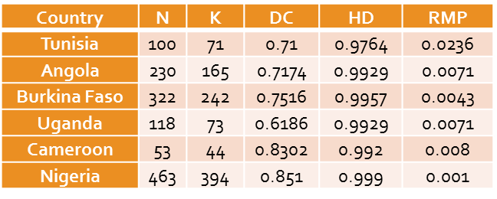
RESULTS
Forensic parameters based on SWGDAM recommended Y STRs of representative African Countries

Slide 8
ANALYSES OF MOLECULAR VARIATION BASED ON SWGDAM 11-LOCI STRS
Marker | Categories | Parameter | Overall(n=22) |  |  | Population (n=5,22) |  |  | Geographic Region (n=5,22) |  |  | Linguistic (n=2,22)
 |  |  | Rst | Variance | P value | Rst | Variance | P value | Rst | Variance | P value | Rst | Variance | P value
 | Among Groups | φst | 0.03 | 2.95 | <0.00001 | 0.0395 | 3.24 | <0.00001 | 0.0367 | 3.03 | <0.00001 | 0.073 | 6.4 | <0.00001
11 STRs | Among populations within groups | φsc |  |  |  | 0.0073 | 0.07 | 0.07918 | 0.0066 | 0.64 | 0.12317 | 0.0097 | 0.9 | 0.01369
 | Within populations | φct |  |  |  | 0.0324 | 96.05 | <0.00001 | 0.0303 | 96.33 | <0.00001 | 0.0635 | 92.7 | <0.00001

Slide 9
Discussion
The state of forensic infrastructure in Nigeria is being upgraded to cope with the current local security challenges .Prior to this, upsurge in violent crimes, rape and indecent assault cases have ranked 4th on the scale of the most crimes against persons reported in Nigeria(Alemika and Chukwuma, 2010).With this approach, weak evidences over female harassment have gained strength .
This work has a complete profile of 463 males from five major Nigerian populations based on the SWGDAM recommended 11-loci STRs providing high HD among individual population, low DC among( Igbo, Hausa and Ijaw)and geographical sub-division among Yoruba and Hausa.
The Y- STR analysed here could be useful in resolving male specific forensic cases despite their non specific identification and the population stratification associated them at both national and continental level.
Having large sampling individuals per population gives an adequate genetic locus (Chakraborty,1992) as this provides improved precicion of a result.
The major challenge of Y-STRs in forensics is the sometimes low diversities and geographical structure within specific population and these could be resolved by increasing the number of polymorphic markers and by adding new and fast mutating STRs (Hedman, et al.2011)

Slide 10
Thank you
Questions?

