Slide 1
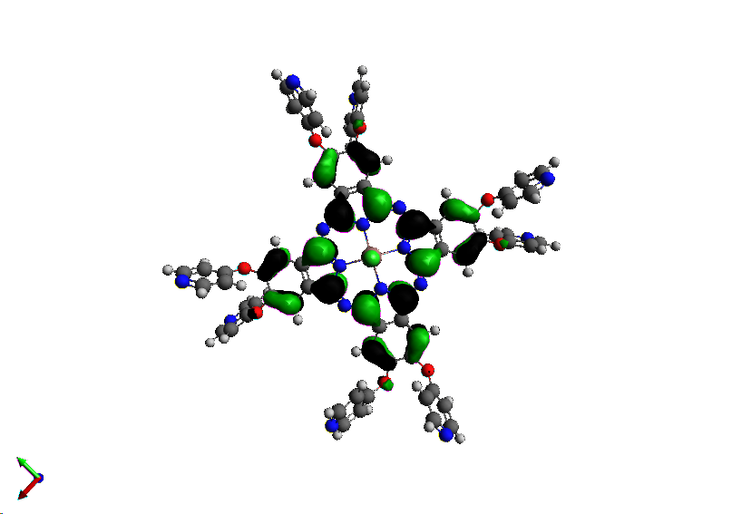
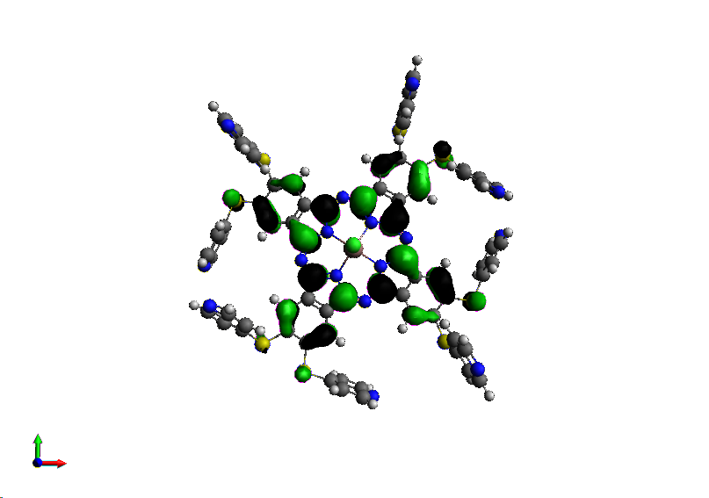
A comparative physicochemical study of two β-substituted octa pyridyloxy and pyridylsulfanyl indium phthalocyanine
By
Osifeko, Olawale Lawrence
and
Prof. T. Nyokong

Slide 2

Introduction
Phthalocyanines are a family of aromatic macrocycles based on an extensive delocalized 18-π electron system.
The solubility of phthalocyanines can be enhanced by adding different kinds of substituents such as
long chain alkyl,
crown ether, Organic solvents
alkylthio or alkoxy groups
sulfonates group
Carboxyl group Aqueous Media
Ammonium group
Notes:
The common means for preparing water soluble Pcs with high efficiency is to attach hydrophilic groups like polyethylene glycol, amino acid, carbohydrates [13-15], ionic groups including cationic and anionic substituent [16-18] at the peripheral and axial positions of Pc ring.

Slide 3
SITE OF MODIFICATION
Non-peripheral
or
α substitution
Variation of the metal
Axial substitution
Peripheral
or
β substitution
Notes:
Synthesis, characterization and investigation of the photophysical and photochemical properties of highly soluble novel metal-free, zinc(II), and indium(III) phthalocyanines substituted with 2,3,6-trimethylphenoxy moieties

Slide 4
Properties of Photosensitiser
A good photosensitizer absorb photons efficiently and have
  high absorption coefficient
  high quantum yield of triplet formation
  the triplet state should be long lived
  Ability of being activated by red light or near infra red light
  Solubility potential in aqueous media

Slide 5
APPLICATIONS OF PHTHALOCYANINES

Slide 6
AIM
To design effective water soluble metallophthalocyanines for inactivating bacteria in water (PACT)
Synthesis and Characterisation of metallophthalocyanines and its quaternized form

Slide 7
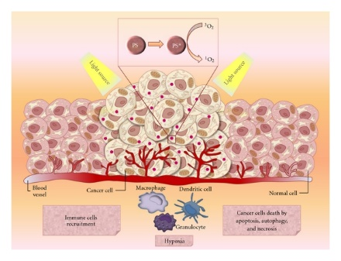
Photodynamic Antimicrobial Chemotherapy
PACT is based on 3 concepts
a non-toxic photosensitizer,
visible light of appropriate wavelength
Molecular oxygen
³O₂
PS
PS*
Light Source
Light Source
¹O₂

Slide 8
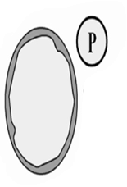
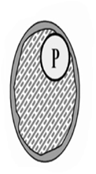
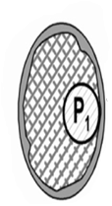
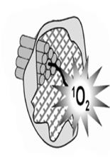

MECHANISM OF DESTRUCTIVE ACTION OF
PHOTOSENSITIZATION IN THE CELL
P
Light
P
P₁
Incubation with
photosensitizer
Accumulation of
Photosensitizer
Irradiation
Cell Death

Slide 9
SYNTHESIS & CHARACTERIZATION

Slide 11
ELECTRONIC ABSORPTION SPECTRAL
= absorption
= excitation
= emission
= In(pyS)₈ Pc DMSO
= Qrt In(pyS)₈ Pc DMSO
= Qrt In(pyS)₈ Pc H₂O
= Qrt In(pyS)₈ Pc H₂O-Trit X
Notes:
the absorption spec- tra of conjugate ZnPc-PL was characterized by a Soret band maximum at 344 nm and a Q-band at 680 nm, while Ce6-PL [16] has a Q-band at 663 nm and a Soret band maximum at 406 nm (as shown in Fig. 1), indicating that the lysine conjugation does not affect the chemical and photochemical properties of ZnPc, as previously observed in the conjugate of ZnPc modified with five lysines [1
The UV-vis spectral of the complexes gave a characteristic strong Q and Soret band in DMSO and aqueous media for the cationic complexes (fig. 1) in DMSO, the complexes show a bathochromic shift of

Slide 12
In(pyS)₈ | EXPECTED | FOUND
C (%) | 56.30 | 55.56
H (%) | 2.62 | 2.88
N (%) | 14.59 | 14.87
In(pyO)₈ | EXPECTED | FOUND
C (%) | 61.44 | 59.53
H (%) | 2.86 | 3.04
N (%) | 15.92 | 14.64

Slide 13
In(pyS)₈ Pc
MALDI TOF MS m/z:
Calcd: 1535
1504.997
1540.565
In(pyO)₈ Pc
MALDI TOF MS m/z:
Calcd: 1407
1411.795

Slide 15
Singlet Oxygen Quantum Yield
ADMA
0 min
Ф_{Pd} = 7.00 X 10⁻⁶
Singlet oxygen quantum yield (Φ_{Δ}) =
Number of molecules in the triplet state/ quanta of light absorbed
Values 0-1
Ф∆ = 0.21
120 min
Ф_{Pd} = 6.34 X 10⁻⁷
Ф∆ = 0.46
DPBF = 1,3 diphenylisobenzofuran
ADMA= anthracene-9,10-bis-methylmalonate

Slide 16
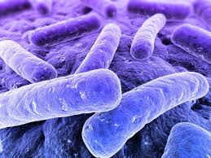
JABLONSKI DIAGRAM
Bacteria death
Singlet oxygen
Ф_{IC}
Bacterial
ISC
Excited Singlet
state
Ф_{F}
Triplet state
Fluoresence
Ф_{T}
Phosphoresence

Slide 17
Transient curve and Triplet Decay curve in DMSO
Ф_{T} = 0.57
τ_{T} = 61 (µS)

Slide 18
EXPERIMENTAL DATA
Comp | ªλ_{abs} (nm) | ªλ_{emm} (nm) | ªλ_{exc} (nm) | Ф_{F} | τ_{F} (ns) | Ф_{T} | Ф∆ | Ф_{IC} | τ_{T} (µS) | Ф_{pd} 10⁻⁶ | S∆
3 | 717 | 731 | 721 | 0.011 | 0.23 | 0.57 | 0.45 | 0.42 | 61 | 1.70 | 0.79
4 | 714 710^{b} | 730 728^{b} | 723 722^{b} | 0.012 0.02^{b} | 0.23 0.28^{b} |  | 0.33 0.21^{b} |  |  | 64.1 7.00^{b} | 0.51 -
5 | 698 | 716 | 705 | 0.012 | 0.25 | 0.53 | 0.46 | 0.46 | 56 | 0.63 | 0.66
6 | 699 697^{b} | 711 710^{b} | 703 702^{b} | 0.013 0.018^{b} | 0.33 0.33^{b} | 0.48 - | 0.33 0.31^{b} | 0.51 - | 66 - | 1.88 13.20^{b} | 0.51 -

Slide 20
Conclusion
We were able to successfully synthesis and characterised the photosensitisers
We have established that the pyridylsulfanyl moiety is more stable than the pyridyloxy moiety
We observed that pyridyloxy moiety easily form radical but do not transform or degrade to other components
We affirm that pyridysulfanyl moiety is a better photosensitiser than pyridyloxy moeity

Slide 21

Acknowledgements
Prof. T. Nyokong
Dr J. Mack
Dr J. Britton
Ms. Gail
S22 family
Chemistry department

Slide 22
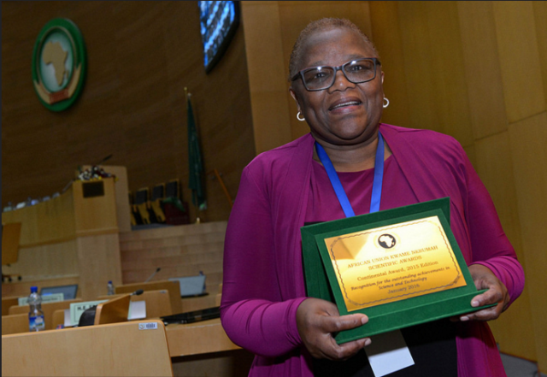
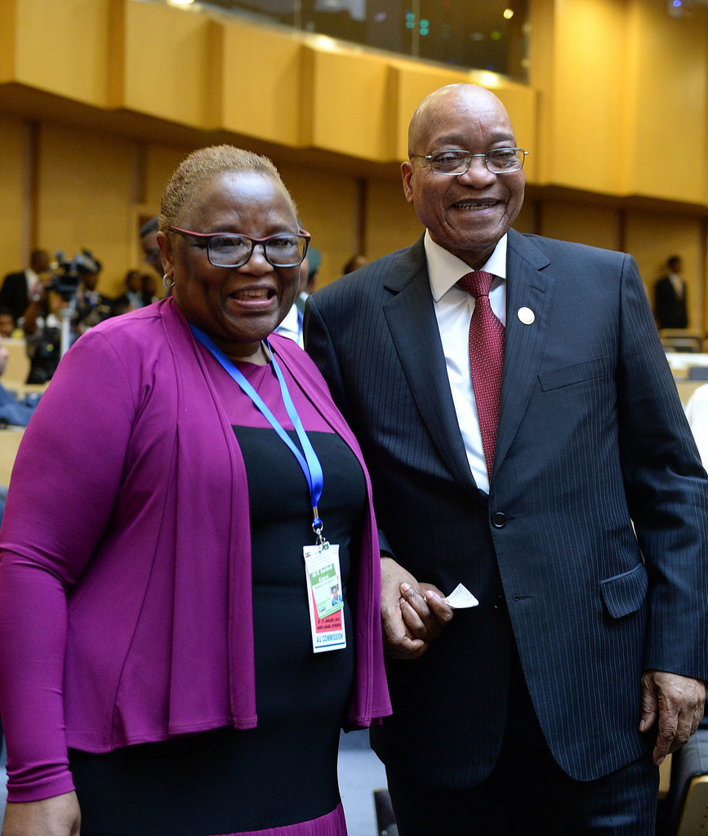
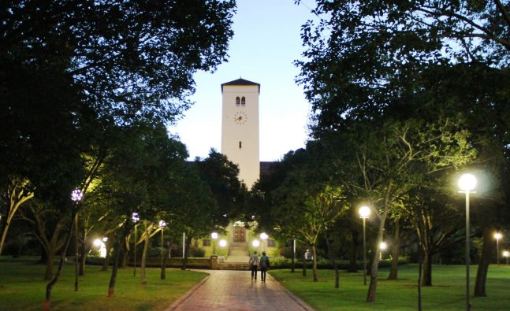

Slide 23
THANK YOU

Slide 24


